Slide 1

Space Science
Leads Committee (SSLC)
Simon Driver (SSLC Chair)

Slide 2
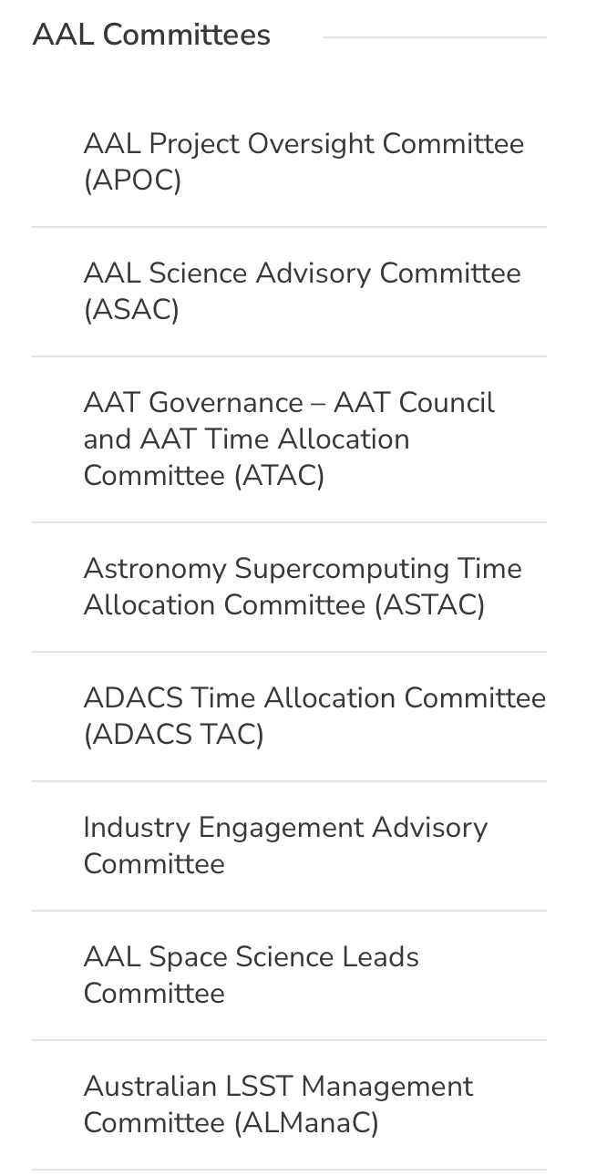
Space Science leads Committee
Established in 2023
An advisory committee to AAL Board
Meets twice per year plus ad hoc
Attend by AAL Board rep (Brian Schmidt)
Remit:
Identify engagement pathways for AAL Board around space (abridged) and guided by DP
Provide comment on space sector priorities for the Astro community as requested
Identify opportunities to value add to AAL’s portfolio around space
Provide comment on opportunities for collaborative research combining space with existing facilities (ESO, SKA etc).

Slide 3
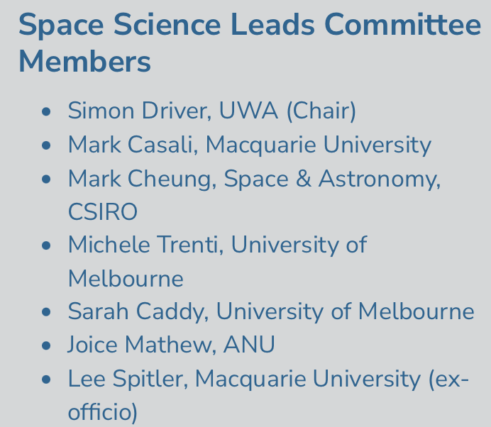
Space Science leads Committee
Who we are:
+ Brian Schmidt (attending AAL Board member)

Slide 4
Space Science leads Committee
What have we done:
Drafted “space” questionnaire that formed part of the Decadal Plan process
Contributed to the International and Space Facilities DP White Paper
Identified opportunity for Australian membership of Euclid (AAL Board item)
Initiated Australian Astronomy Space Workshop

Slide 5
Space Science leads Committee
What have we done:
Drafted “space” questionnaire that formed part of the Decadal Plan process
Contributed to the International and Space Facilities DP White Paper
Identified an opportunity for Australian membership of Euclid (ongoing AAL Board item)
Initiated Australian Astronomy Space Workshop …

Slide 6
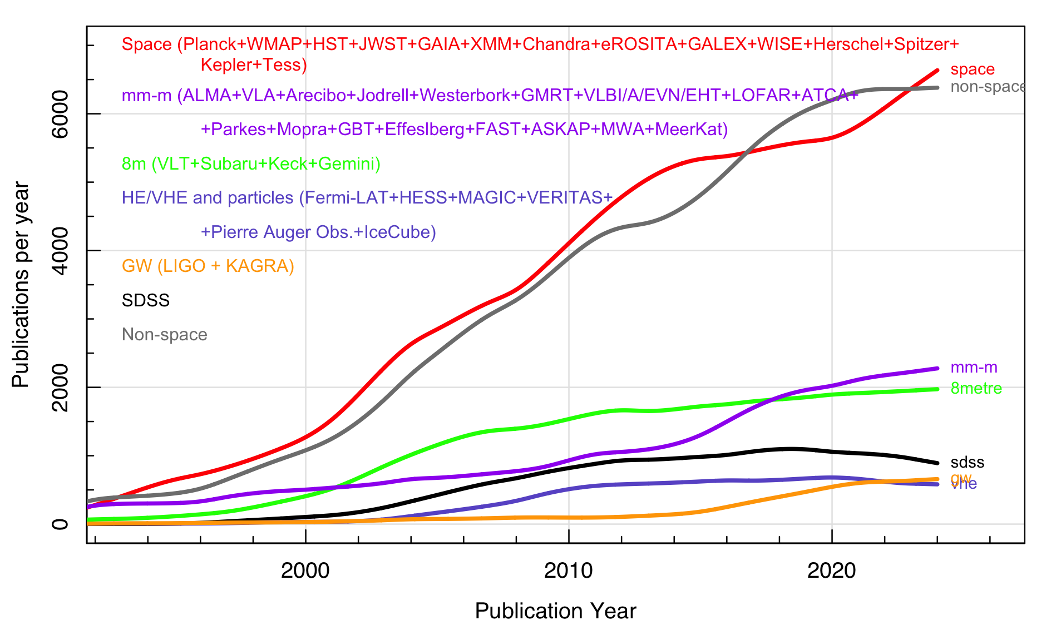
Space Science leads Committee
How the international community is moving:
A pretty stable but balanced publication rate between space and non-space
Space is complementary to ground-based observations

Slide 7
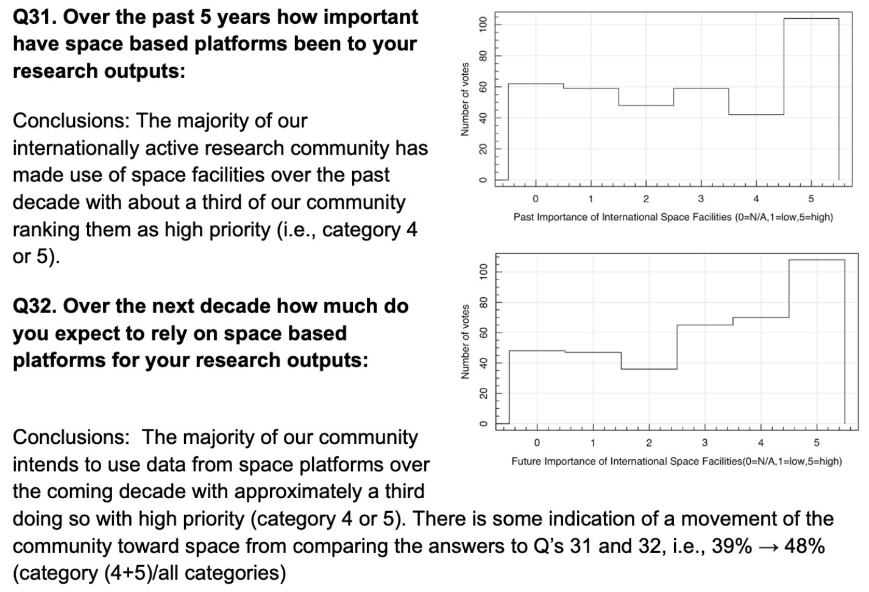
Space Science leads Committee
Questionaire:
Half the community uses space telescopes

Slide 8
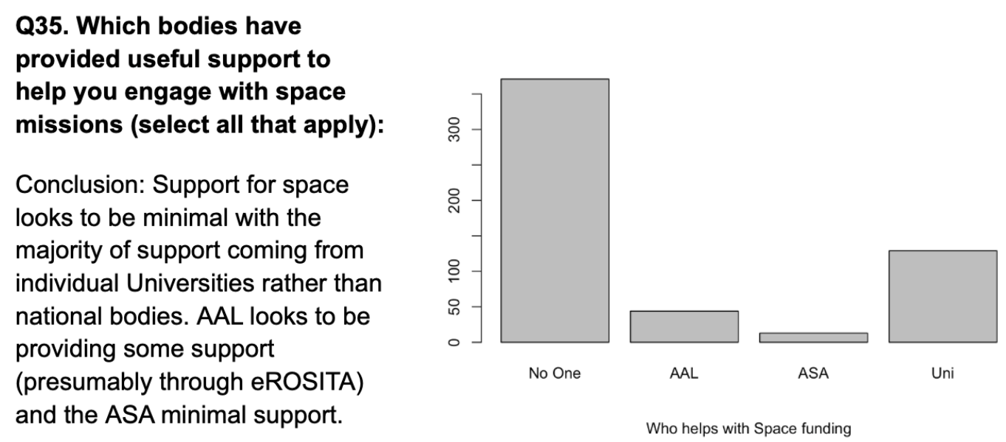
Space Science leads Committee
Questionaire:
Not a lot of support out there

Slide 9
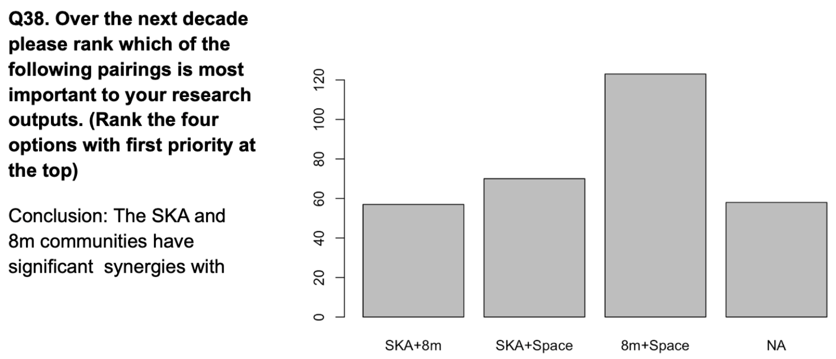
Space Science leads Committee
Questionaire:
Space is highly complementary to both big optical and radio

Slide 10
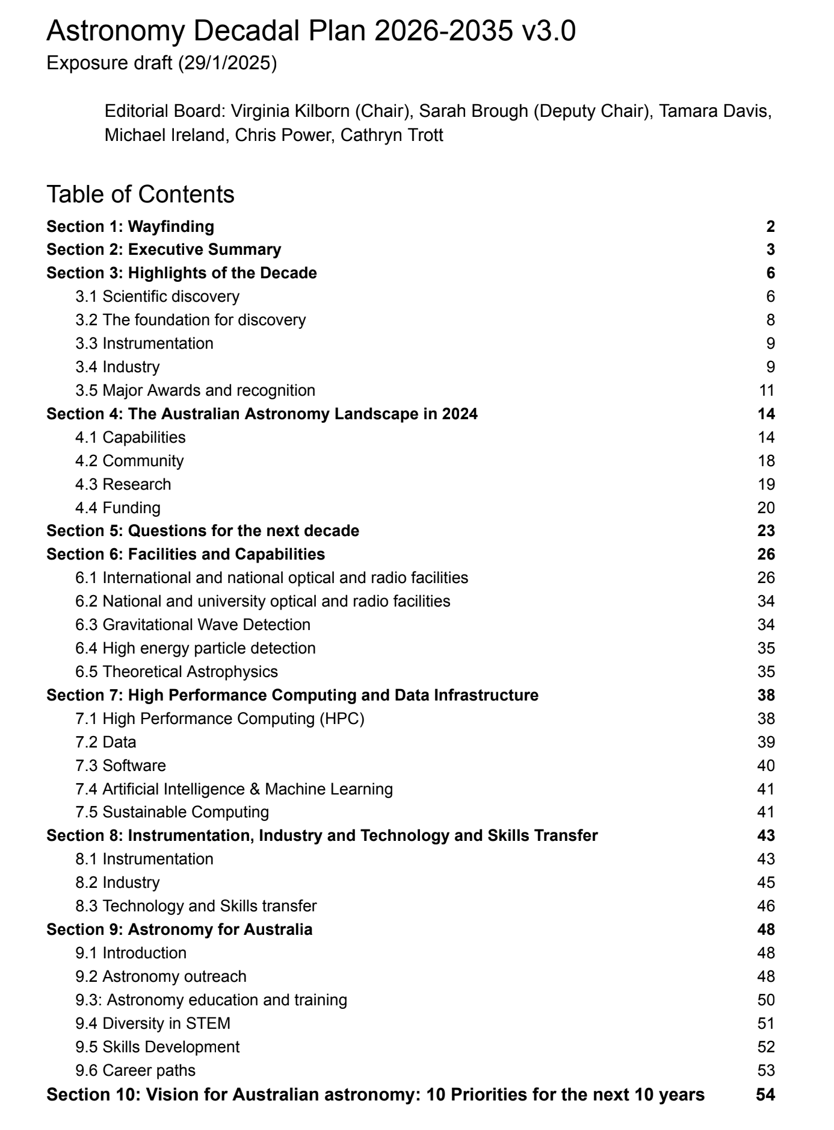
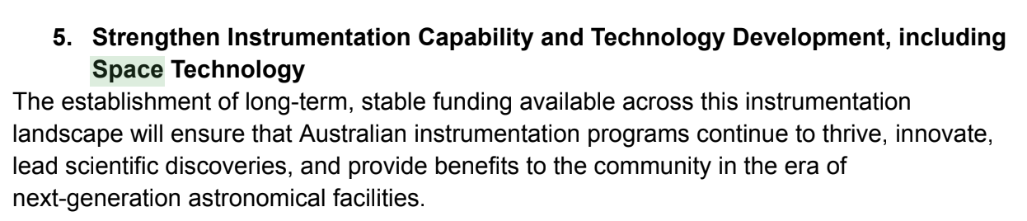
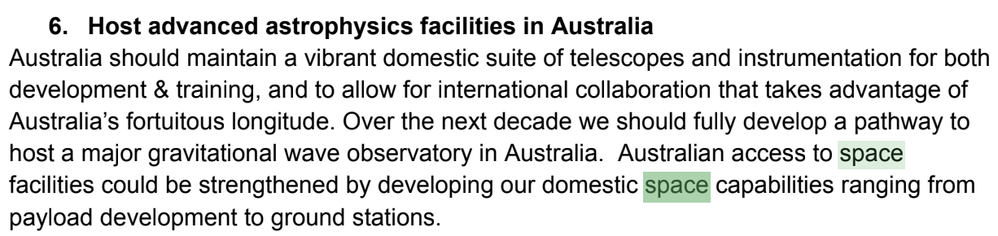
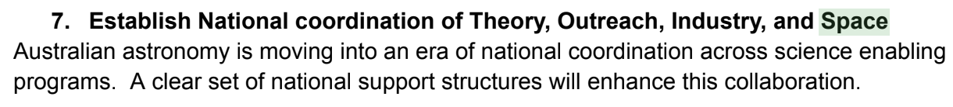
2025-2035 Decadal Plan
Space mentioned ~40 times
No clear space recommendation to AAL
…but what would/should it be???

Slide 11
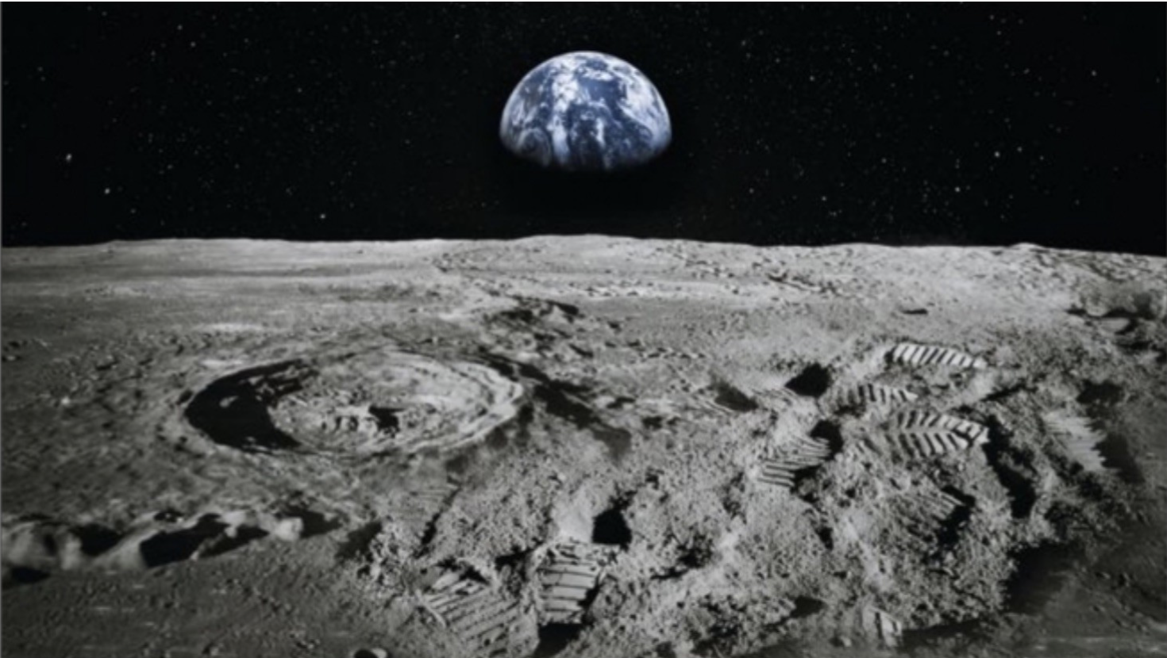
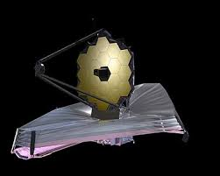
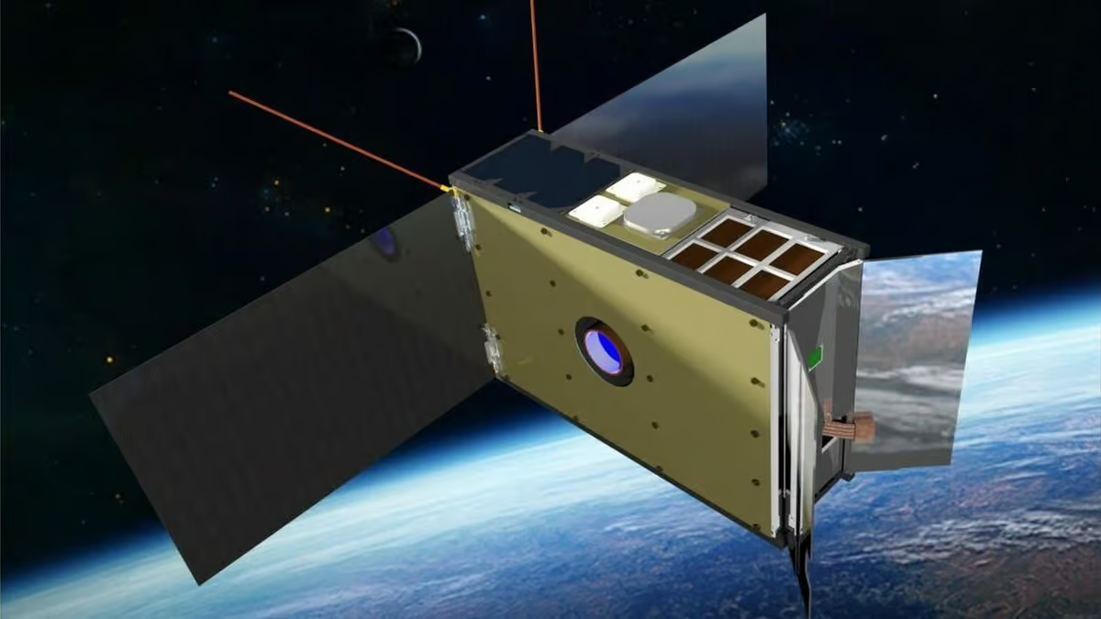
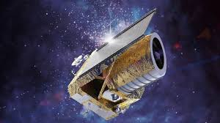
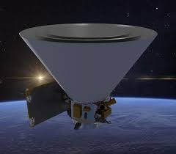
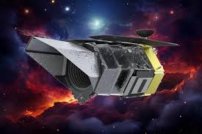
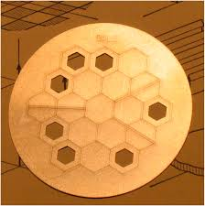
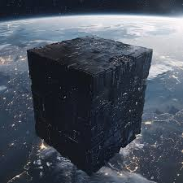
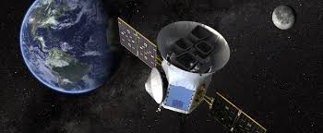
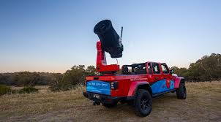
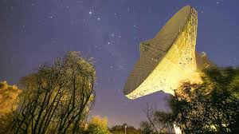
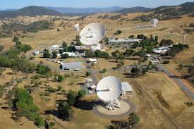
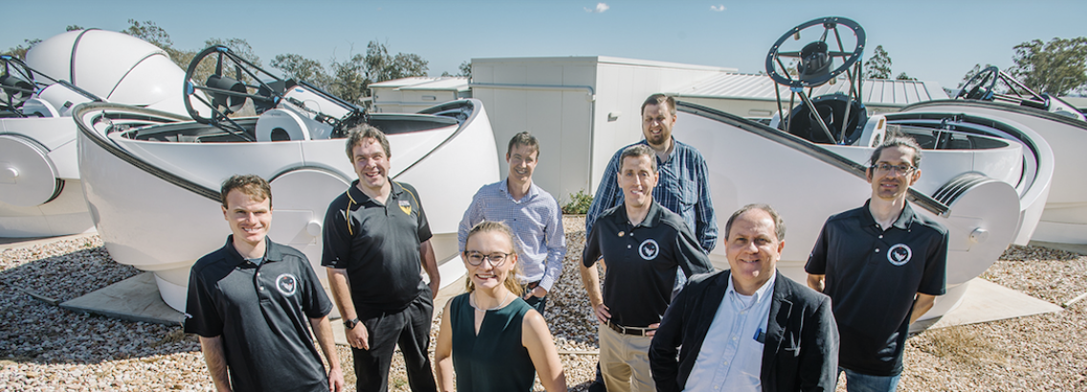
The complex space landscape
National (millions) ← → International (billions)
NASA JWST
SpIRIT
SkyHopper
++
Earth Obs
ESA Euclid
NASA SphereX
NASA Roman
Planetary Science
(piggyback missions)
U Syd AMI
Uni’s:
InSpace
USQ
ISC
NASA TESS
CPUs in space
Data Fusion
Data Central
Laser comms
MINERVA-Australis@TESS
International downlink
New Norcia
Tidbinbilla

Slide 12
The complex space landscape
National (millions) ← → International (billions)
NASA JWST
SpIRIT
SkyHopper
++
Earth Obs
ESA Euclid
NASA SphereX
NASA Roman
Planetary Science
(piggyback missions)
U Syd AMI
Uni’s:
InSpace
USQ
ISC
NASA TESS
CPUs in space
Data Fusion
Data Central
Laser comms
MINERVA-Australis@TESS
International downlink
New Norcia
Tidbinbilla

Slide 13
The complex space landscape
National (millions) ← → International (billions)
NASA JWST
SpIRIT
SkyHopper
++
Earth Obs
ESA Euclid
NASA SphereX
NASA Roman
Planetary Science
(piggyback missions)
U Syd AMI
Uni’s:
InSpace
USQ
ISC
NASA TESS
CPUs in space
Data Fusion
Data Central
Laser comms
MINERVA-Australis@TESS
International downlink
New Norcia
Tidbinbilla

Slide 14
An Australian Space Telescope Science Institute and Data Fusion
Simon Driver

Slide 15
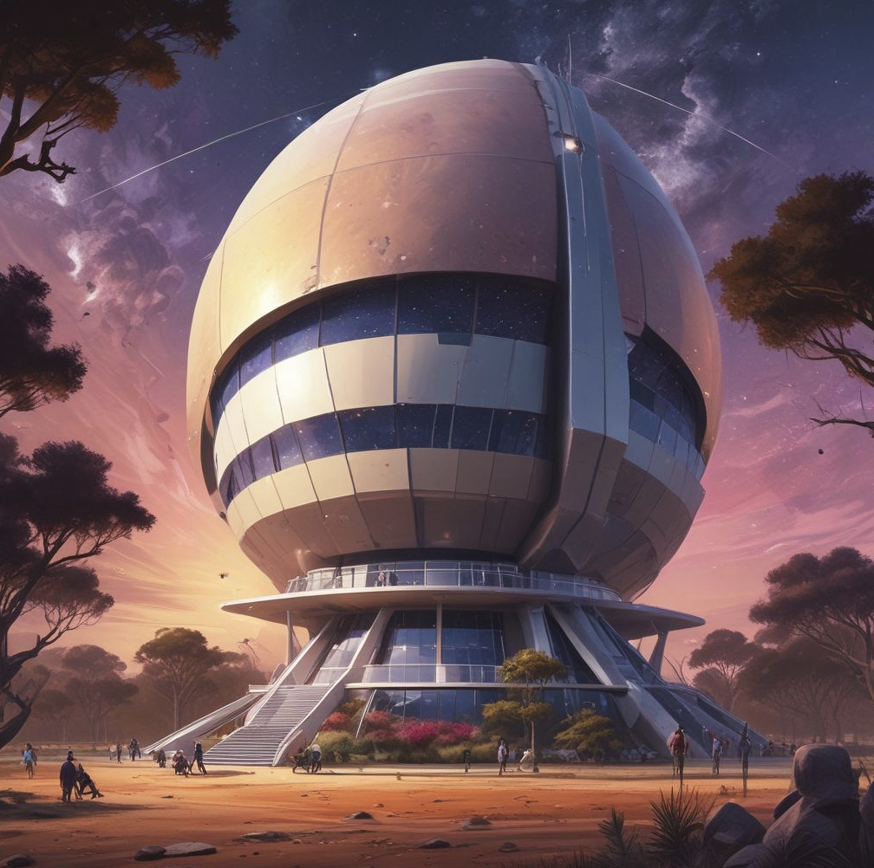
An Australian Space Telescope Institute
ASTI

Slide 16
An Australian Space Telescope Institute
ASTI
AAL
ASA
Sovereign
Telescopes
Internat’l
components
Comms
(trad +
Laser)
Ground
Support
Data
Fusion
Internat’l
Agencies
T & I & O

Slide 17
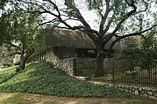
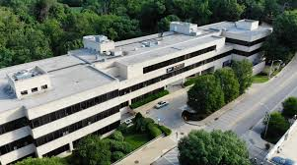
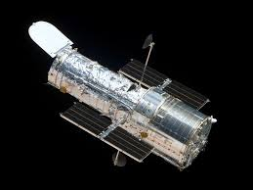
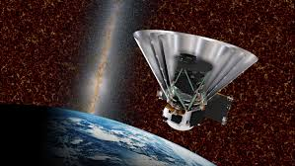
An Australian Space Telescope Institute
ASTI
Data
Fusion
STScI
(600 employes)
IPAC
(180 employes)
A$1.3billion of NASA/ESA
Infrastructure growing & replenishing
(300 employees)

Slide 18
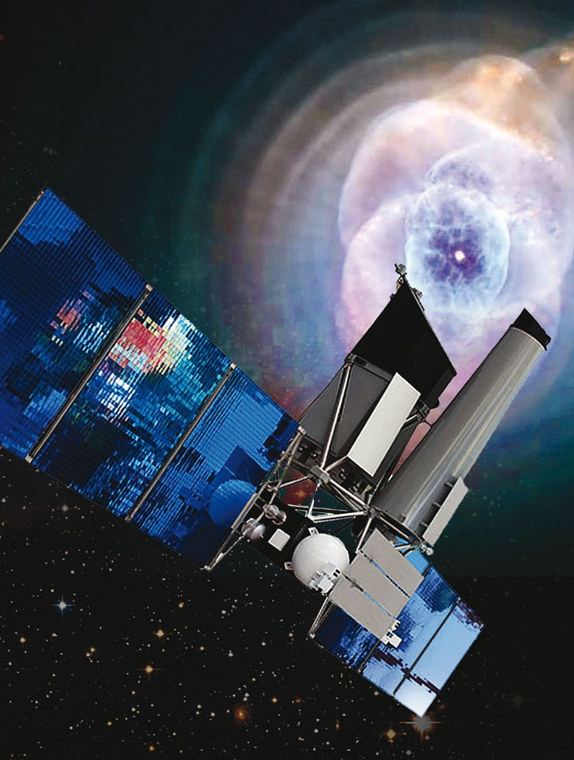
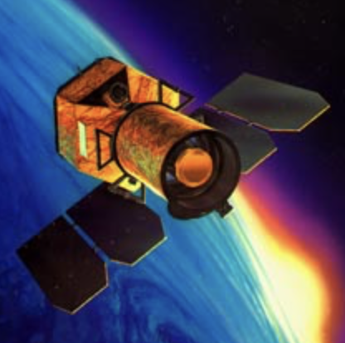
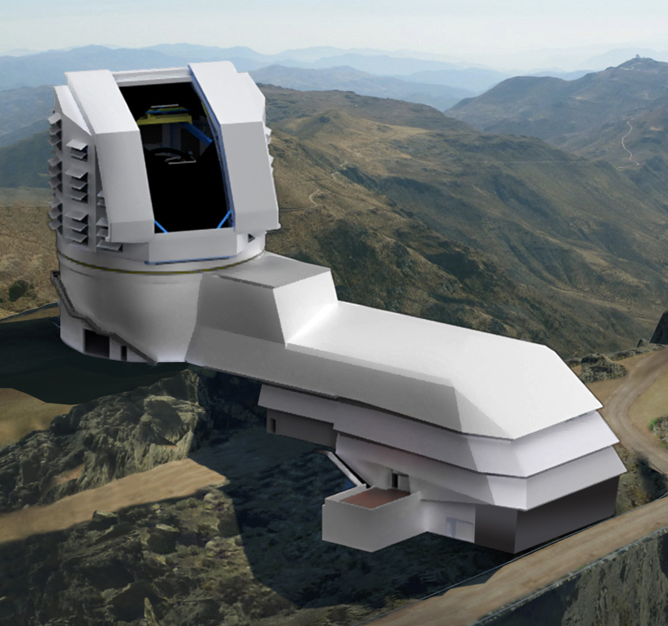
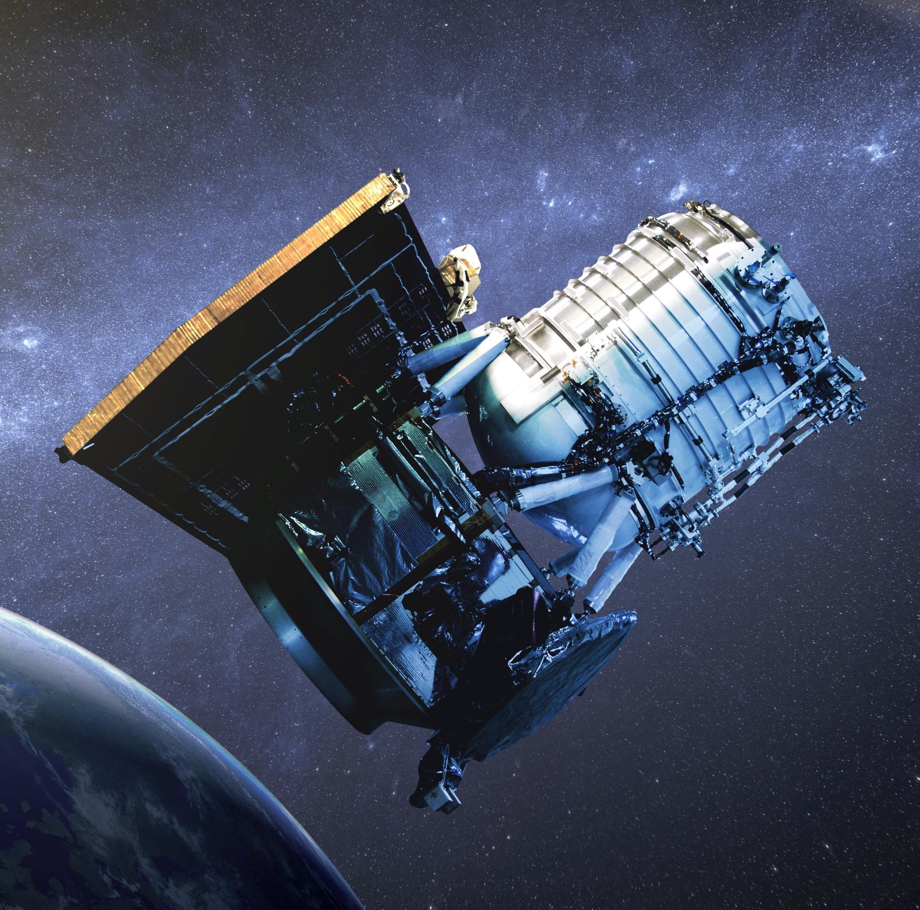
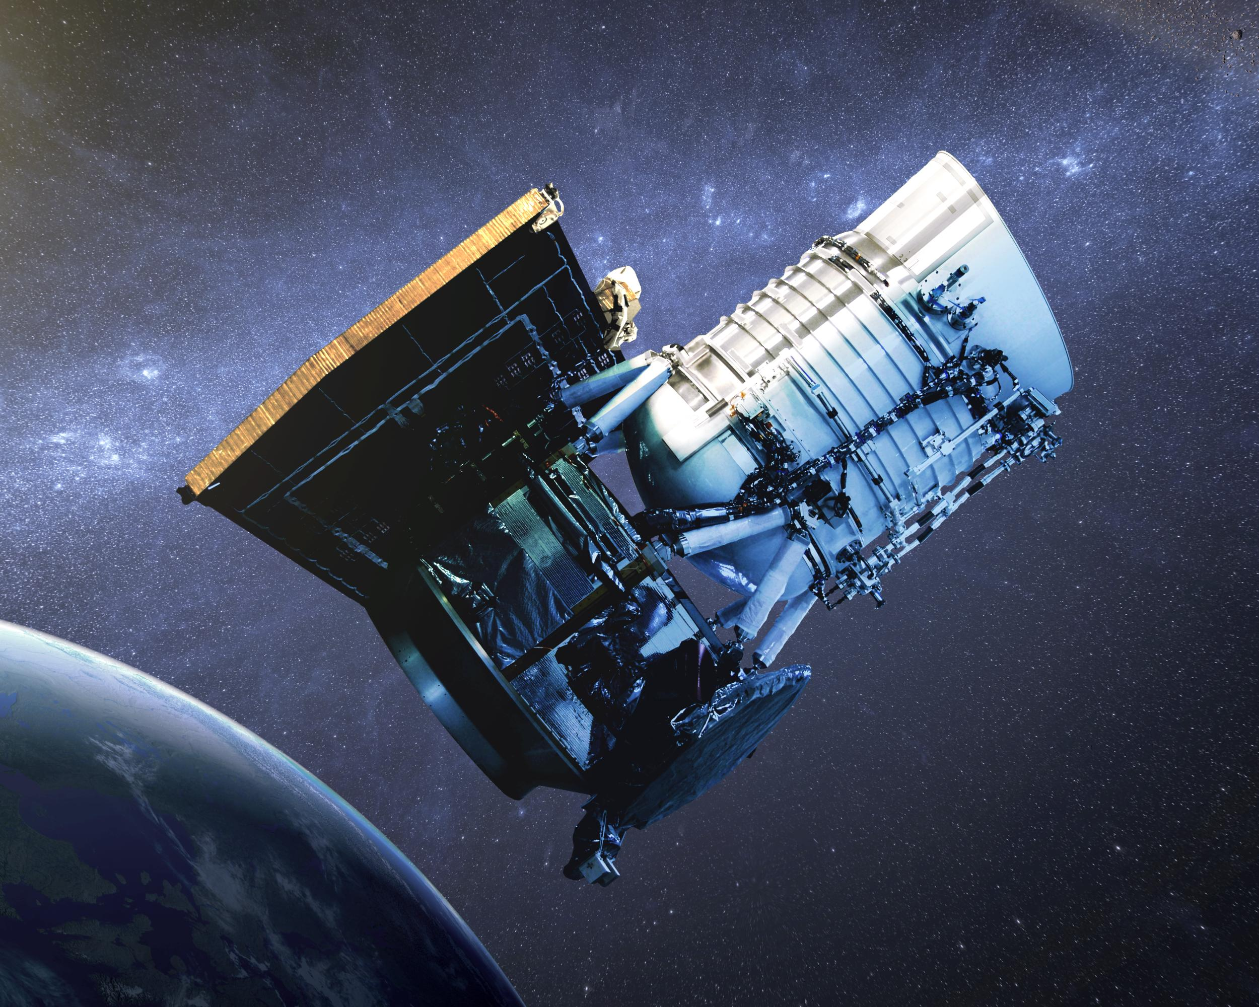
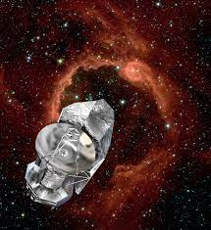


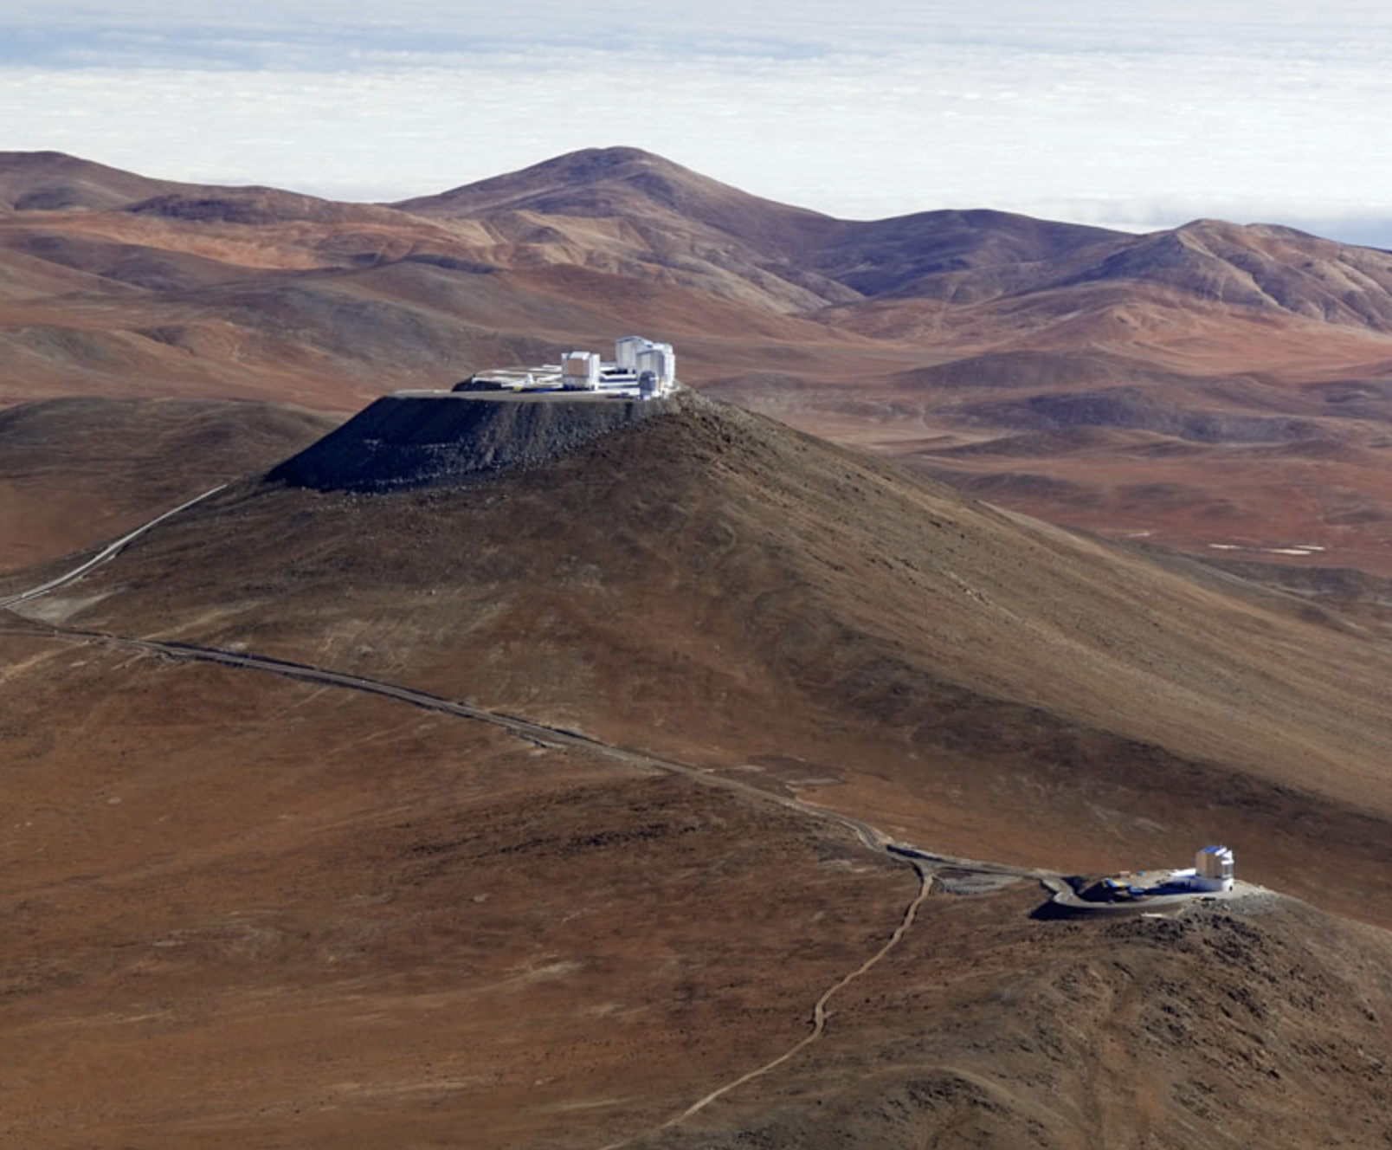
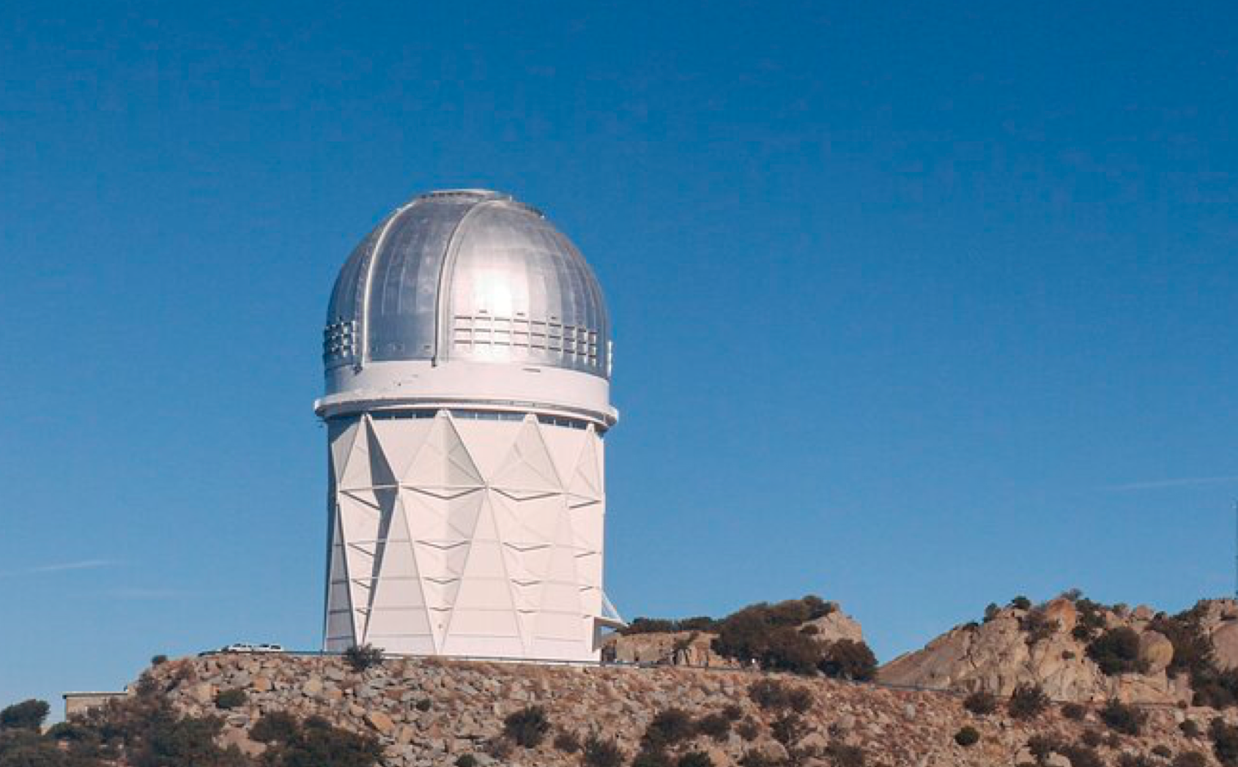
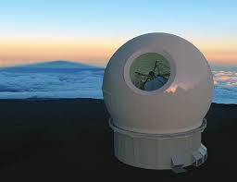
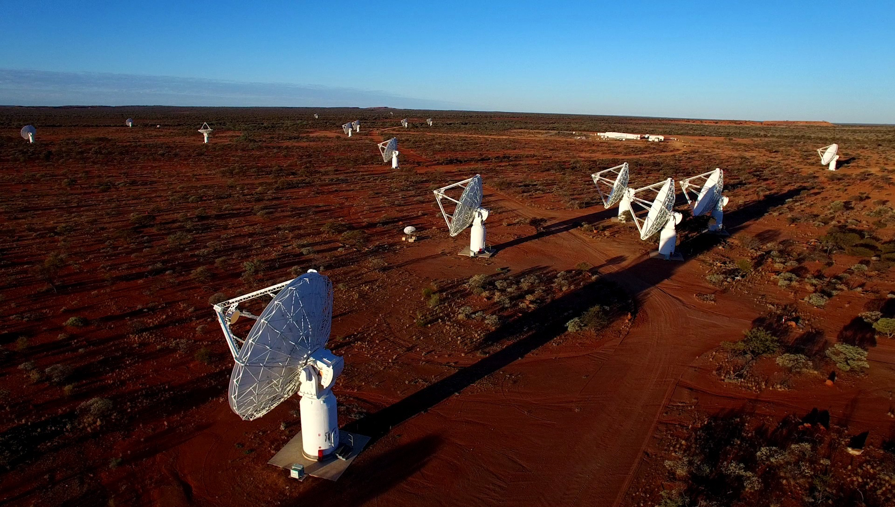



What is Data Fusion?
PLASMA, STARS, AGN & DUST
LSS and sub-structure is the next frontier
critical to understand gas flows, gas properties, merger rates
and the role of the Dark Matter Halo
eROSITA
GALEX
LSST (2024)
EUCLID (2023)
Roman (2026)
WISE
Herschel
DISTANCES, GROUPS
& DARK MATTER
GROUND
& SPACE
IMAGING
NEUTRAL GAS &
CHARGED
PARTICLES
Data
Fusion
Centre
MOONS (2024)
OPTICAL
SPECTROSCOPY
RADIO
SURVEYS
4MOST (2024)
ASKAP (2021)
DESI (2021)
WST or MSE
SKA (2029)
COLLABORATION & SCIENCE

Slide 19
Why Fuse Data?
Any single facility only sees a small fraction of the electromagnetic spectrum, e.g., optical
LSST
HST
AAT
Mature
stars

Slide 20
Why Fuse Data?
Any single facility only sees a small fraction of the electromagnetic spectrum, e.g., near-infrared
VISTA
Euclid
Roman
Old
stars

Slide 21
Why Fuse Data?
Any single facility only sees a small fraction of the electromagnetic spectrum, e.g., mid-infrared
WISE
JWST
SPhereX
Hot
Gas
AGN

Slide 22
Why Fuse Data?
Any single facility only sees a small fraction of the electromagnetic spectrum, e.g., far-infrared
Herschel
Dust &
Cold Gas

Slide 23
Why Fuse Data?
Any single facility only sees a small fraction of the electromagnetic spectrum, e.g., sub-mm/mm
LMT
ALMA
Cold &
Molecular
Gas

Slide 24
Why Fuse Data?
Any single facility only sees a small fraction of the electromagnetic spectrum, e.g., radio
ATCA
Parkes
ASKAP
SKA
Synchrotron
Free-Free
Neutral Hydrogen

Slide 25
Why Fuse Data?
Any single facility only sees a small fraction of the electromagnetic spectrum, e.g., optical
GALEX
AstroSat
Swift
Young
Stars &
AGN

Slide 26
Why Fuse Data?
Any single facility only sees a small fraction of the electromagnetic spectrum, e.g., x-ray
eROSITA
Warm &
Hot Gas
XRBs
AGN

Slide 27
Why Fuse Data?
Any single facility only sees a small fraction of the electromagnetic spectrum, e.g., VHE!
← CTAO/Fermi/H.E.S.S./MAGIC
BLAZARS
CRs

Slide 28
Why Fuse Data?
To see the full picture one needs to survey the entire electromagnetic spectrum = data fusion
And wherever possible add or estimate distance information (spec-z and photo-z)

Slide 29
Why Fuse Data?
To see the full picture one needs to survey the entire electromagnetic spectrum = data fusion
And wherever possible add or estimate distance information (spec-z and photo-z)

Slide 30
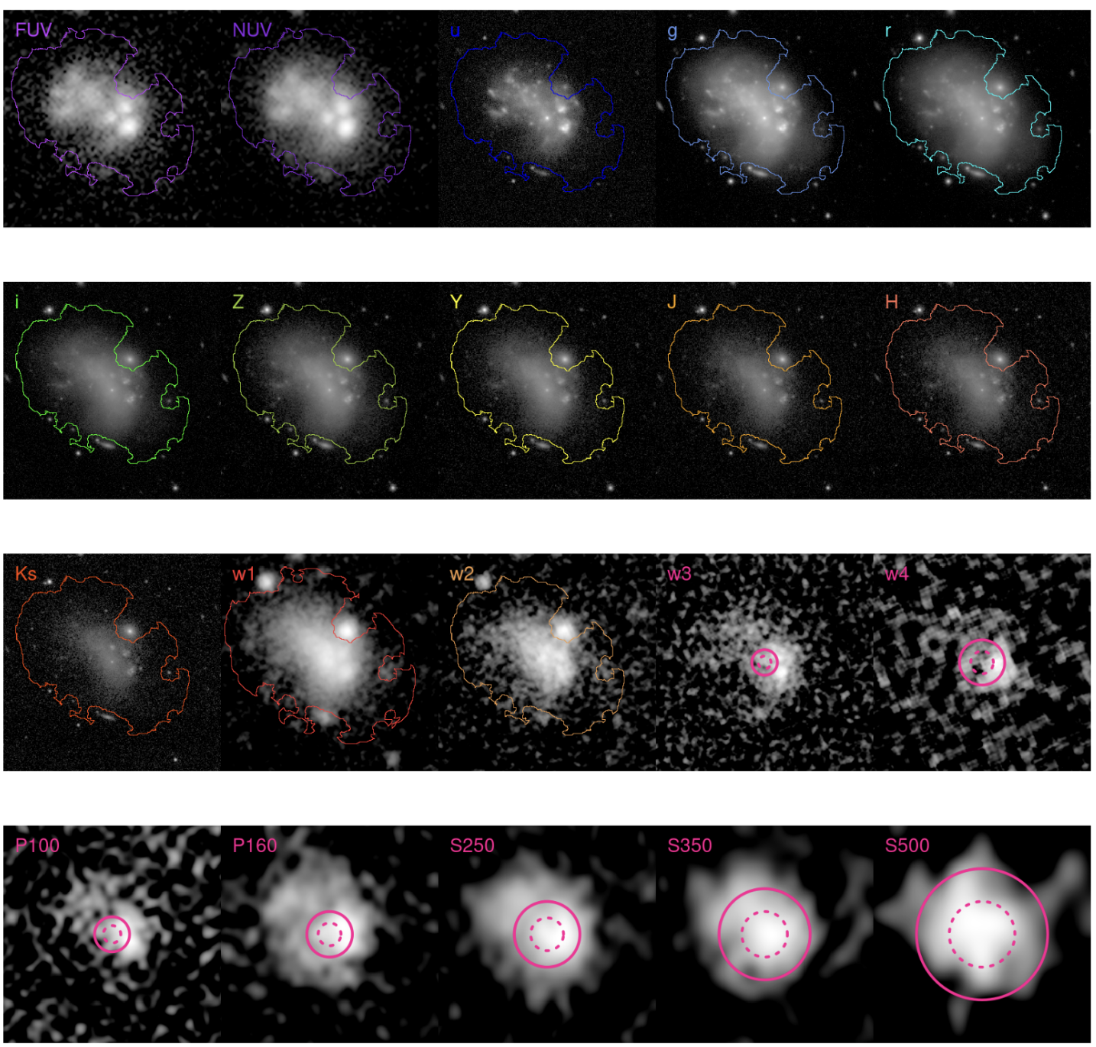
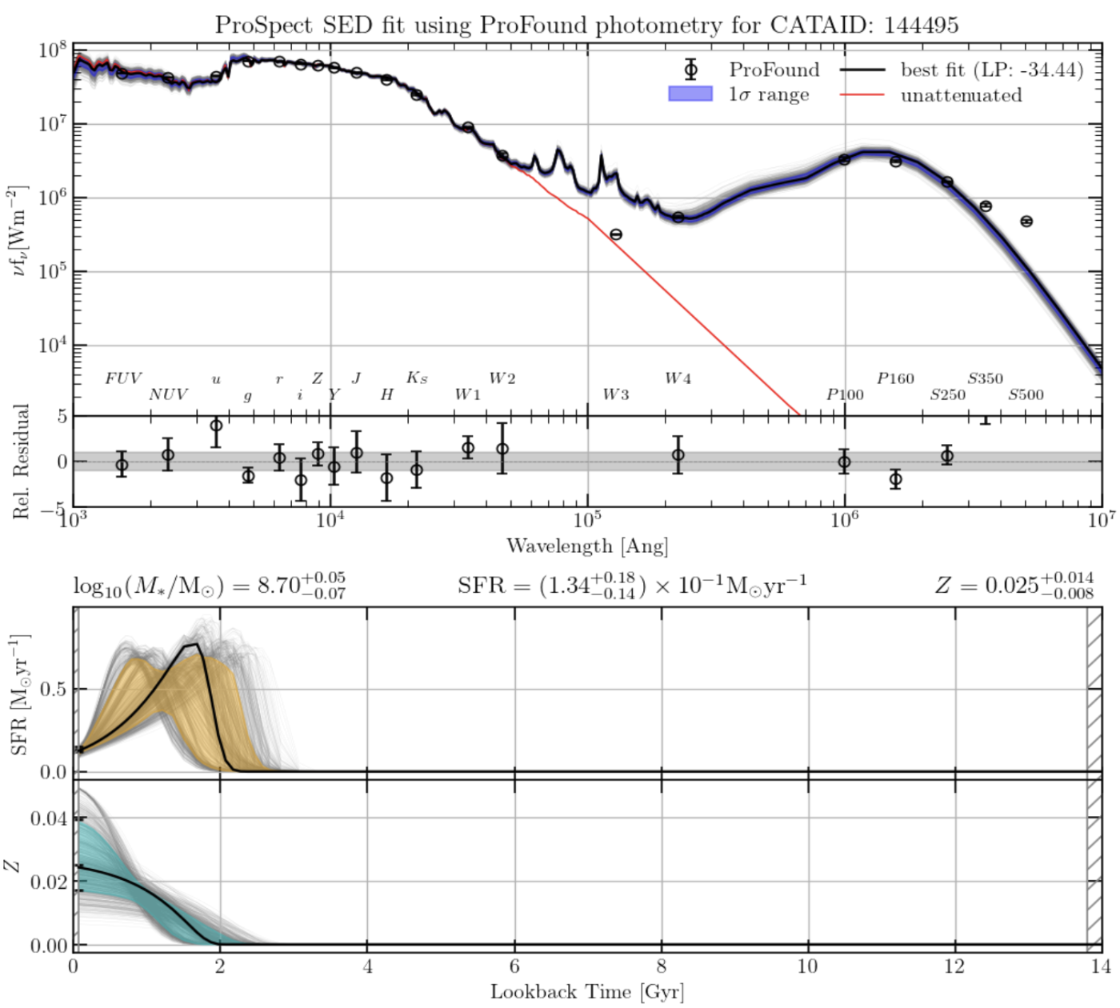
Galaxy And Mass Assembly
In GAMA we fused UV to far-IR for over 300,000 galaxies
“Fused” data
Derived SEDs
Star-formation history
Metallicity history

Slide 31
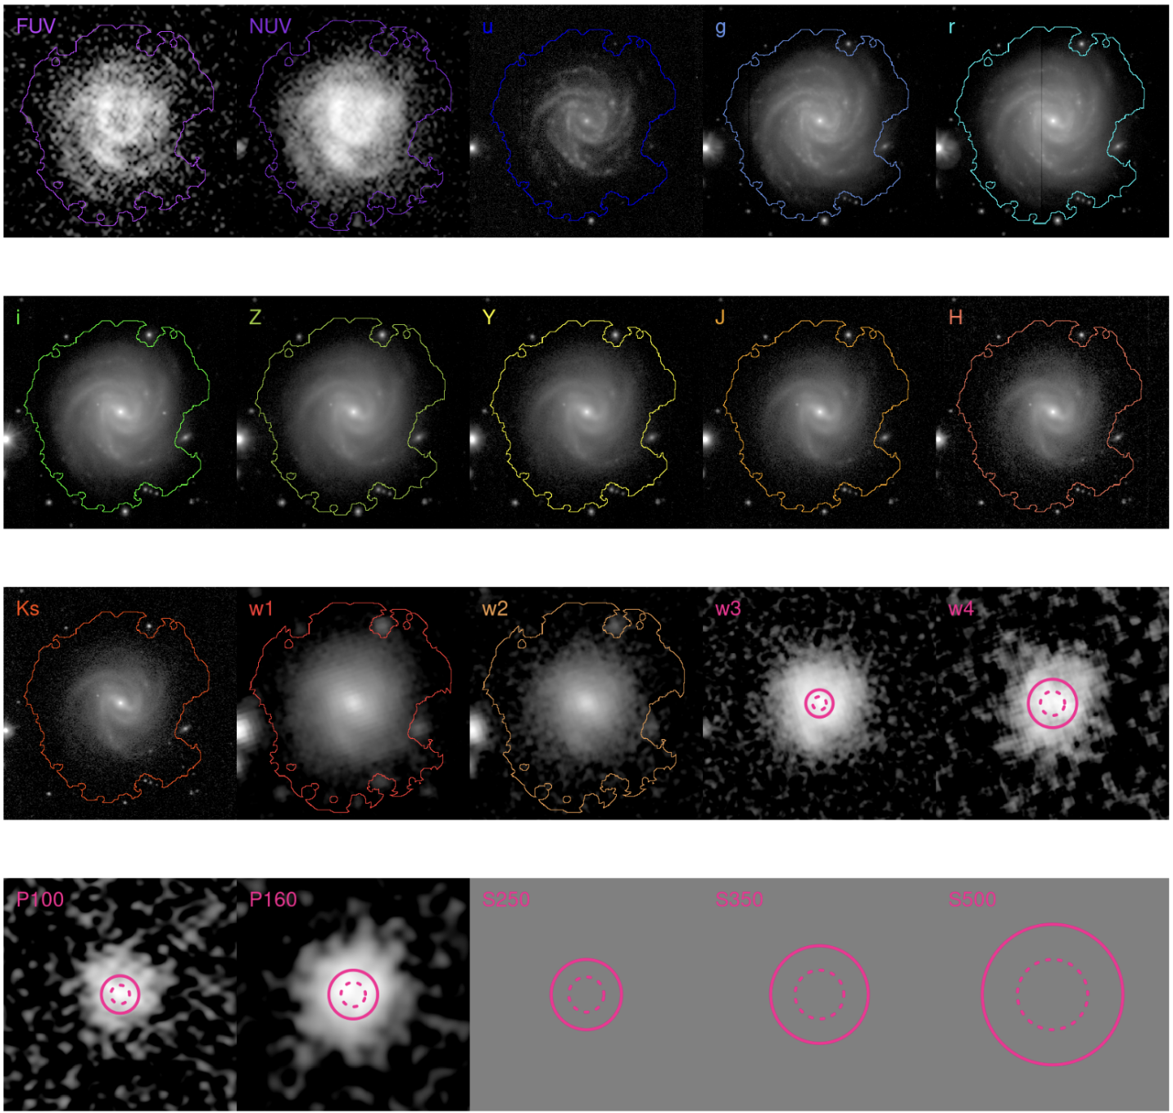
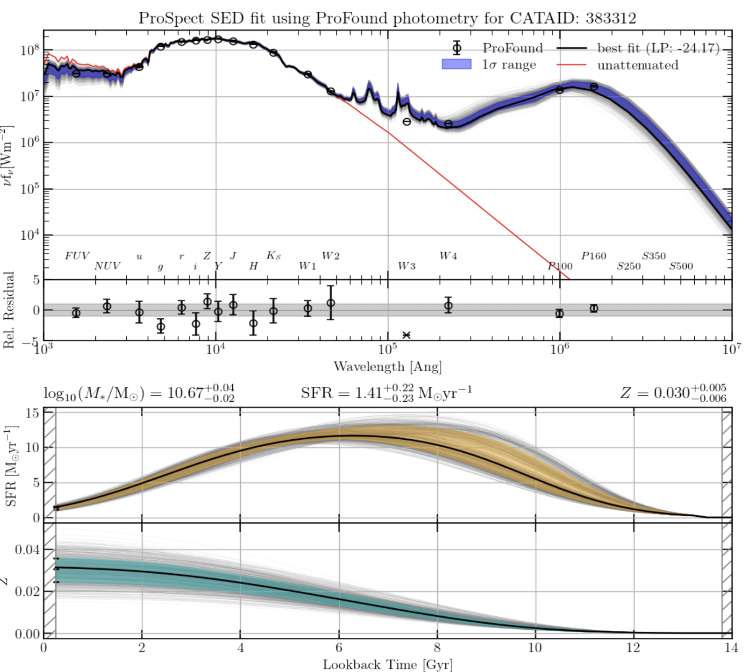
Galaxy And Mass Assembly
In GAMA we fused UV to far-IR for over 300,000 galaxies
“Fused” data
Derived SEDs
Star-formation history
Metallicity history

Slide 32
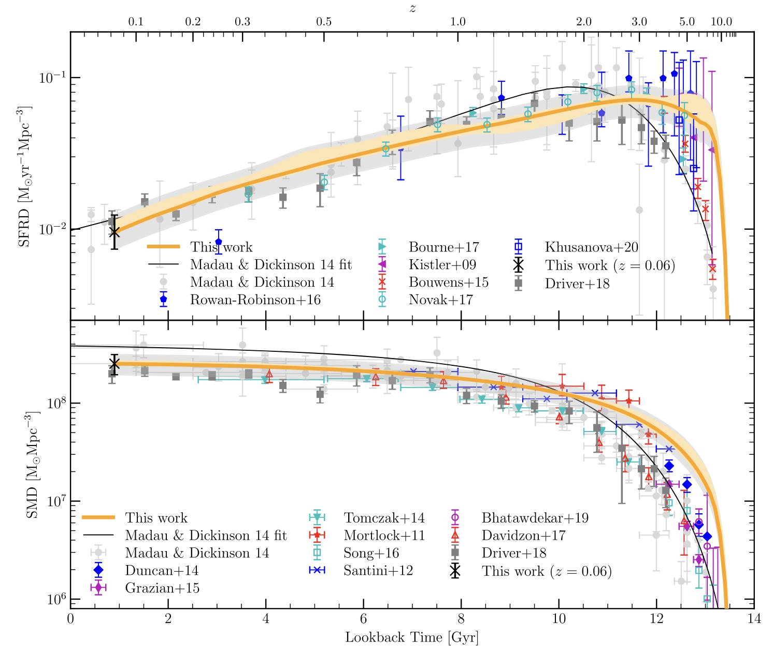
Galaxy population science
e.g., Reconstruct Cosmic tar-formation history (Bellstedt et al 2020)
A “Forensic” reconstruction
Of the entire cosmic
star-formation history from
6000 nearby galaxies →
The build-up of stellar-mass
over time →

Slide 33
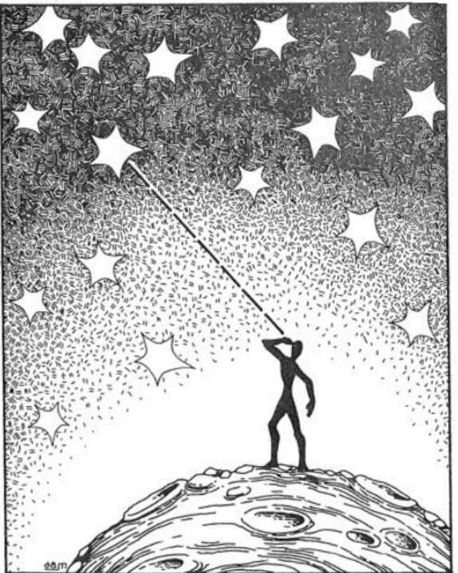
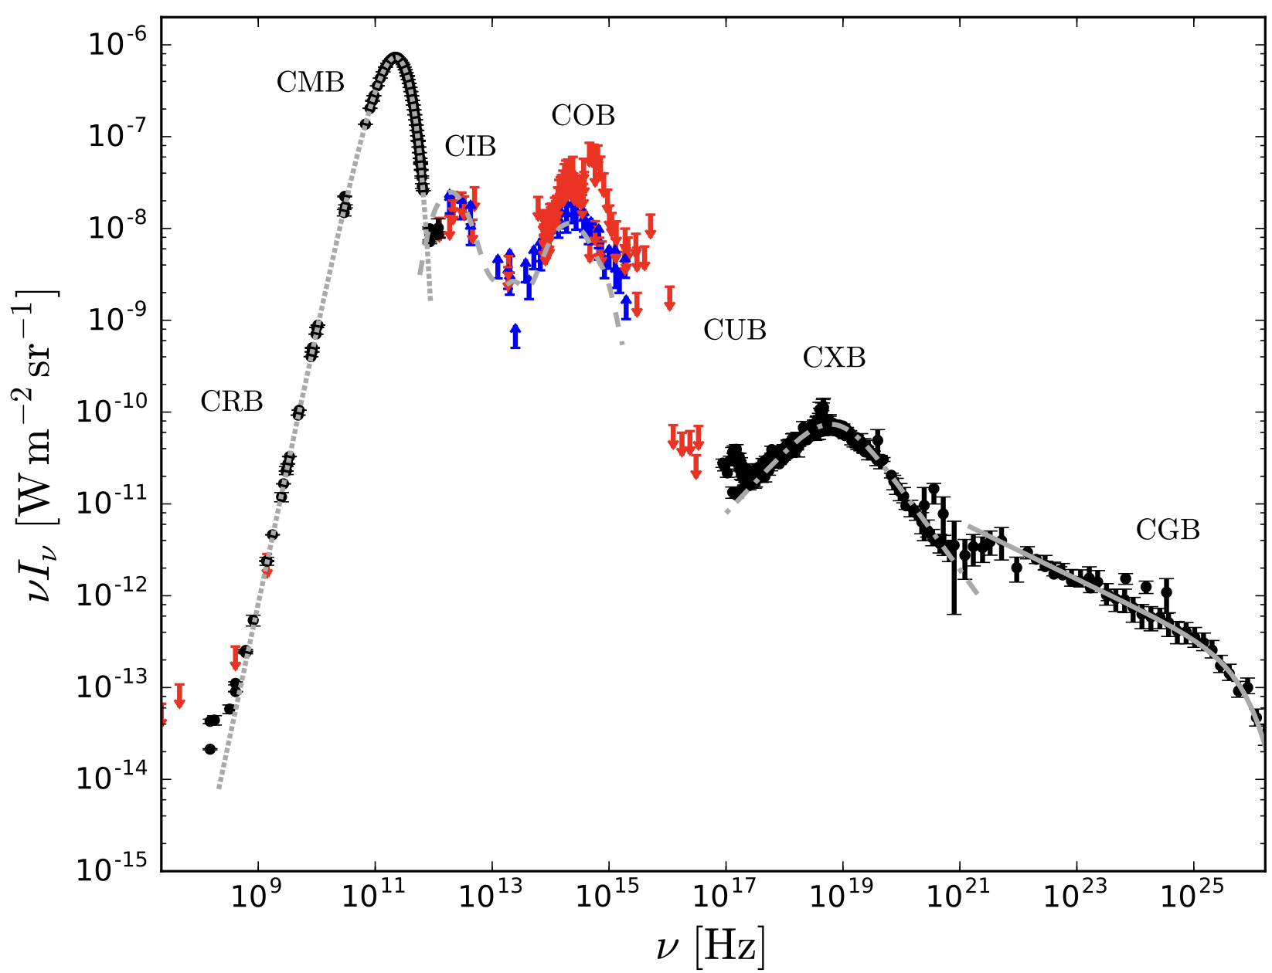
Olbers Paradox → EBL
Contrary to Olbers paradox the sky is NOT dark but
radiates at all wavelengths: measureable and modelable
100% → 20% → 5% → 2%
The Cosmic Optical Background
+Cosmic Infrared Background

Slide 34
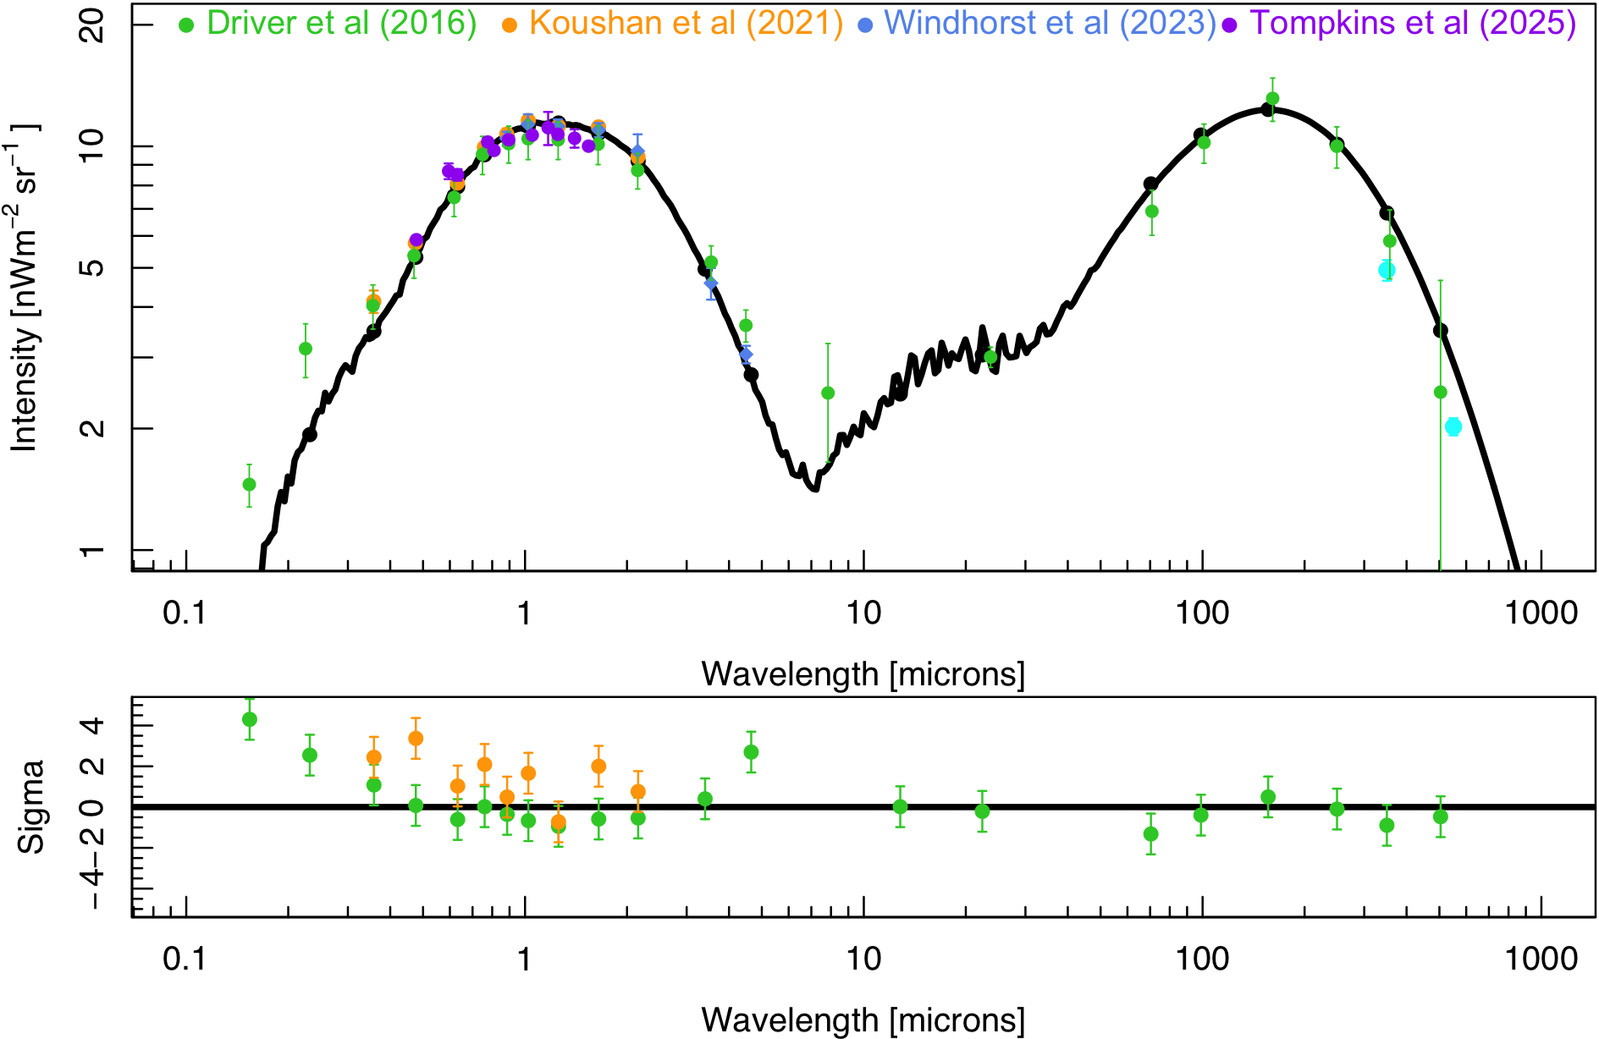
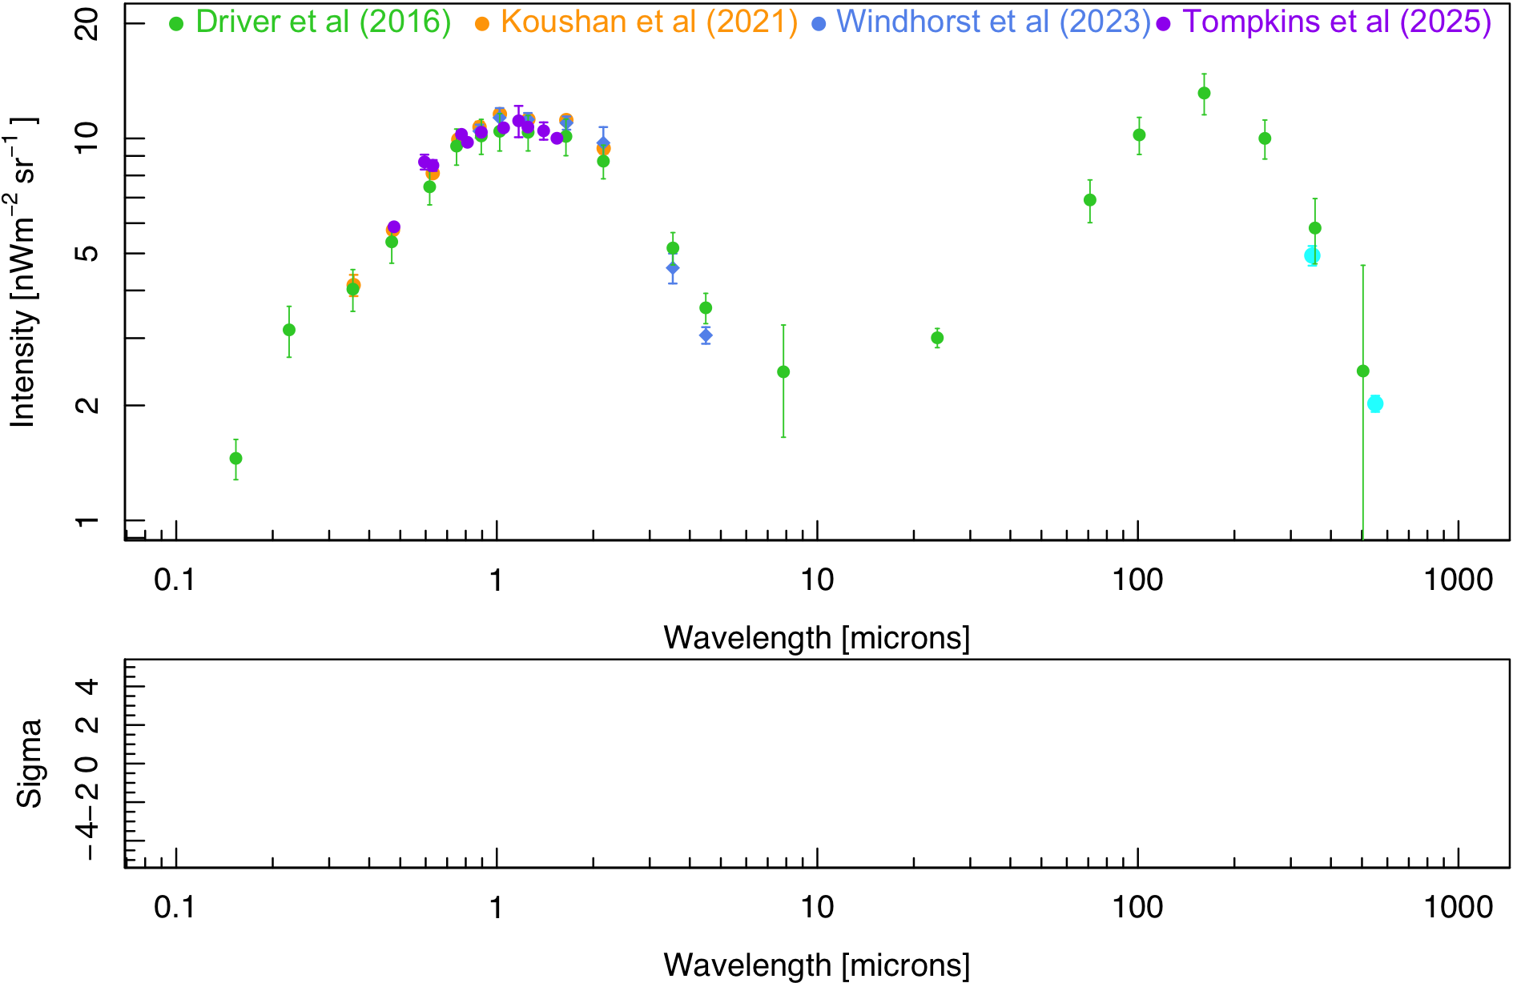
Measuring the spectrum of the Universe
Model = MD14 CSFH + Chabrier IMF + Evolving Z + Charlot & Fall

Slide 35
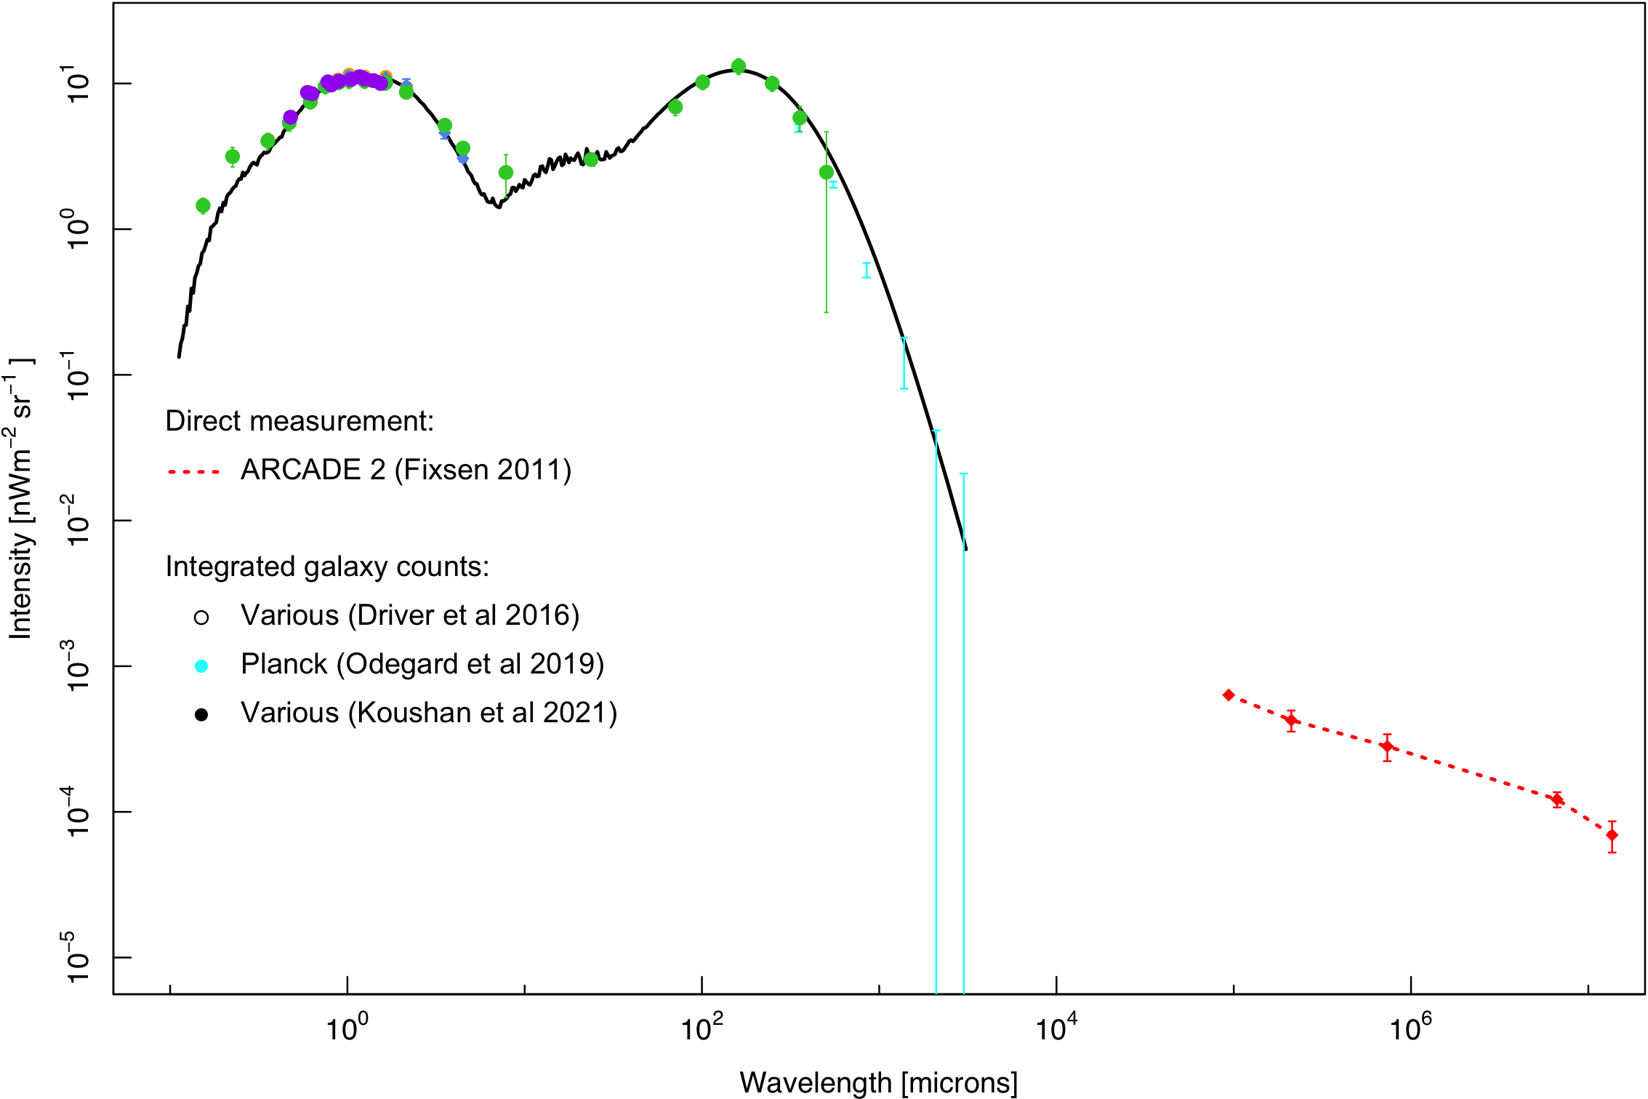
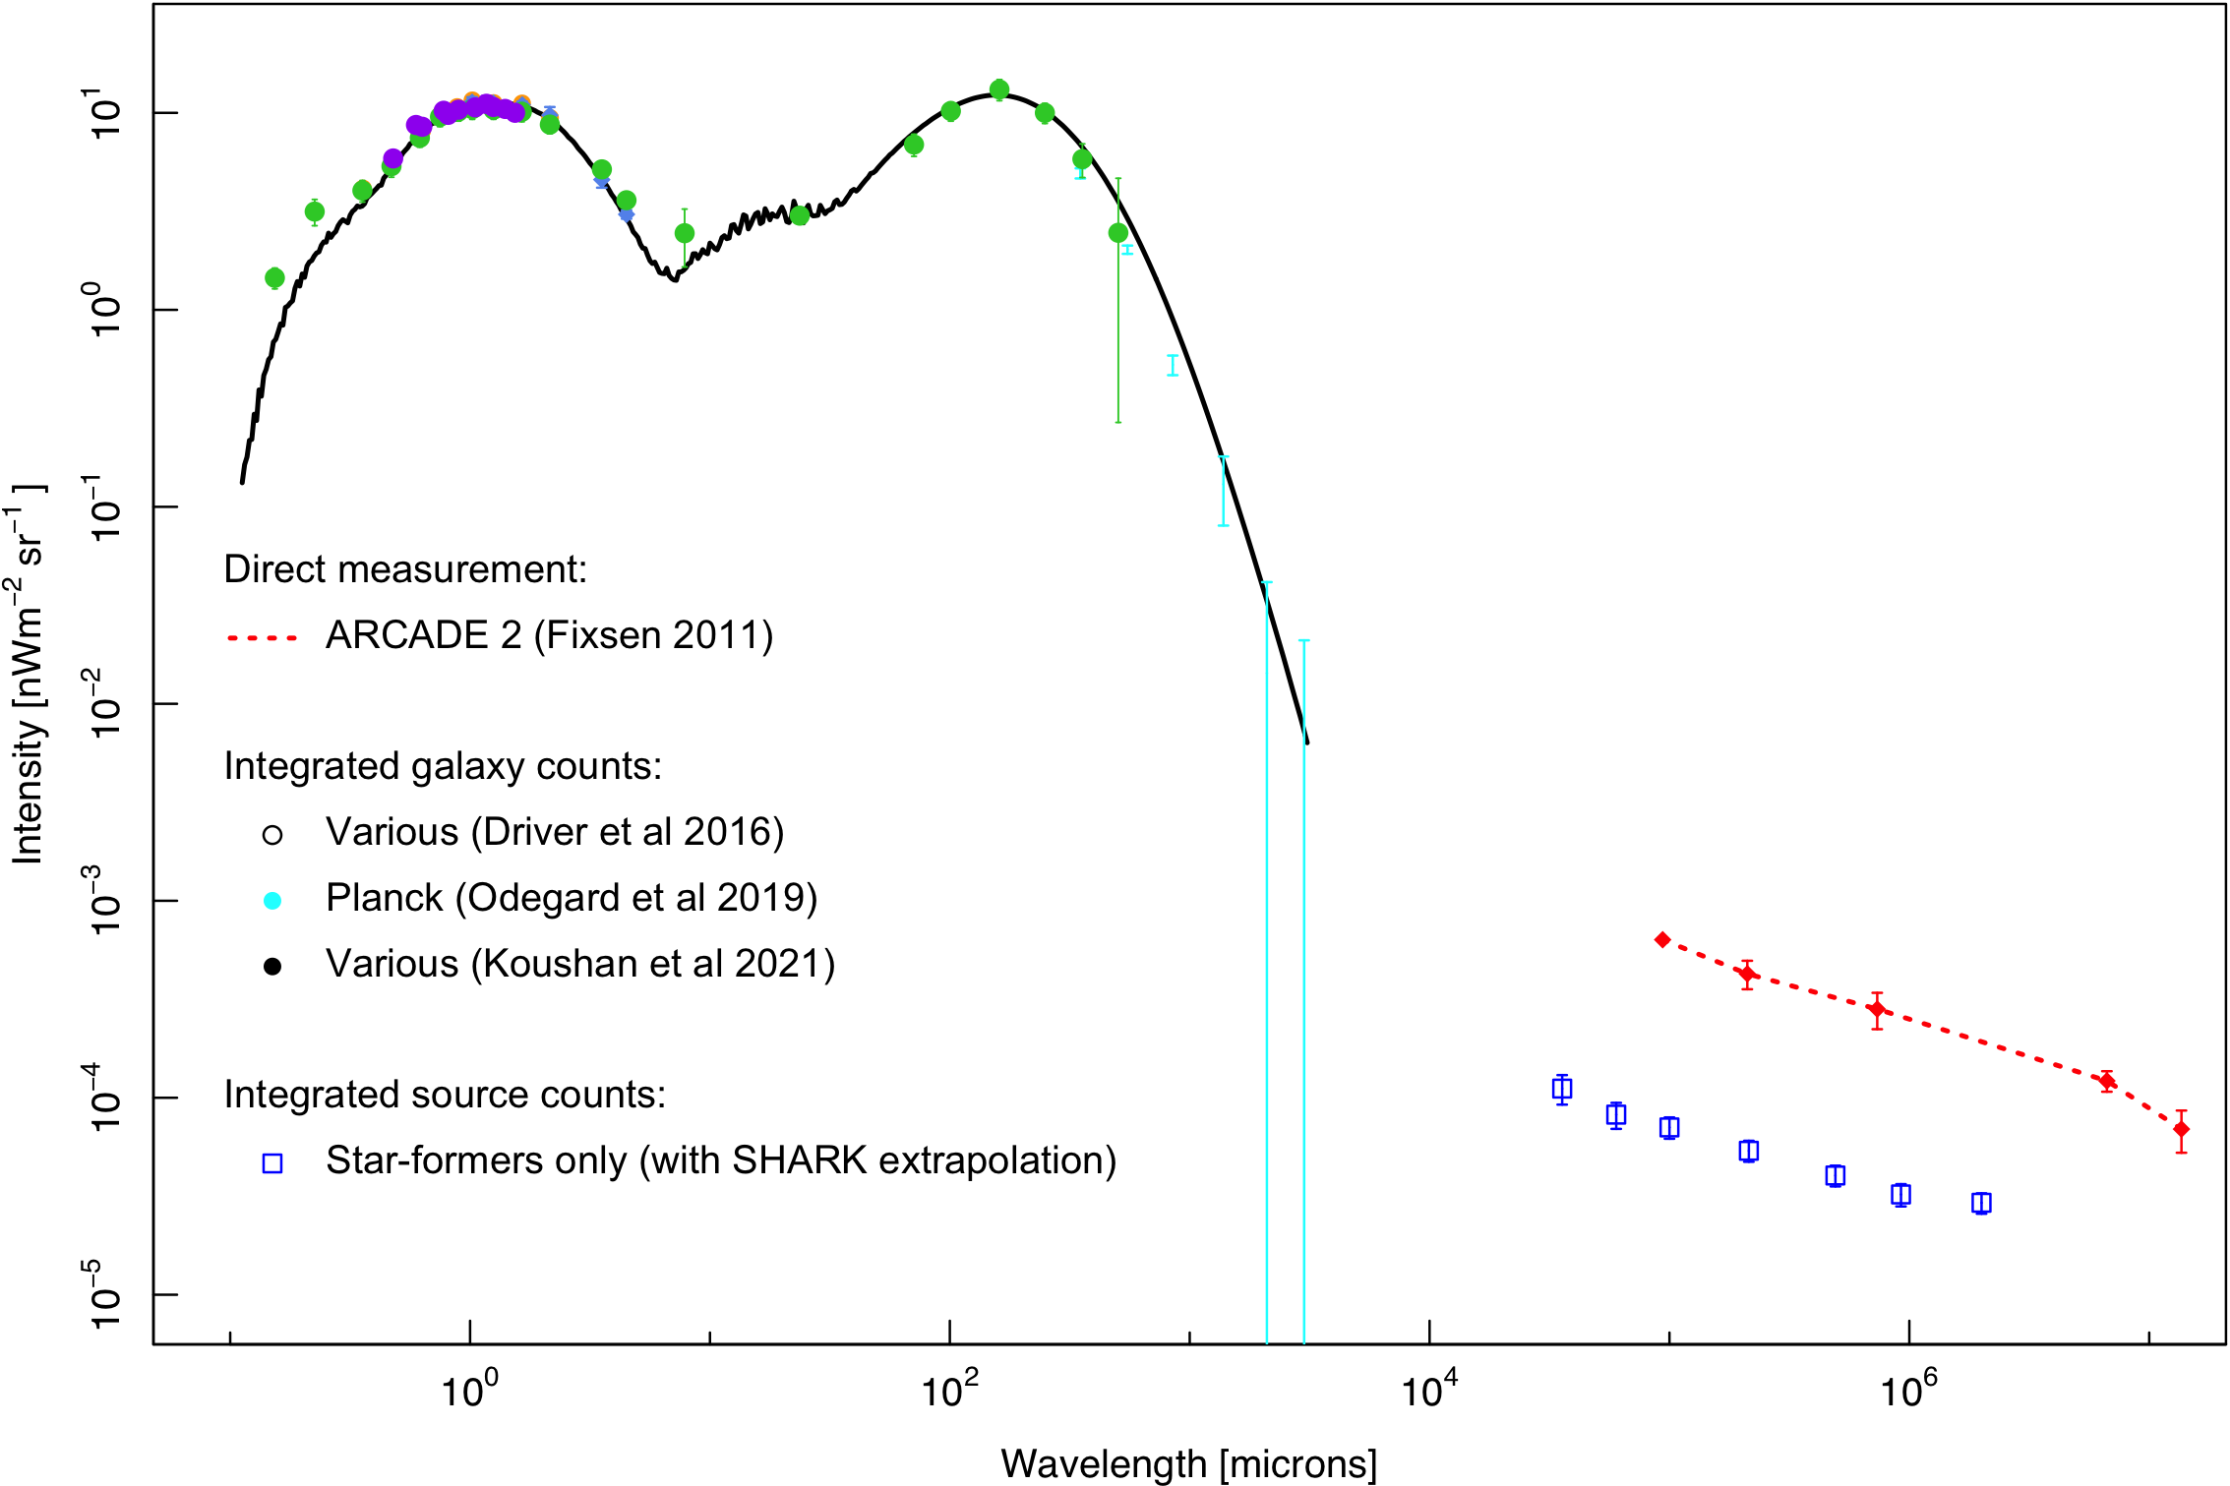
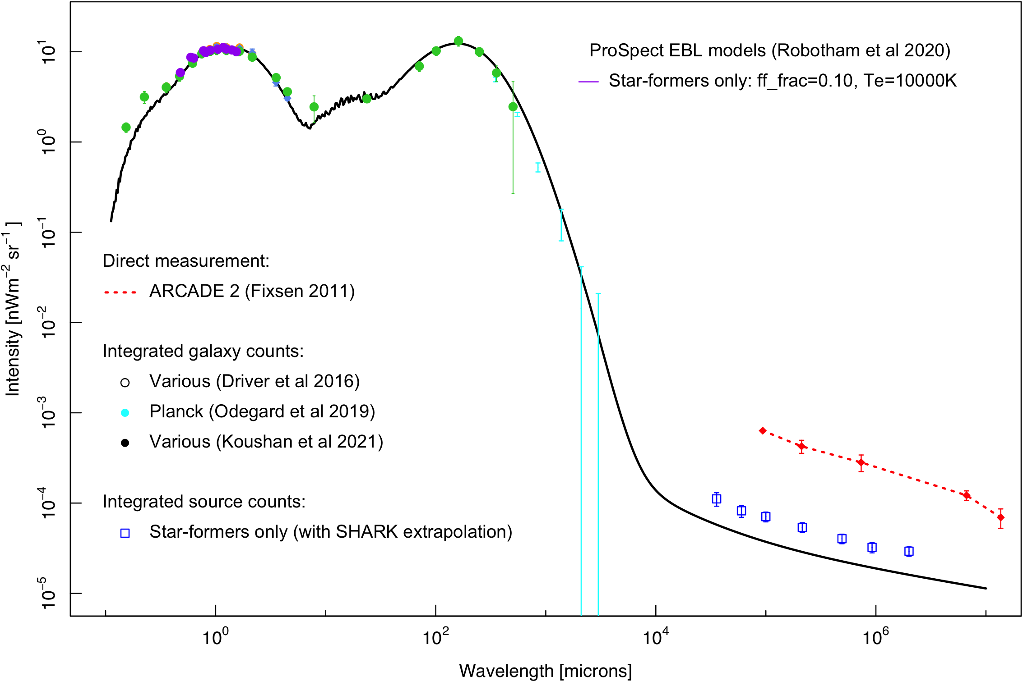


Extending out the radio
Marvil, Owen, Eilek (2015) for SF continuum emission built into ProSpect
Need to either increase free-free emission or plasma temperature to fit SF data. .
AGN need as well as better mid-IR sampling: SphereX and JWST
AGN
Tompkins et al (2023)

Slide 36

Extending to the full EBL
Most energy production is via three processes:

Slide 37
The EBL and the search for Dark Matter signatures
If Dark Matter annihilates, decays or interacts it will likely produce anomalous radiation at some wavelength that we cannot explain.
Most searches are in γ-ray and x-ray and focused on galaxy halo centres where DM density is highest but it could appear at any wavelength or from anywhere as most DM is outside galaxies (do we watch the galaxy or the Universe?)
The Extragalactic Background Light can be measured and modelled 100% → 20% → few%-> <1%
    The cosmic star-formation history
    The cosmic AGN history
    Dust reprocessing
    Intracluster and group plasma properties
    AGN Jets (Blazars and radio jets)
  Anomalies may point towards DM or as yet unknown physics
  Lack of anomalies provides DM annihilation/decay/interaction constraints
  Recent optical/infrared controversy now resolved (New Horizons v IGL v VHE)
  Current issues in radio (x5) and ultraviolet (New Horizons x2)
  X-ray under review (eROSITA)

Slide 38
The EBL and the search for Dark Matter signatures
A 1m3 of space:
Will contain:
~2 hydrogen atoms
~10-10000 dark mater particles (mass?)
Trillions of γ-ray to radio photons per s
Potential for an interaction giving rise to
anomalous radiation, chances miniscule but scaled to entire Universe who knows?
Better to observe one galaxy, or a steradian of the Universe, i.e., the EBL?

Slide 39
How to Fuse Data?
Most elements/steps exist and proven through GAMA (unique Australian multi-facility survey: ~500 papers)
National effort needed to scale TB → PB
Spectroscopic
Distances
(DESI, 4MOST, WST)
Ingest
(diverse formats and origins)
Homogenise
(WCS, Tiles,
Calibration)
Measure
(fluxes,
Shapes etc)
Extract Physical Properties
(M*, SFR, distance)
Serve
(Database,
SQL etc)
LSST
Euclid
Roman
JWST
SphereX
eROSITA
CTAO/Fermi
ASKP/SKA
ProPane
Data
Warping
to common
WCS and
Sky tiles
ProFound
Source
detection &
segment
photometry.
Flux & shape
measurements
ProSpect
ProFuse
ProZac
Science
ready
high-fidelity
QC’d cats
Data
Central
Catalogue
and data
cutout server

Slide 40
What is Data Fusion?
PLASMA, STARS, AGN & DUST
LSS and sub-structure is the next frontier
critical to understand gas flows, gas properties, merger rates
and the role of the Dark Matter Halo
eROSITA
GALEX
LSST (2024)
EUCLID (2023)
Roman (2026)
WISE
Herschel
DISTANCES, GROUPS
& DARK MATTER
GROUND
& SPACE
IMAGING
NEUTRAL GAS &
CHARGED
PARTICLES
Data
Fusion
Centre
MOONS (2024)
OPTICAL
SPECTROSCOPY
RADIO
SURVEYS
4MOST (2024)
ASKAP (2021)
DESI (2021)
WST or MSE
SKA (2029)
COLLABORATION & SCIENCE

Slide 41


What Data Volume are talking about?
GAMA = 3TB
WAVES/4HS = 10PB
No longer doable on a basic machine

Slide 42
Data Fusion and an ASTI, Qs ?
Data Fusion:
  Something we Australia leads through our survey tradition: 2dFGRS → GAMA → 4MOST and builds on our unique optical-radio perspective.
  Value adds to multi-billion investments into space (NASA, ESA), optical (ESO) and radio (SKA) facilities.
  While we currently lead, we’re now hitting the TB → PB barrier requiring a national approach (beyond any single Uni)
  Window of opportunity likely to close within the next decade
  Surprisingly cheap: just computers, storage and software egineers
  Potential to build back and out from Data Central
ASTI
  A good home for Data Fusion
  A good home for all our interests
  A direct peer-to-peer link with major international institutsions: JPL, StScI, IPAC, JPL etc
  Could it (should it) be a research extension to the ASA?
  How could it be funded? not in DP so arguably dead for a decade…

Slide 43
An Australian Space Telescope Institute
AAL
ASTI
ASA
Sovereign
Telescopes
Internat’l
components
Comms
(trad +
Laser)
Ground
Support
Data
Fusion
Internat’l
Agencies
T & I & O

Slide 44






CSFH is the primary ingredient
snorm function

