Slide 1
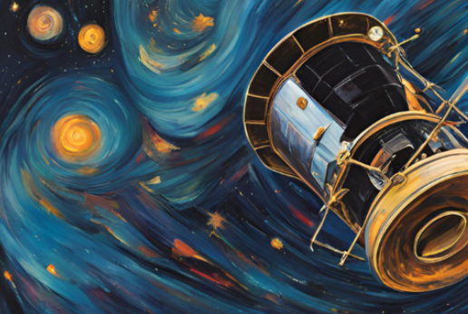
Space-based Astrophysics 2.0
Space 2.0
Space Astrophysics 2.0
Concept

Slide 2
Space 2.0
most dynamic period since the Apollo era
Characterised by commercialisation and industrialisation of space
Many new nations are participating and have made rapid development
a spacecraft launch today is ~ 10x cheaper than a decade ago. 50x cheaper than the 1970s.

Slide 3
Low Launch Costs and dropping
Eg. SpaceX publishes base pricing (no integration, testing etc.) on Falcon 9 for rideshare launches under its SmallSat Rideshare Program to SSO and others:
Up to 50 kg: $275,000 total
50 kg to 100 kg: $550,000 total
100 kg to 200 kg: $1.1 million total
For masses above 200 kg, the cost is $5,500 per additional kg.
Starship and 100+ tons into LEO
“You can imagine that if Starship brings 100 tons into space frequently, this will change everything out there in space, how things are constructed and how space is being utilized.”
Oct 15, 2024. Josef Aschbacher, DG of ESA
Notes:
Despite successful Ariane 6 (up to 22 T payload) launch in July 2024

Slide 4
Not just about Launch costs
massive increase in number of commercial suppliers of components and launch services
demonstrator missions to qualify new technology are affordable
multi-mission approach with smaller satellites lowers complexity, timescale and risk per mission (US DoD)
More nations are gaining space capabilities (eg UAE) -> more partnering options
Notes:
Khalifasat, First UAE satellite built by Emirati engineers, 330kg, 2018

Slide 5
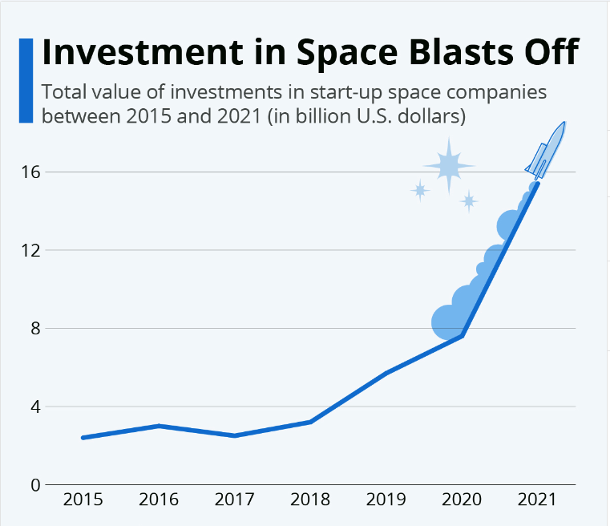
$26 Bn in 2024

Slide 6
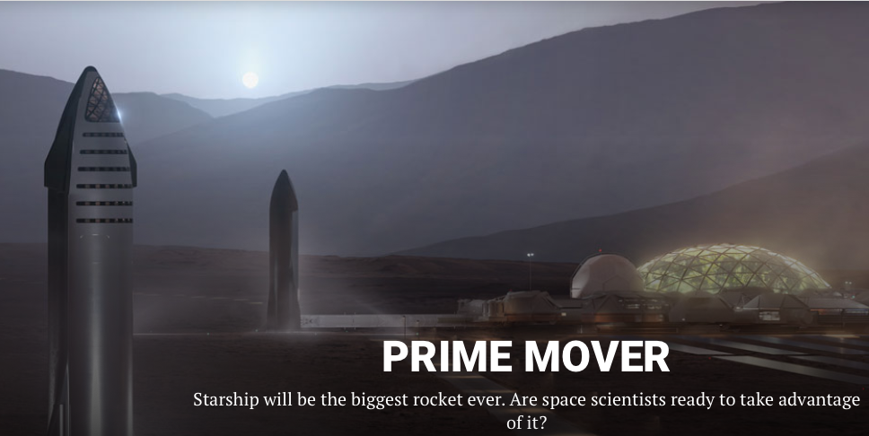
Space-based Astrophysics 2.0
“Trade risk for mass” Elvis, Lawrence, Seager, Physics Today 676 (2) 40-45
Notes:
Left to right: Falcon 9, commercial bus, astrosat 11m dish in Bangalore

Slide 7
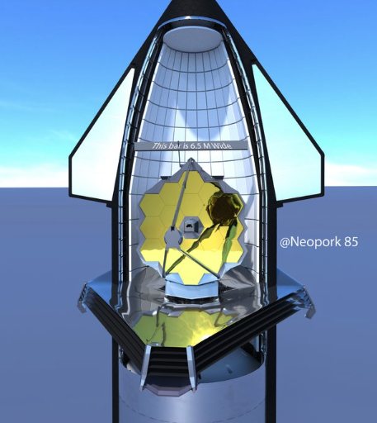
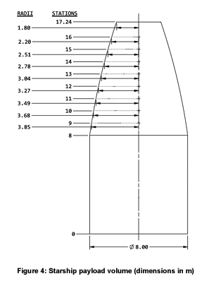

Slide 8
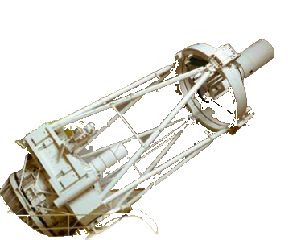
AAT to LEO
116 tonnes
easy!
$60M on starship ?

Slide 9
Why go to space for observation?
Full availability of electromagnetic spectrum
No airglow or thermal emission from atmosphere (ZD background)
Possible to cool main telescope optics
Diffraction limited operation
Photometric precision (transparency, scintillation)
Long periods of uninterrupted observation

Slide 10
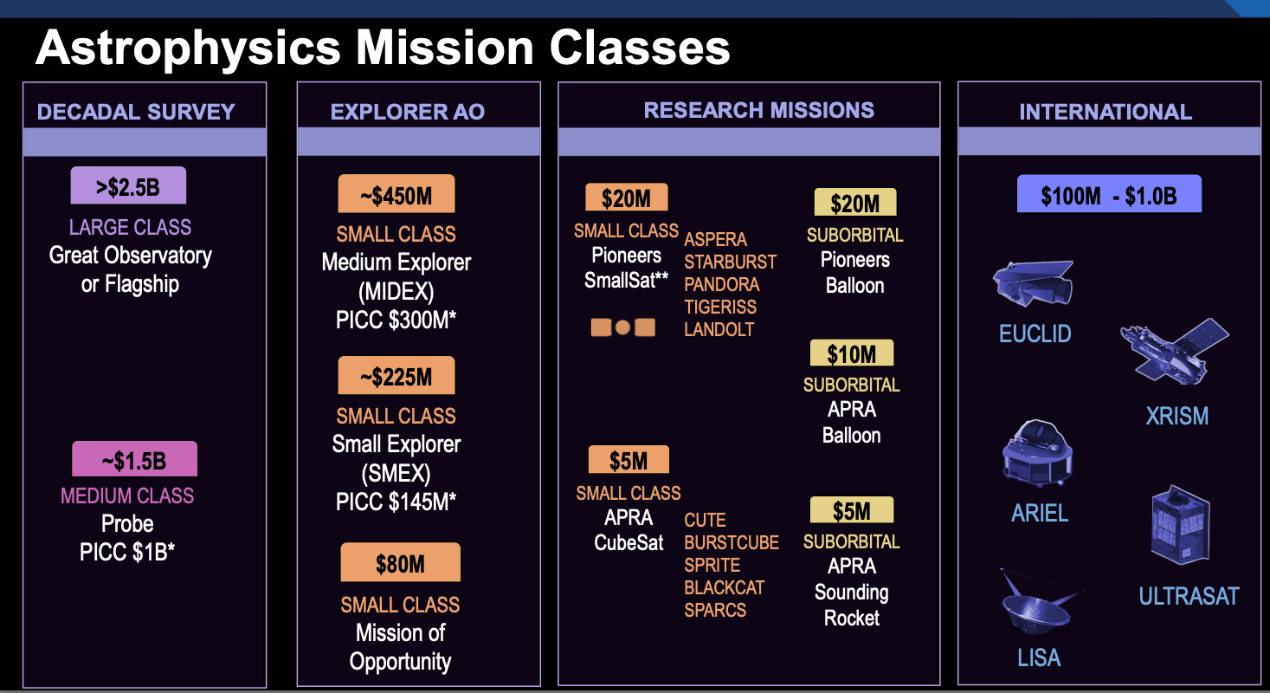
Notes:
Major agencies developing smaller scale missions

Slide 11
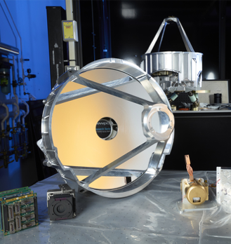
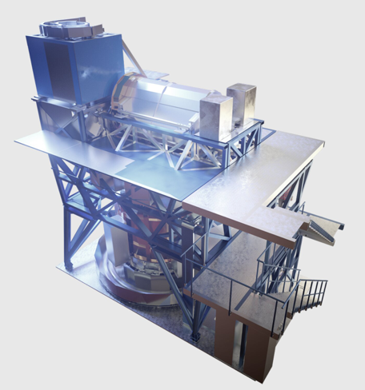
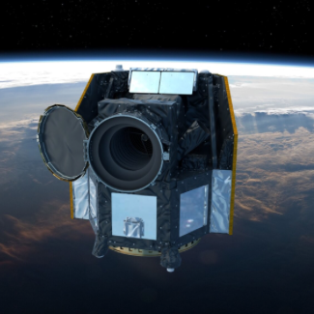
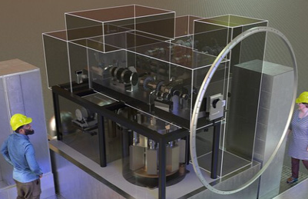
NASA-pioneers-PANDORA. AUD32M+launch
ESA-S-CHEOPS. AUD35M+launch
HARMONI-ELT.
~AUD150M.
MAVIS-VLT.
AUD65M.
Notes:
ESA S-Class, NASA Pioneer class

Slide 12
Example - India
ISRO AstroSat
2015 launch
Still partial function 2025
Multi-instrument Observatory
X-ray to Visible
400mm UV/V optics
1500 kg
Low incl orbit (6º)
GS at Bangalore
Item | AUD
payload | 37M
Bus & launch | 37M
Ops & Data | 19M
Total | 93M
Notes:
X-ray, optical, UV

Slide 13
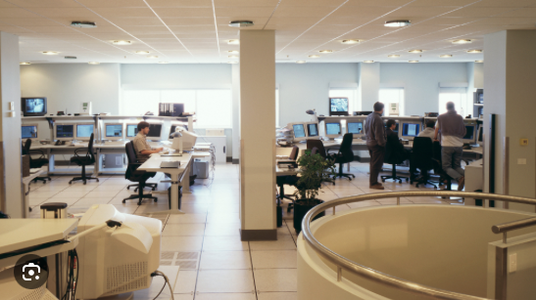
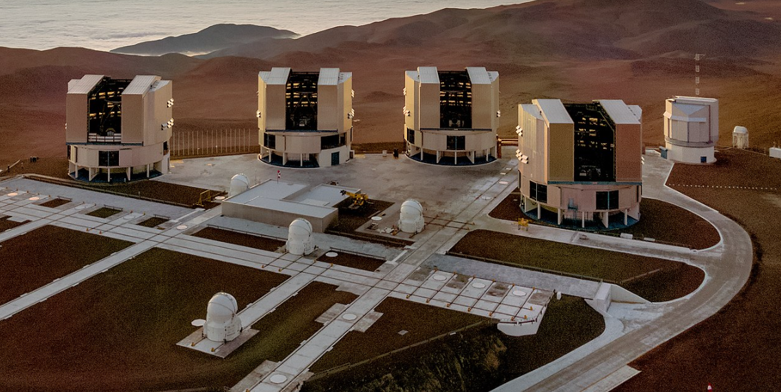
From ground-based to space-based astro
Control and operations
Data pipeline and archive
Payload Instrument
Telescope infrastructure
Notes:
Left to right: Falcon 9, commercial bus, astrosat 11m dish in Bangalore

Slide 14
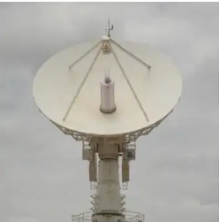
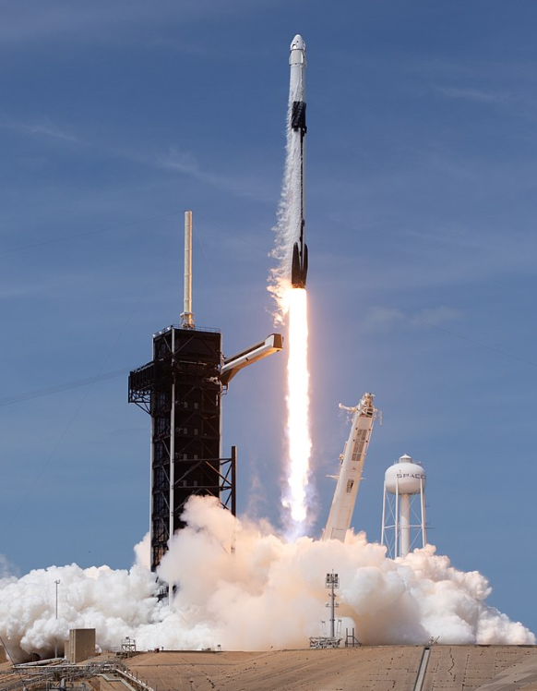
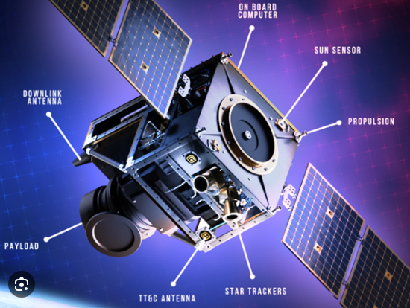
From ground-based to space-based astro
Data pipeline and archive
Ground station & operations
Payload Instrument
Commercial Launch
Commercial Platform
Notes:
Left to right: Falcon 9, commercial bus, 11m dish in Bangalore. Interesting reading that some companies are moving away from vertical integration model (smallsat conference, silicon valley).

Slide 15
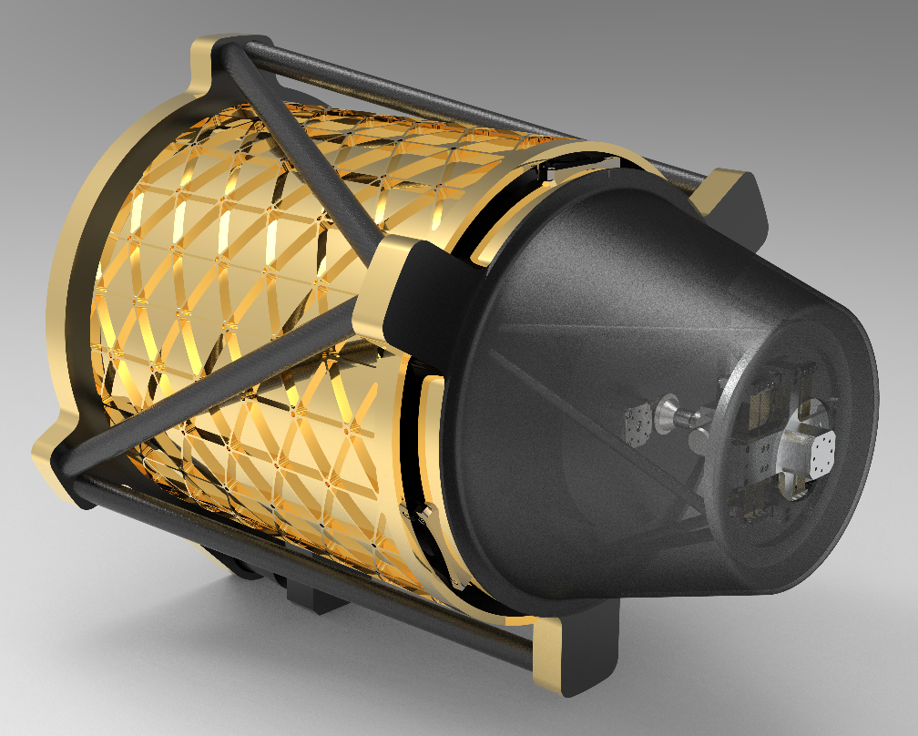
Concept: Bi-Lateral project
500mm
F/3.6
3-5 micron, HgCdTe
>3 yr lifetime
105 kg (very rough)
AUD$6M delivered.
Eg. HOTSPOT : 0.5m MWIR EO Telescope
AUD$12M
AUD$6M
Notes:
ISI India grants

Slide 16
Conclusions
We are in a period of disruption in the space industry
Novel opportunities for innovative approaches to space astronomy exist and will grow
Low-risk missions are feasible at affordable costs at bilateral level
be the biggest rocket ever. Are space scientists ready to take advantage of it

