Slide 2
Acknowledgment of Country
The Australian Academy of Science acknowledges and pays respects to the Ngambri and Ngunnawal people, the Traditional Owners of the lands on which the Academy office is located. The Academy also acknowledges and pays respects to the Traditional Owners and the Elders past, present and emerging of all the lands on which the Academy operates, and its Fellows live and work. They hold the memories, traditions, cultures and hopes of Aboriginal and Torres Strait Islander peoples of Australia.

Slide 3
Overview
•The Australian astronomical community is carrying out a formal strategic planning process on a ten-year timeframe, reviewing its goals and progress at the mid-term mark.
•This process is run by the Australian Academy of Science’s National Committee for Astronomy.
•It provides the opportunity for Australian astronomy to
•carry out a review of its current capabilities, assess its impact both nationally and internationally,
•provide a vision for the future and set priorities and develop strategies to implement the vision
•Astronomy Australia Limited (AAL) supports the delivery of the infrastructure goals of the Australian Astronomy Decadal Plan

Slide 4
Process
The decadal plan has been developed through extensive community and stakeholder consultation. The findings and recommendations are drawn from the conclusions of working groups
Consultation occurs throughout the two-year drafting process
National presentations and discussion at the 2023 and 2024 Annual Scientific Meetings of the ASA
Nationwide town hall and WG meetings between Feb-July 2024
Individual / institutional surveys
Release of an exposure draft for feedback in early 2025 + roadshow.

Slide 5
Decadal Plan Development Timeline
Date | Activity
June-December 2023 | Project Initiation and establishment of working groups Presentation at ASA conference Development of working group plans and white papers
February-May 2024 | Establish Editorial Board Nationwide town hall meetings and online consultation
June-July 2024 | National presentation at ASA conference Development of Working Group reports Series of in-person town hall meetings
September 2024 | Working group white papers provided to NCA (Sept 1) Incorporation into first draft of the decadal plan by the editorial board (September 16)
September – December 2024 | Editorial committee preparation of exposure draft (including feedback by NCA / Academy of Science)
January-February 2025 | Exposure draft consultation
March – June 2025 | Report finalization and prepublication
July 2025 | Launch of the Decadal Plan at the ASA conference and Academy of Science
We are here
Notes:
The decadal plan has been developed through extensive community and stakeholder consultation. The findings and recommendations are drawn from the conclusions of working groups
Consultation occurs throughout the two-year drafting process

Slide 6
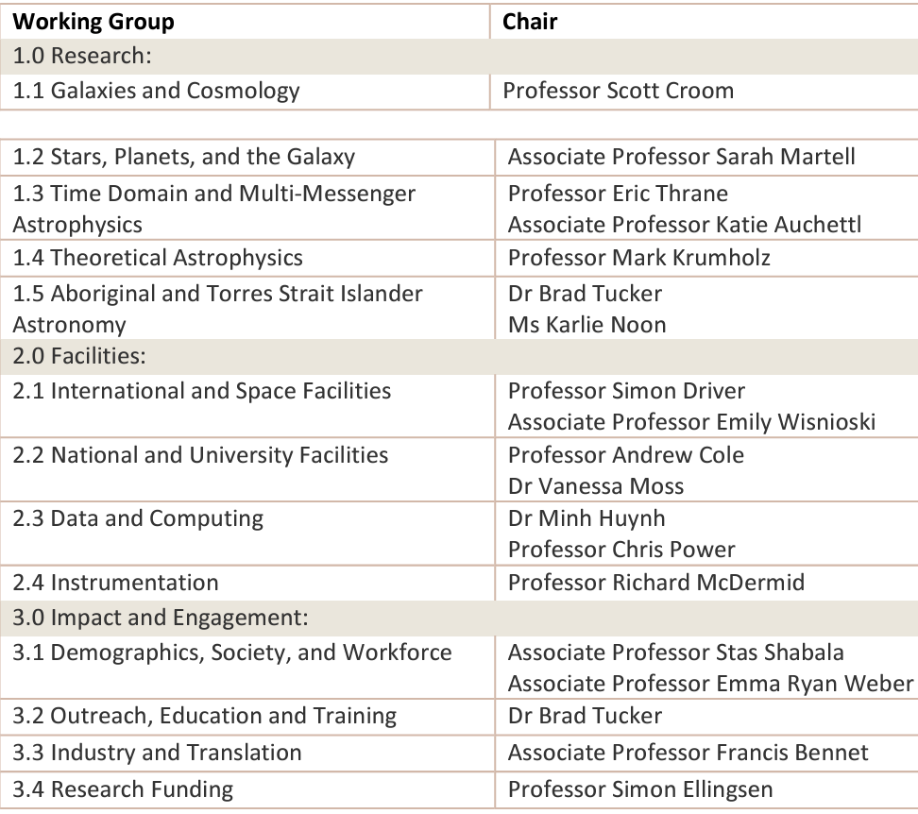
Decadal plan working groups
White papers provided by working groups provide the basis for the Decadal Plan
Working groups
13 working groups established.
Working group chairs met monthly to provide feedback to the NCA chair, and to ensure collaboration in the development of the WG white papers
Membership:
An overwhelming response from the community, with approximately 253 members contributing to various working groups. This diverse group represents a wide range of institutions, fields, and demographics, showcasing the robust engagement of our community in shaping the future of Australian astronomy.
13 white papers were delivered in September

Slide 7
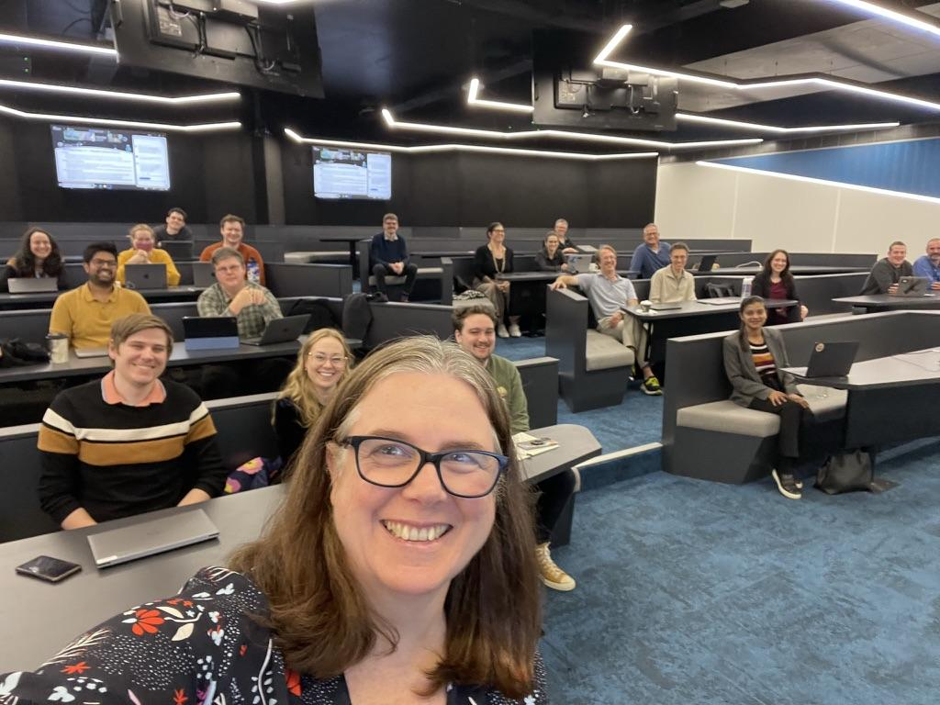
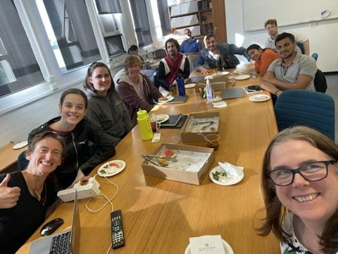
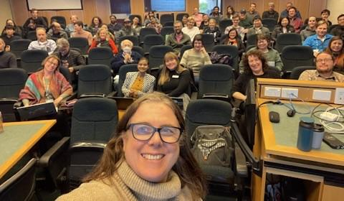
2024 Town-hall consultations
In-person town halls
Seven in-person with virtual option town halls in July/August to discuss initial findings to help white paper drafting. Led by Virginia Kilborn, Sarah Brough, Chris Power
Locations: Vic, Qld, Tas, ACT, NSW, WA, SA between July 18th to August 2nd
Over 200 people attending in-person, and 170 online
Outcomes – feedback to the WGs, plus a new report on Astronomy sustainability + dark skies

Slide 8
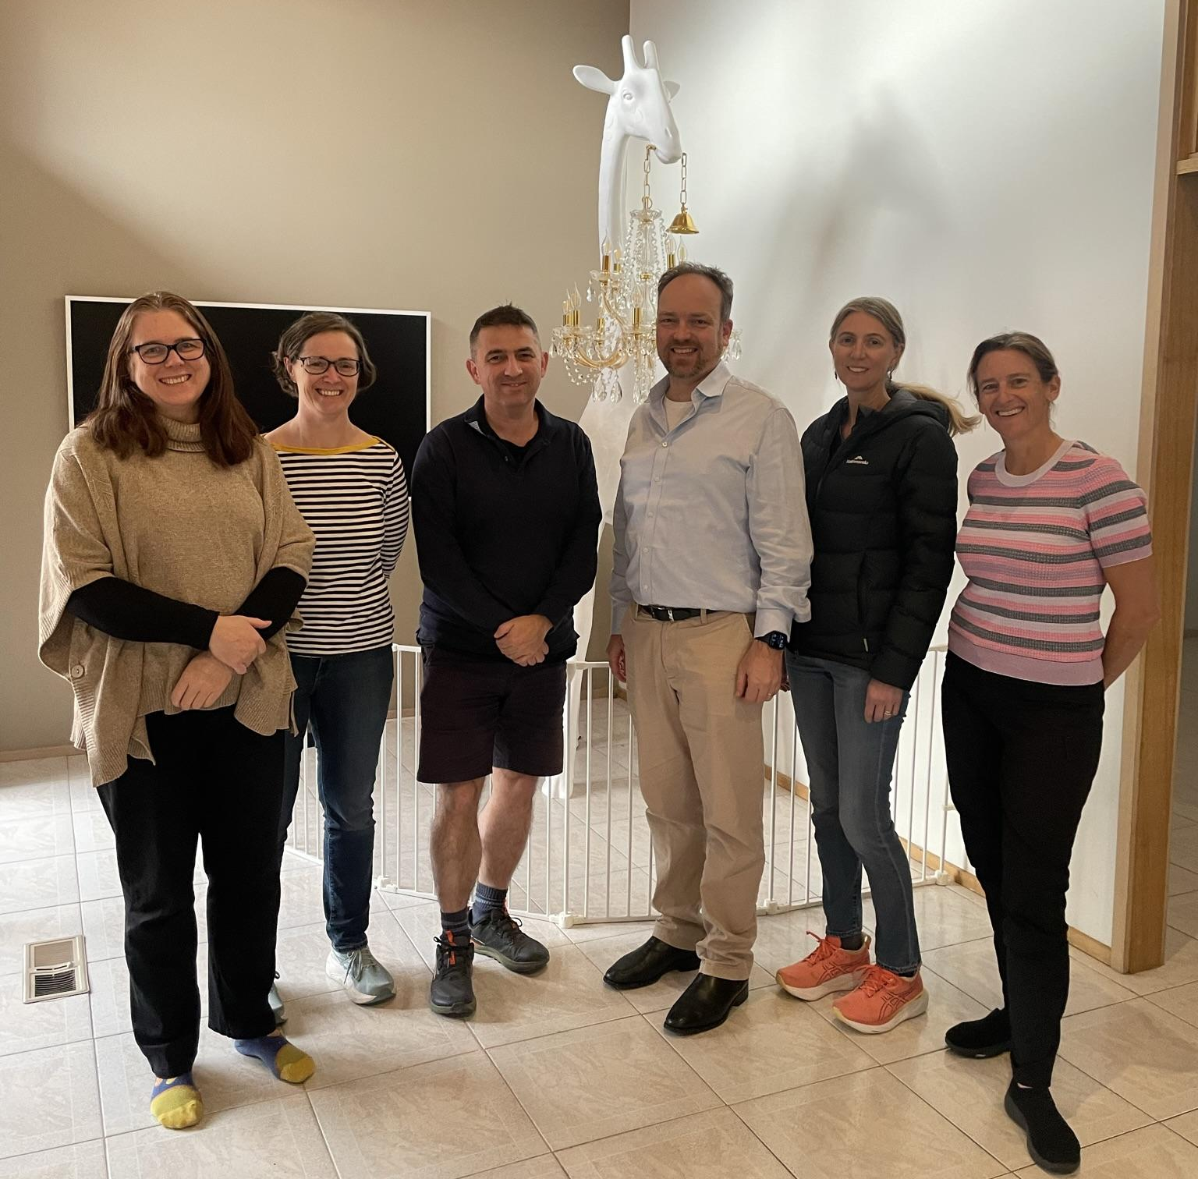
Decadal Plan Editorial Board
The editorial board tasked with taking the community white papers and drafting the decadal plan
The EB met in mid-September to write the first draft of the DP
Editorial member | Role | State
Professor Virginia Kilborn | Chair | Victoria
Professor Sarah Brough | Deputy chair | New South Wales
Professor Tamara Davis | Board member | Queensland
Professor Cathryn Trott | Board member | Western Australia
Professor Mike Ireland | Board member | ACT
Professor Chris Power | Board member | Western Australia

Slide 9
Methodology
The decadal plan draws from the 13 community white papers
The EB all read each paper, and the main themes were sketched out
Themes and sections refined during the intensive writing week - WG chairs were contacted when needed for clarifications / further information
The first draft DP was submitted to NCA in October, and 3 rounds of feedback have taken place
We are now seeking community feedback

Slide 10
Timeline from here
July
Launch of Decadal plan at the Academy of Science and ASA ASM.
May
Endorsement of proofs by NCA and AAS Council
April
Final revision by editorial board
March-May
Typesetting and layout of DP by academy staff and external publishing company
Engagement plan includes developing resources for stakeholders - government, industry, educators, scientists etc
The launch may include an industry showcase
March
Submit near-final DP to AAS council for endorsement

Slide 11
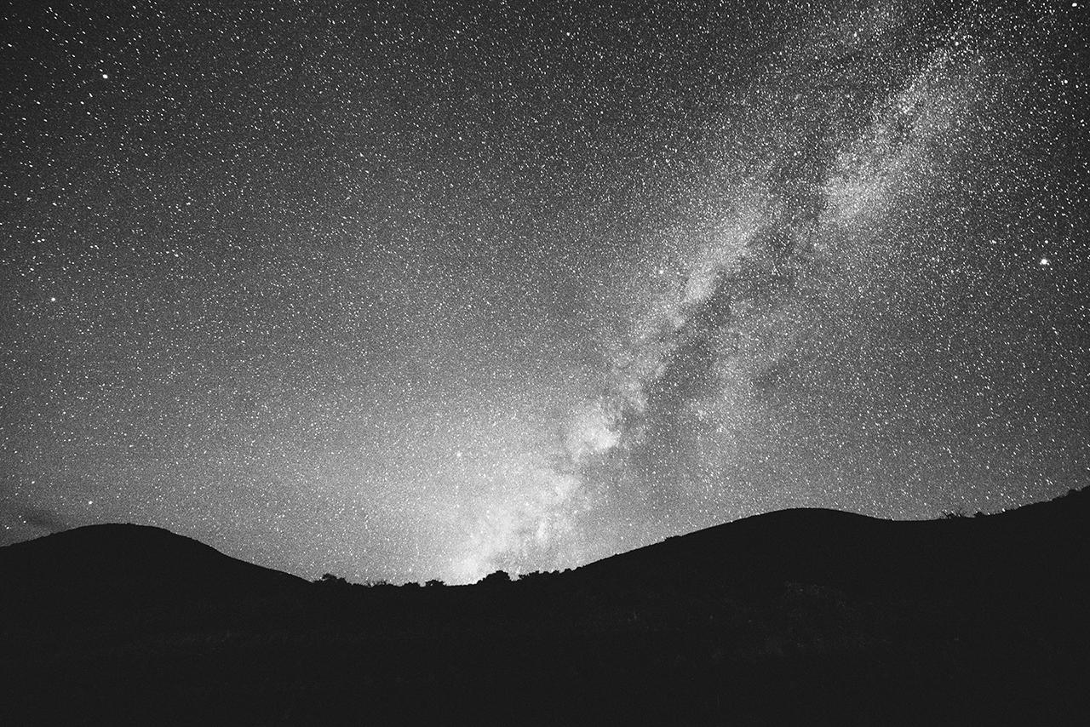
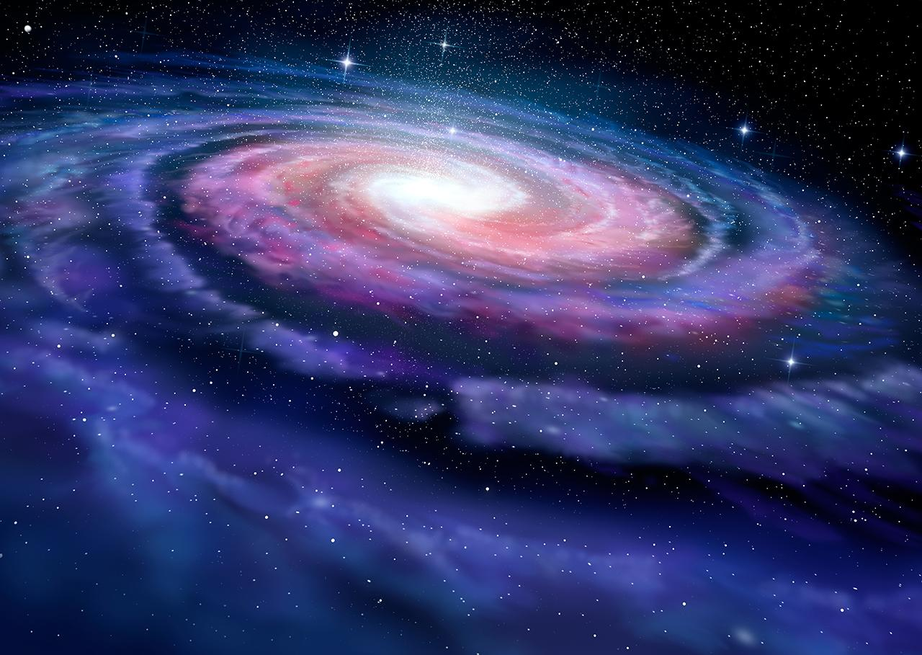
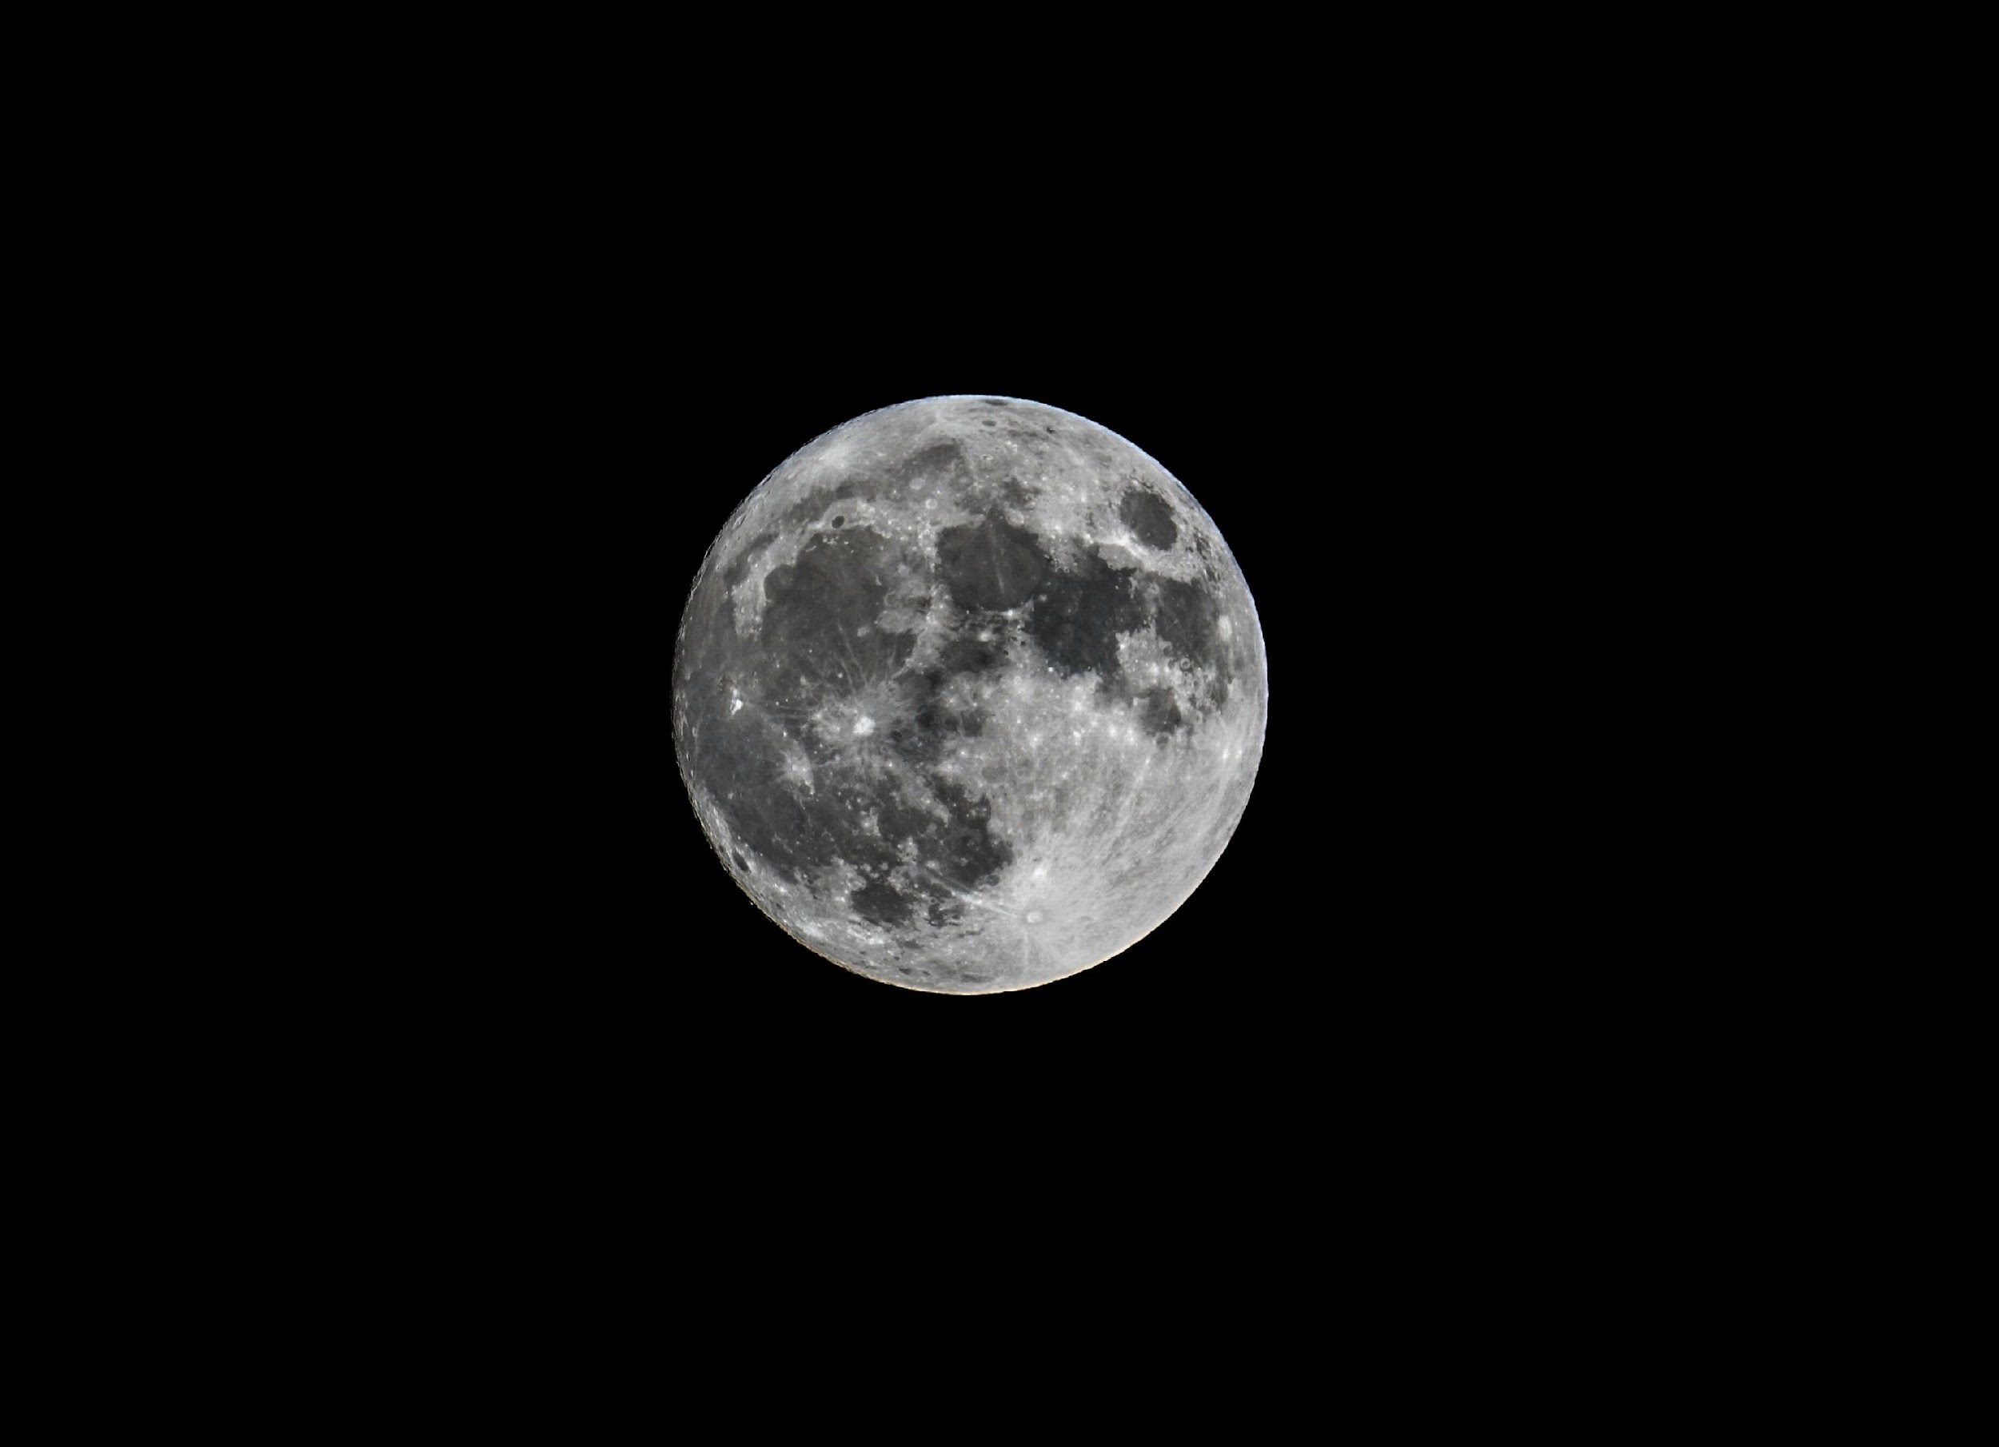
Images/ case studies for Decadal Plan
We need you to provide images and case studies to go in the decadal plan:
Please gather images for which you have the copyright, and are relevant for inclusion in the plan
Could be astronomical images, instruments, students and other people doing astronomy (please ensure correct permissions)
Submit to this link: https://www.surveymonkey.com/r/T5J9J83

Slide 12
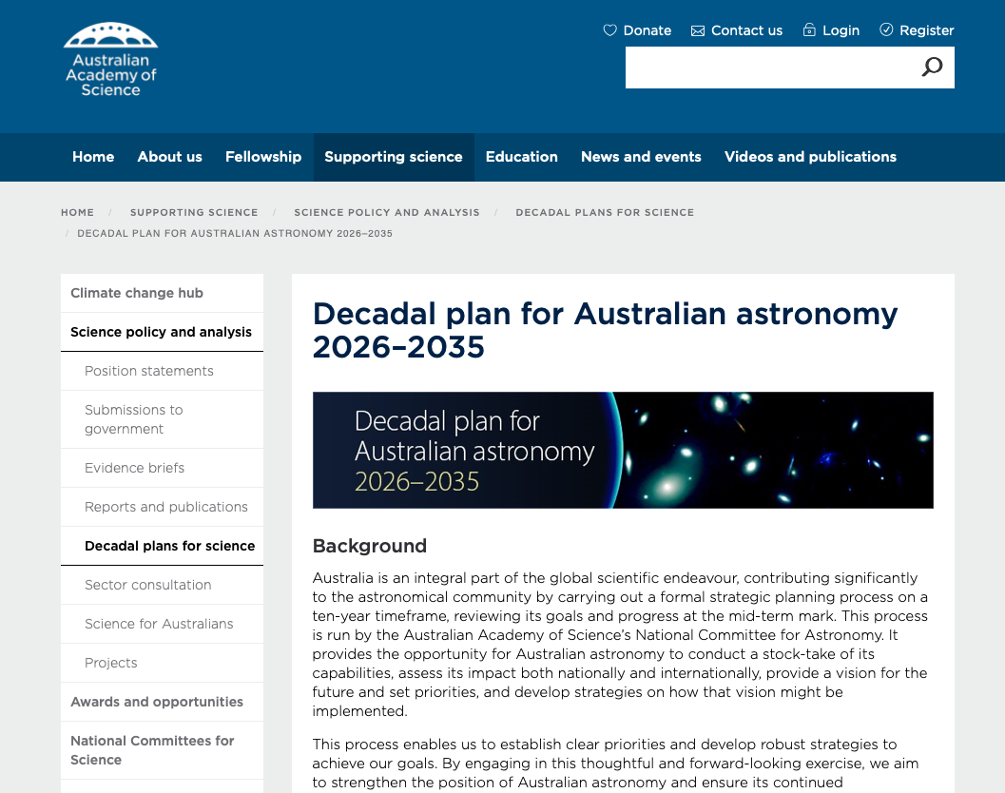
Decadal plan website
Website is a repository for documents, white papers, and working group and board memberships (white papers will be uploaded shortly)
https://www.science.org.au/supporting-science/science-policy-and-analysis/decadal-plans-for-science/astro2035

Slide 13
Themes from the white papers
Strong theme of interconnection and coordination of the community and science
Impact of Australian astronomical technologies for the broader Australian community
Educational and diversity goals within STEM fields:
Advancing educational initiatives
Promote diversity in astronomy and beyond
Indigenous knowledge for the decadal plan – first time Indigenous astronomy knowledges and techniques throughout the DP
Infrastructure – strong support for SKA and ESO-like capabilities, recognising the importance of mid-scale facilities - and the role of national facilities for science, education, training and development
Notes:
f

Slide 14
A bold vision for Astronomy in Australia
For over 65,000 years, Aboriginal and Torres Strait Islander peoples have maintained the world's most ancient and continuous astronomical knowledge and observations. …. astronomy reaches out into the Australian community, providing inspiration, education and training, industry opportunity, connection with First nations science and scientists, and effective international relationships.
“The vision for Australian astronomy is one that inspires Australia, and where Australia benefits from excellence in fundamental science, and the applications that derive from this.”

Slide 15
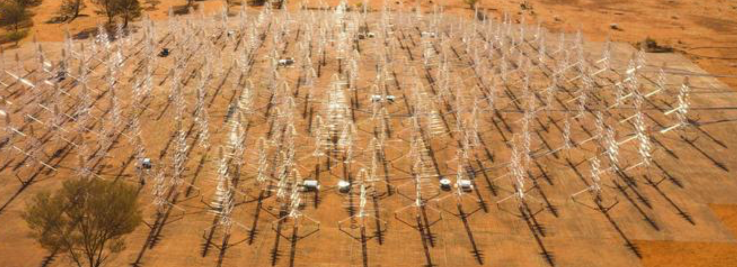
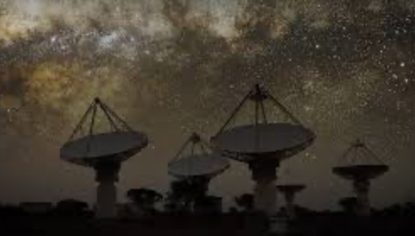
(a few) Highlights of the decade
Gravitational Waves detected by LIGO
ESO strategic partnership began
SKAO IGO established, construction of SKA-low
ASKAP began science operations
SAMI / GALAH / GAMA / HECTOR all saw milestones in previous decade
Matthew Bailes won the Shaw prize for FRBs
Industry and instrumentation flourished

Slide 16
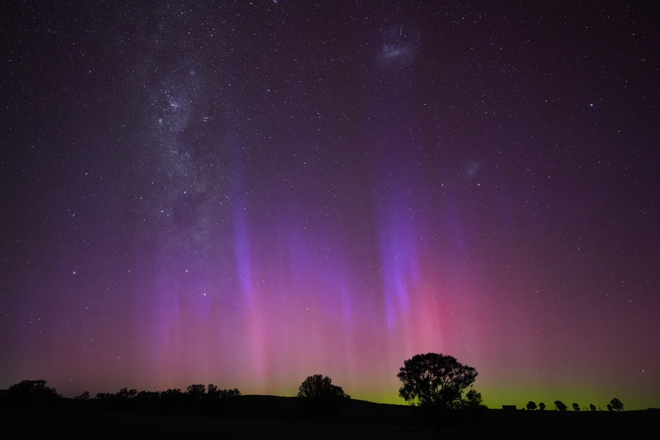
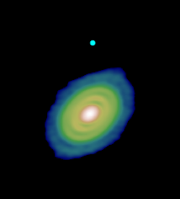
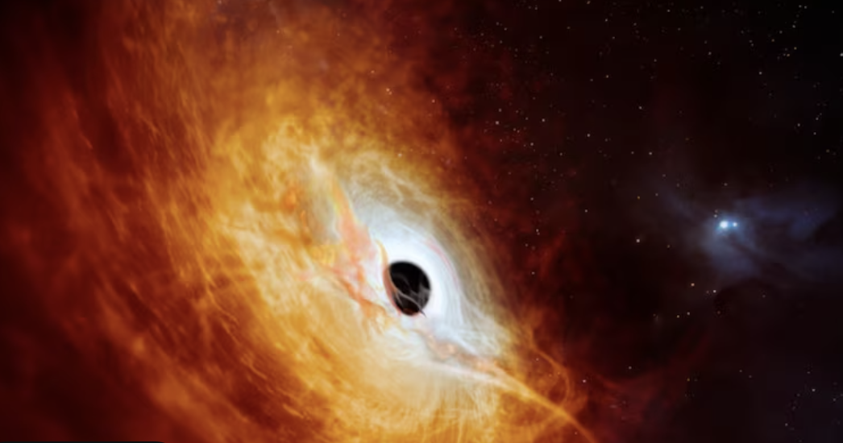
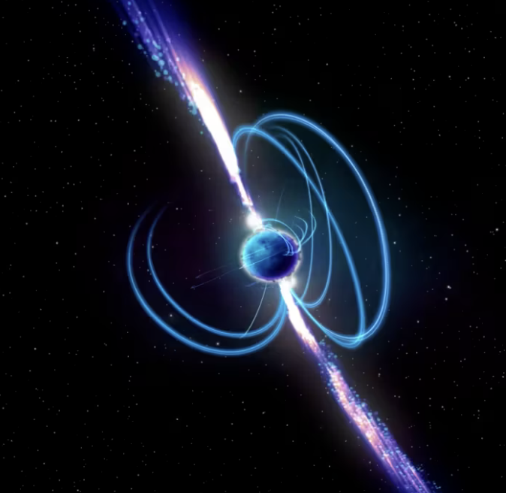
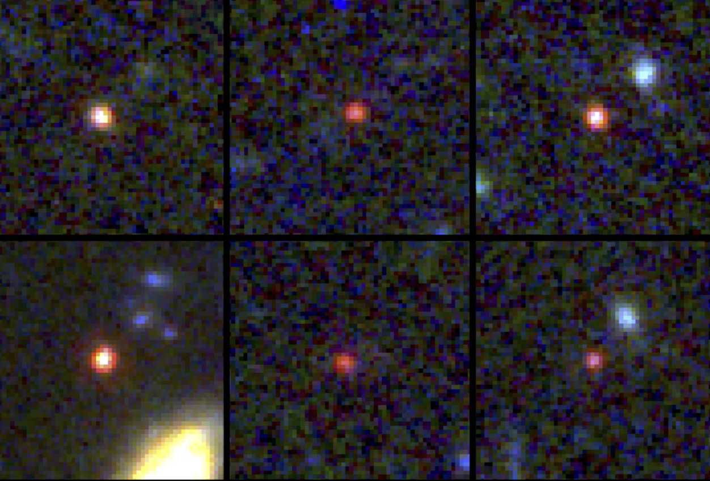
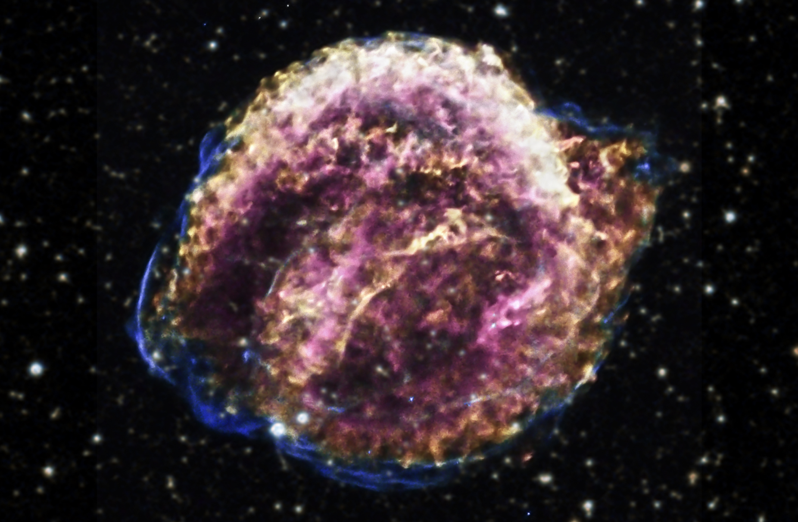
(some) Discoveries of the decade
Gravitational Waves
Planets
Black holes
Transients
Stars and the Milky Way
Galaxies
Cosmology

Slide 17
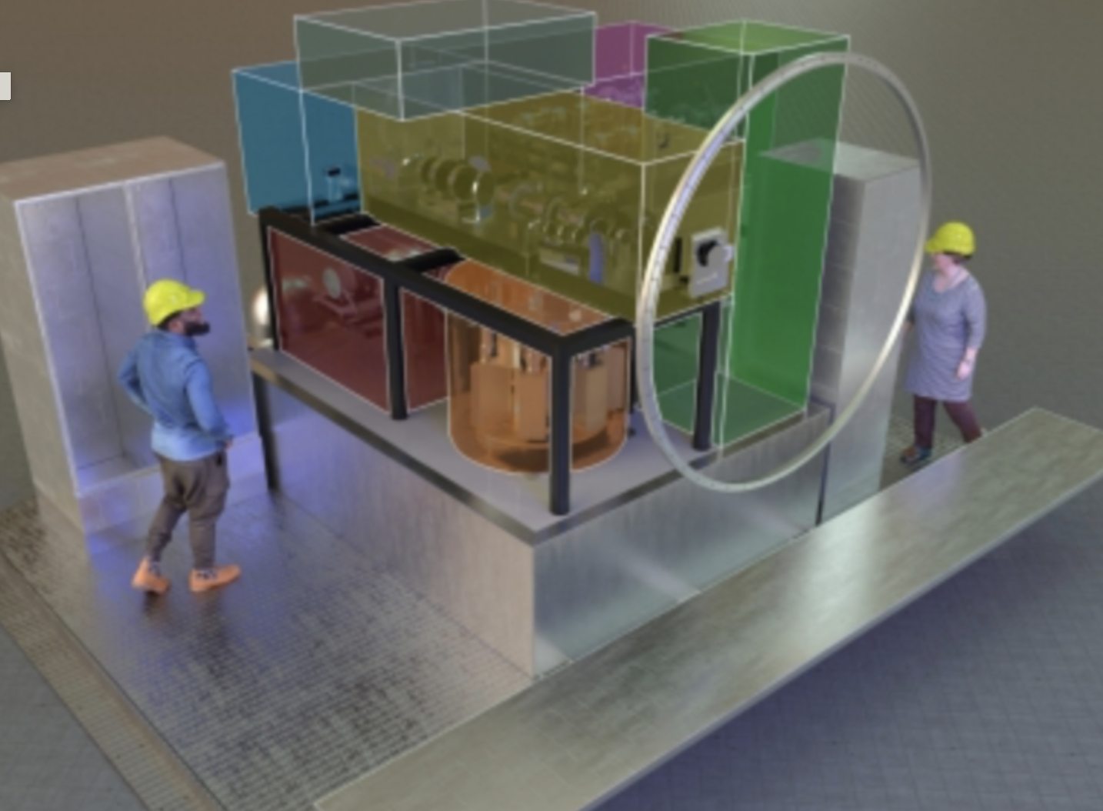
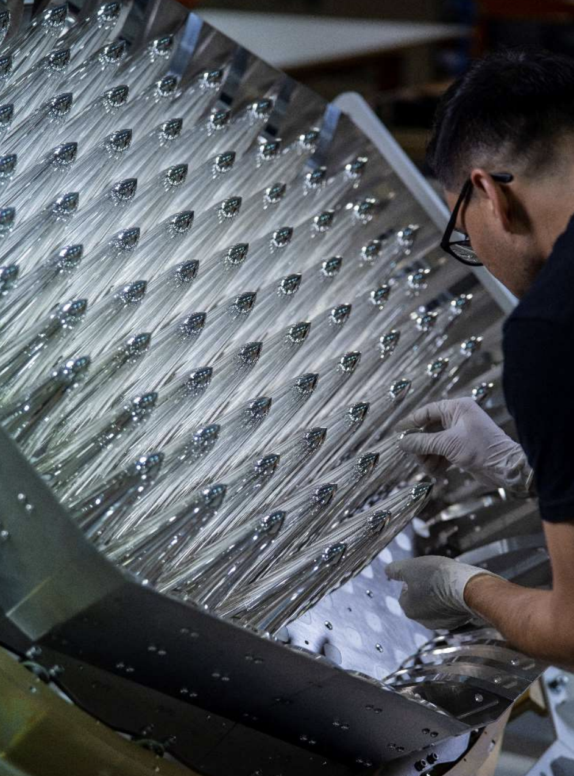
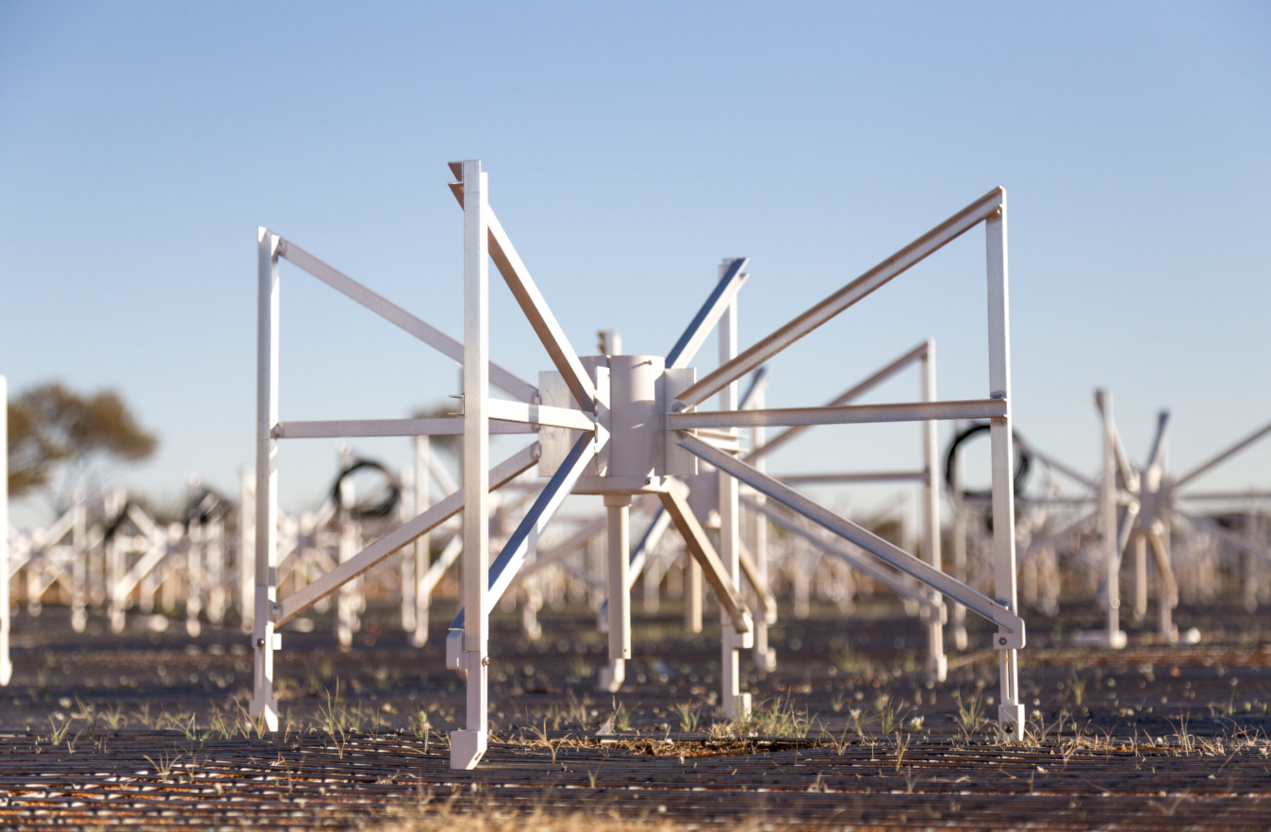
Instrumentation and Industry
Australia has continued to develop a world-class instrumentation program
In the past decade the AAO instrumentation group moved to Astralis, and other instrumentation groups at universities and CSIRO continued to grow
Instrumentation contributions form an important route for access to international collaborations for some telescopes.
Engagement with industry has grown particularly with SKA contracts (>$200M)
Credit: ESO
Parkes cryoPAF
Image Credit: CSIRO
Credit: ICRAR/Curtin

Slide 18
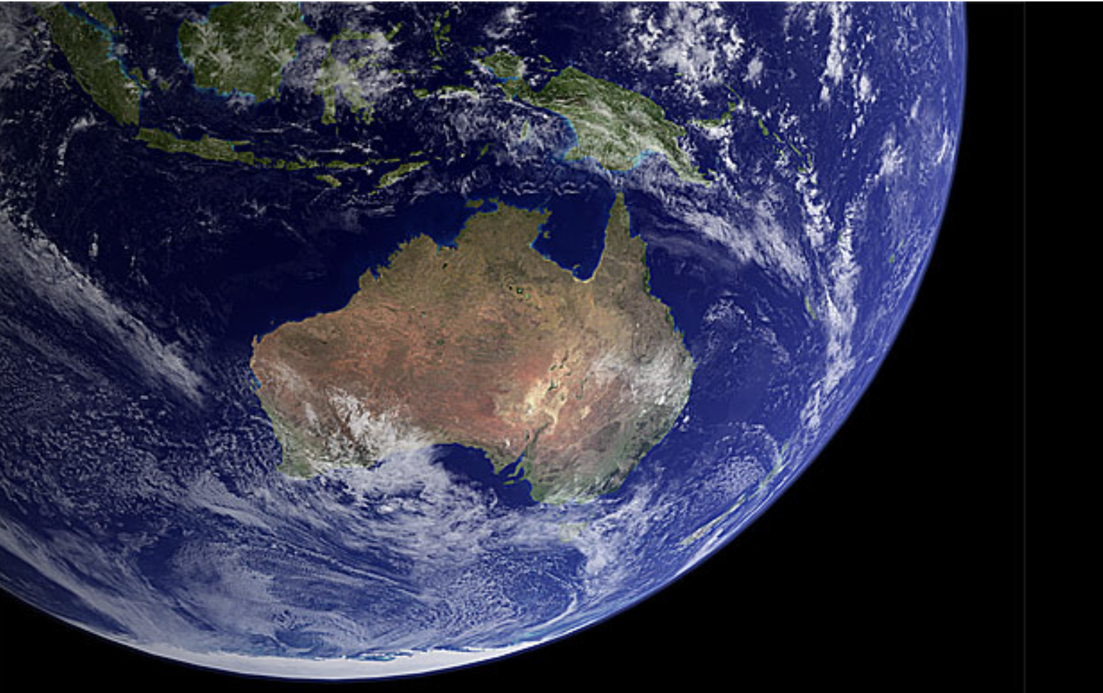
Priorities for the next decade
Community
Facilities

Slide 19
Facilities
Optical and mm
SKAO
Australian facilities
HPC, Data and Software
International collaborations
Instrumentation, Industry and Space
How can we support and grow Australia’s science, instrumentation, industry and international leadership?

Slide 20
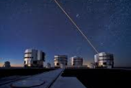
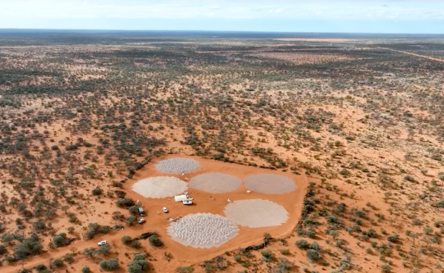
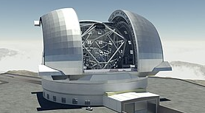
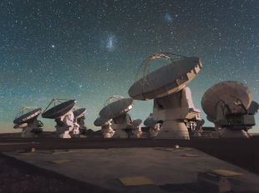
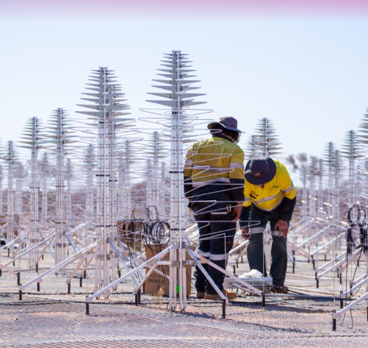
1&2: International access and leadership
Secure access to large optical telescopes
Capitalise on SKAO opportunities
Image credits: ESO
Image credits: SKAO

Slide 21
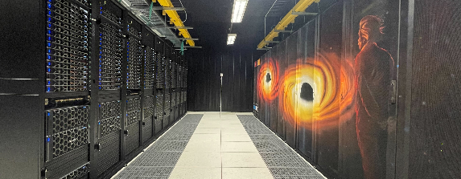
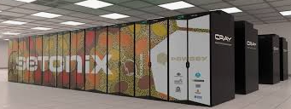
3. Access to HPC, Data and Software
Vital for the large-scale theory and observational projects coming in the next decade
Image credit: Swinburne
Astronomy’s leadership in this area working with the national landscape to uplift computing for other scientific disciplines
Investment required in access, data management, software development and careers
Image credit: Pawsey

Slide 22
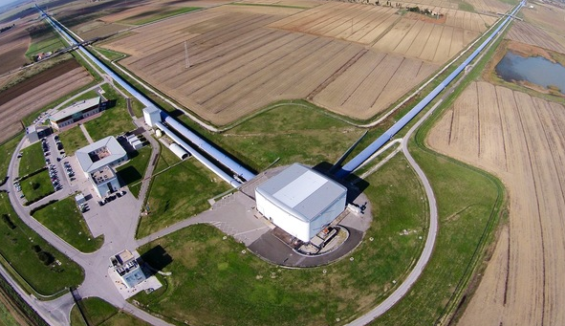
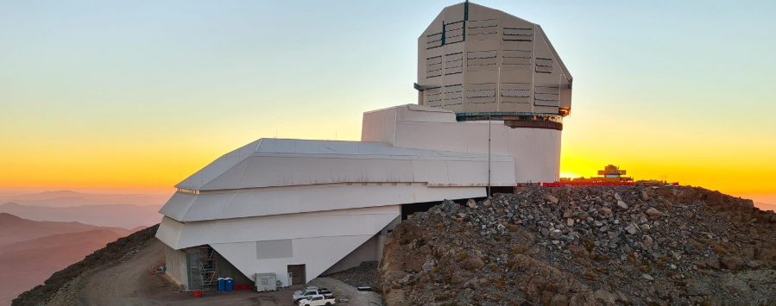
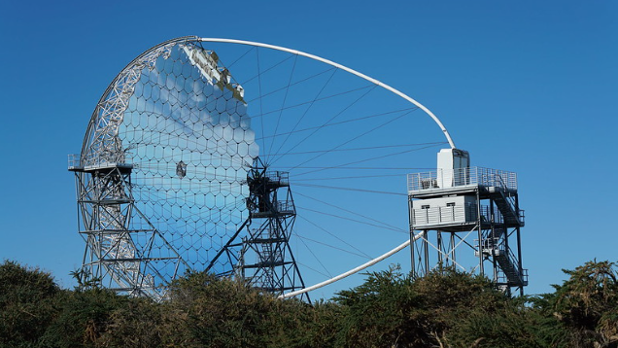
4. Enhance Australian Involvement in international collaborations
Recognising astronomy is an international endeavour and looking for stable pathways for access to key projects such as
LIGO
Rubin
CTA
Image credit: LIGO
Image credit: Rubin Obs./NSF/AURA
Image credit: Iván Jiménez (IAC)

Slide 23
5. Instrumentation Capability and Technology Development, including Space Technology
The establishment of long-term, stable funding available across this instrumentation landscape, will ensure that Australian instrumentation programs continue to thrive, innovate, lead scientific discoveries, and provide benefits to the community in the era of next-generation facilities.
Technology development, pathfinder missions and partnerships (e.g. SPIRIT, launched 2023) will be important, and capitalise on the industry linkages astronomical instrumentation has made over the past decade. Continuing these linkages and technology development mean that Australian astronomy can also be ready for instrument opportunities if the scope of the Australian space agency expands.
By the end of the decade Australia should have grown the capacity to participate in payload development for major missions. This should be achieved through the pursuit of new funding pathways that complement our existing ground-based instrumentation programs in collaboration with adjacent disciplines and with coordination between NCA and NCSS.

Slide 24
6. Australian advanced astrophysics facilities
Australia should maintain a vibrant domestic suite of telescopes and instrumentation to allow international collaboration that takes advantage of Australia’s fortuitous longitude (e.g. for transient follow-up from Rubin and LIGO)
Domestic facilities at the national and University level are currently very successful and a key training ground for Australian astronomers.
To maintain the primacy of Australian astrophysics in the future we should host world-leading telescopes and instrumentation. Building on the success of the SKAO, Australia should develop the pathway for major new multi-decade international efforts to build advanced facilities in Australia. Over the next decade we should fully develop a pathway to host a major gravitational wave observatory in Australia, as part of an international partnership. Australian access to space facilities could be strengthened by developing our domestic space capabilities ranging from payload development to ground stations.

Slide 25
Community
National coordination: Theory, Outreach, Industry, and Space
Focus on Education, Outreach and careers
Connections with First Nations Astronomy
Promote dark and quiet skies
And sustainable astronomy
How can we support and grow Australia’s astronomy community, and return value to Australia?

Slide 26
7. National coordination
A virtual national theoretical institute should be created
National coordination of outreach activities for maximum impact, and providing the opportunity for all school students to have an astronomy experience in the next decade
Establishment of a central body to promote and facilitate industry engagement with the next generation of global facilities
A strategic and coordinated approach should be taken to capitalise on Australia’s unique location for space-support operations

Slide 27
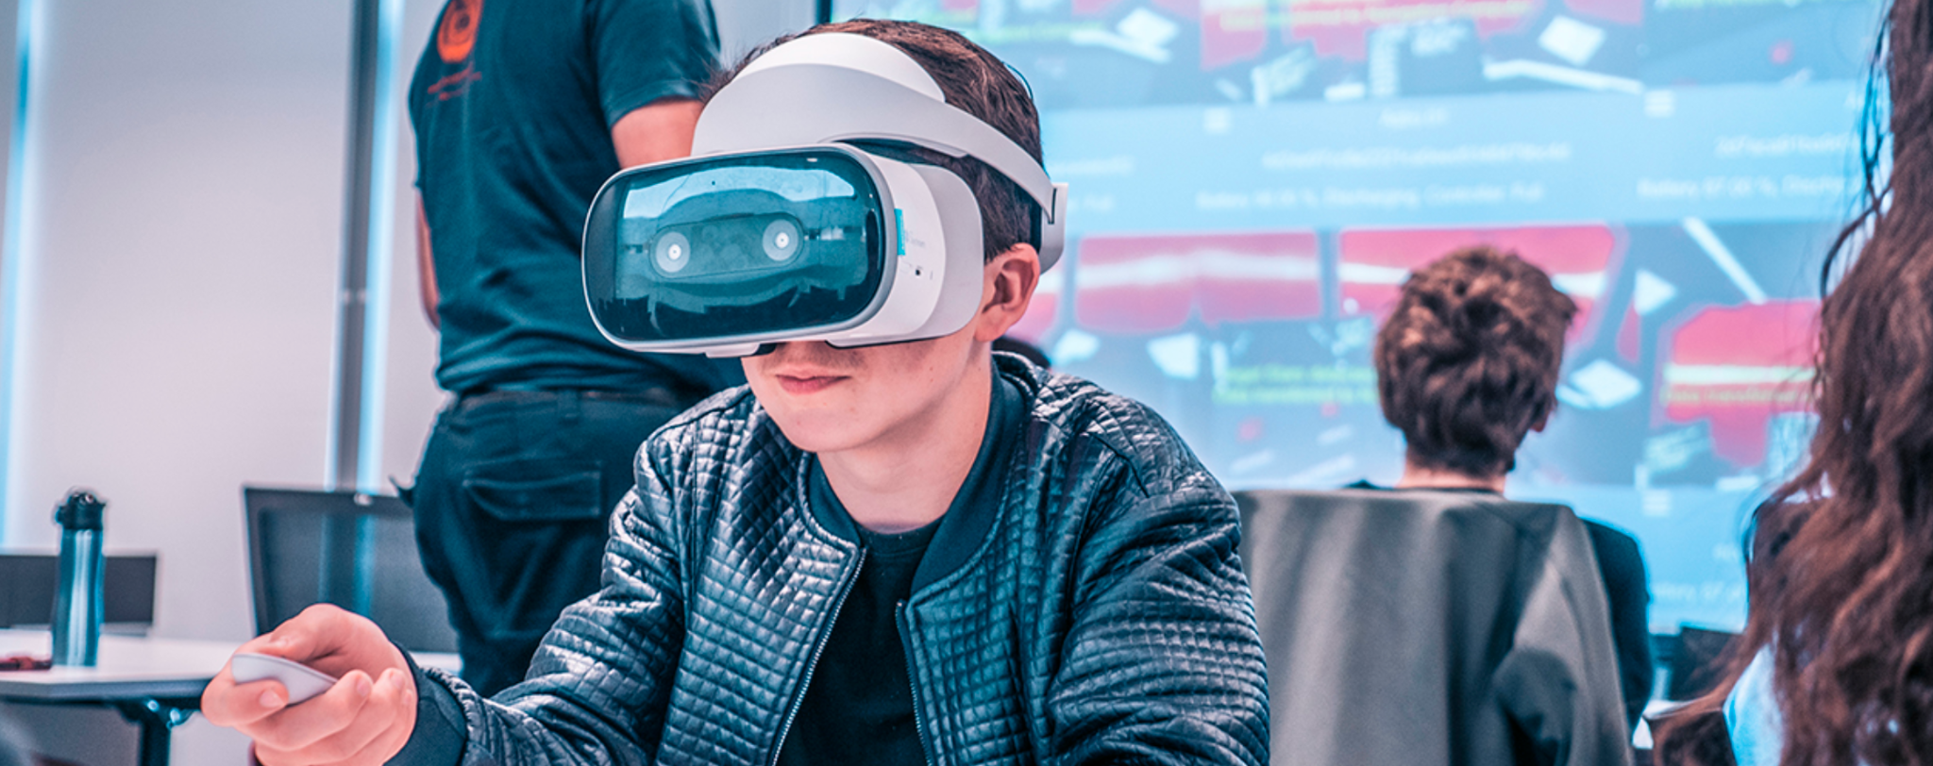
8. Education, Outreach and Careers
● Improve opportunities for education and training of early-career researchers
● Expand upon activities that support Indigenous students to thrive in STEM fields
● Support skills development and training programs to create a pipeline of students for STEM industries and researcher skills to enable future industry engagement.
● Work towards equity across all axes for astronomy staff so the Astronomy community more closely reflects the diversity in the Australian community. This includes renewing its focus on turning around the gender gap in PhD completions and expanding efforts to support underrepresented socio-economic groups and ethnic groups.

Slide 28
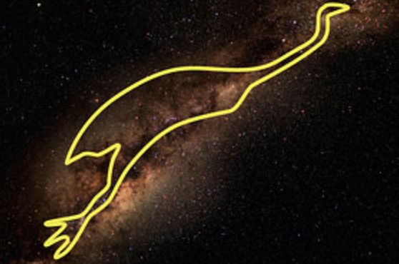
9. Build connections with First Nations Astronomy
Over the next decade, the astronomy community should build respectful connections with First Nations astronomers through the education of the astronomy community,
including observatories, universities and research centres.

Slide 29
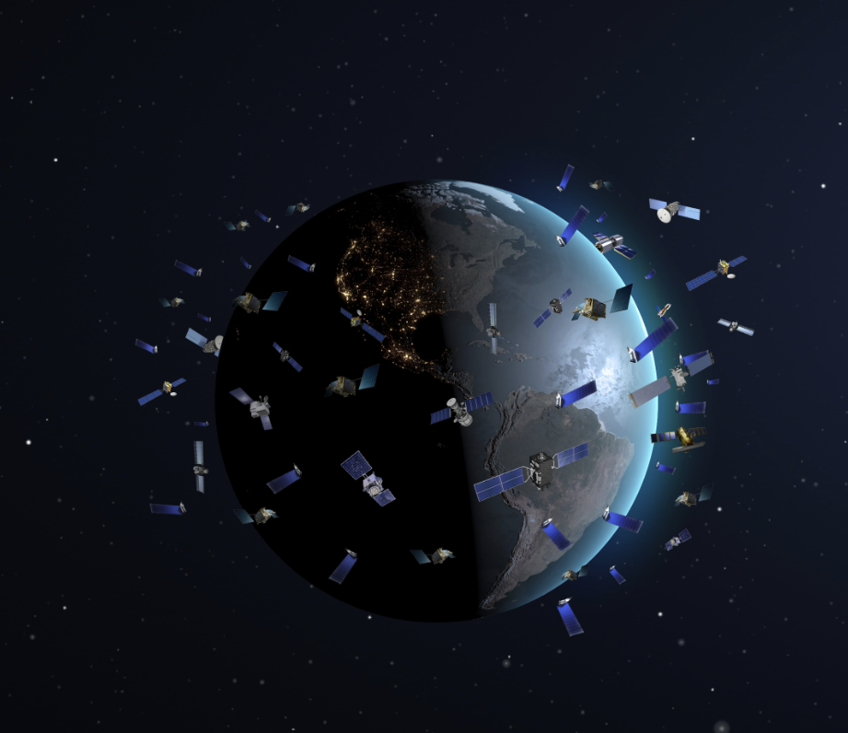
10. Promote Dark and Quiet Skies and Sustainable Astronomy
● Astronomy groups and universities to support dark sky conservation and light pollution mitigation tactics and research
● Astronomy groups and observatory sites to work with the government and the IAU Centre for Protection of Dark and Quiet Skies (CPS) to help mitigate satellite disruption to observatories
● Implement sustainable practices in astronomy activities including considerations around travel and green computing.

Slide 30
Science questions for the next decade
How do planets, stars, and galaxies evolve, and how is that evolution connected from the smallest to largest scales?
What is the dark Universe made of?
How does physics work in extreme environments?
What kinds of exoplanets exist and are they habitable?
In the Decadal Plan - Section 5 describes the questions, Section 6 looks at the facilities requirements

Slide 31
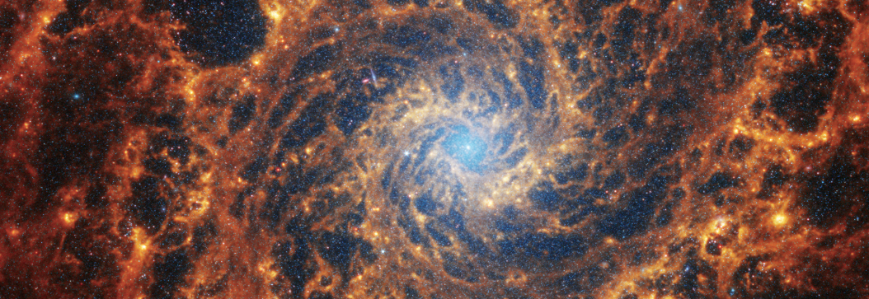
How do planets, stars, and galaxies evolve, and how is that
evolution connected from the smallest to largest scales?
Large, multiwavelength datasets and theory will make this type of study possible
a. How do galaxies evolve through multi-scale processes and what role does
environment play?
b. Where are the different elements forged? How are they transported to new
environments to form new generations of stars and planets?
c. What can the composition of the Milky Way’s stars tell us about our home
galaxy’s history?
d. What were the properties of galaxies and the intergalactic medium during the
Epoch of Reionization and Cosmic Dawn?

Slide 32
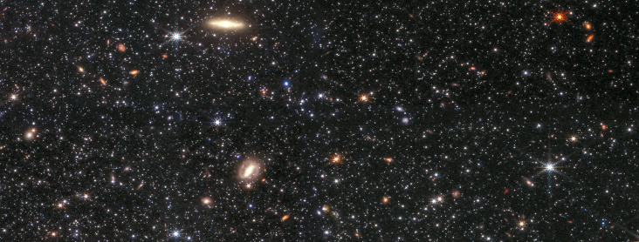
2. What is the dark Universe made of?
a. What are the properties of the black hole population across the Universe?
b. What is the expansion rate of the Universe, and how is it changing with time?
c. Can new particles or new physics explain dark matter and dark energy?

Slide 33
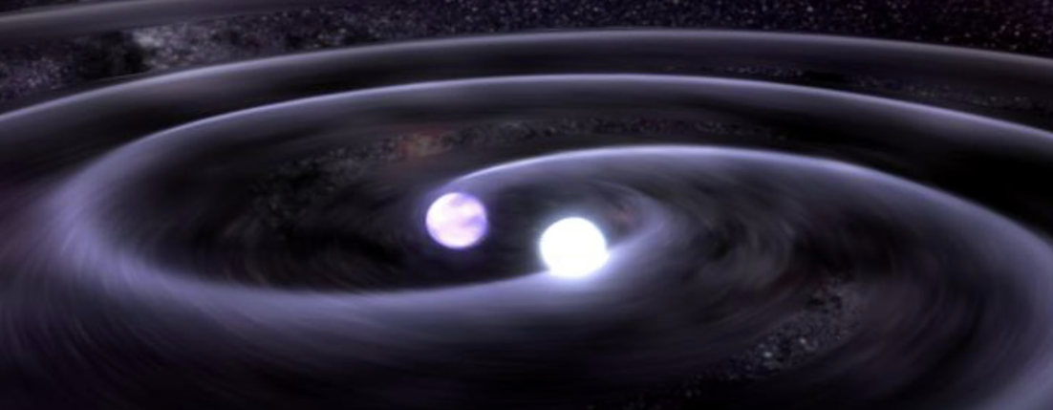
3. How does physics work in extreme environments?
a. What are the best models to explain the complex interiors of stars?
b. How does matter behave at extreme densities, such as in merging neutron stars?
c. What are the progenitors of gravitational waves, fast radio bursts, and other explosive events?

Slide 34
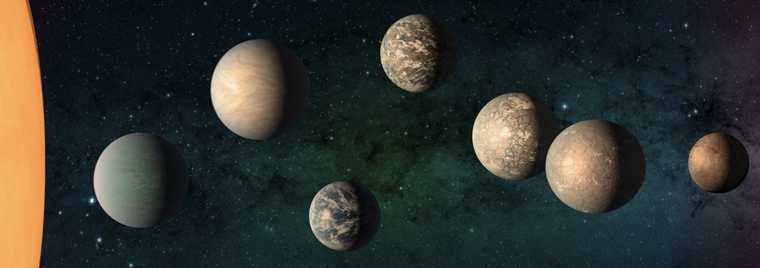
4. What kinds of exoplanets exist and are they habitable?
a. How do planetary systems — including systems like our own — form and evolve?
b. How do solar and stellar activity influence planetary atmospheres and their habitability?
c. How can we best detect signatures of other life in the Universe?

Slide 35
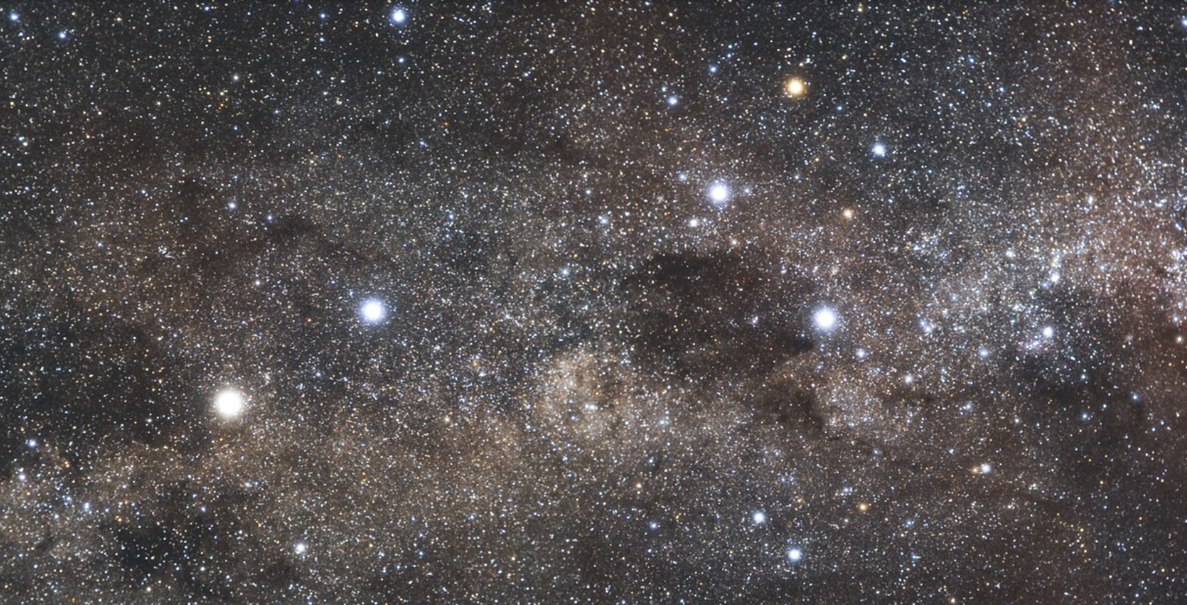
Questions?
https://www.surveymonkey.com/r/LSZX9N9
You can provide feedback and case studies here before 21 Feb

Slide 36
Thank you for your participation today!!

