Slide 1
ASTROPHYSICAL RESEARCH FROM BALLOON-BORNE PLATFORMS
Ravi Sood
School of Science
UNSW Canberra
&
Station Director, Balloon Launching Station
Alice Springs

Slide 2
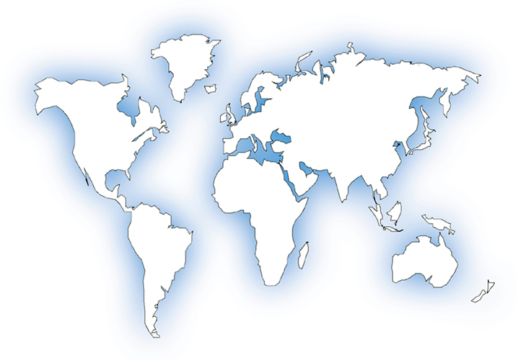
Locations from where I have carried out balloon operations (no. of flights)
Cardington, UK (6)
Alice Spr (80+)
Longreach (2)
Mildura (1)
Kampala,
Uganda (13)
Lusaka,
Zambia (4)
RAF Gan,
Maldives (4)

Slide 3
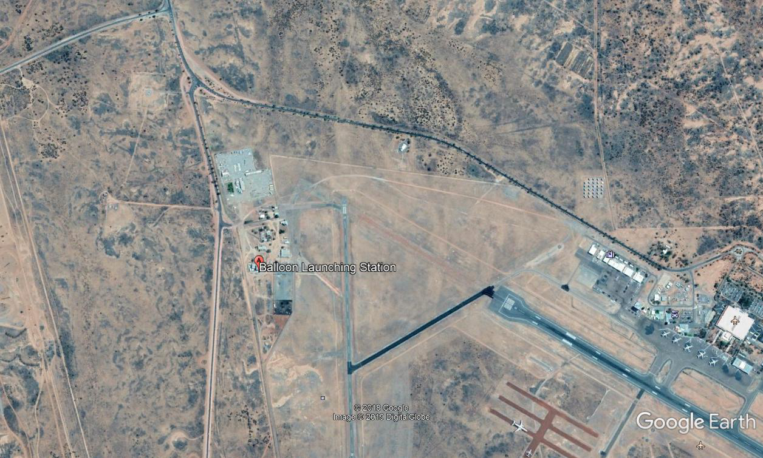
Layout of Balloon Launching Station

Slide 4
PAYLOAD READY FOR LAUNCH

Slide 5
SUMMARY OF PRESENTATION
Possible fields of research
Operational requirements and constraints
Advantages
Limitations

Slide 6
Why do we fly balloons into the stratosphere?
Astrophysics of stars and galaxies
Gamma-rays
X-rays
Infra-red radiation
Cosmic Radiation (heavy nuclei, anti-matter)
Study of the atmosphere
Climate change
Lightening, electric fields
Communications capability
Military, internet
Surveillance (Chinese balloon over USA????)

Slide 7
The Earth’s Atmosphere – residual pressure

Slide 8
The Earth’s atmosphere – temperature profile

Slide 9
HOW DO WE FLY BALLOONS AT THE EDGE OF SPACE?
AT SEA LEVEL
1 cubic meter volume balloon will displace 1 cubic meter of air
The density of air at sea level is 1.3 kg per cubic meter
Therefore a 1 cubic meter balloon can lift 1.3 kg near sea level
1 CUBIC METRE
1.3 kg

Slide 10
HOW DO WE FLY BALLOONS AT THE EDGE OF SPACE?
AT 20 KM ALTITUDE
Density of air is 0.09 kg per cubic meter
To lift 1.3 kg to 20 km altitude, we need to displace (1.3/0.09) = 15 cubic meters of air
We therefore need a 15 cubic meter volume balloon to lift 1.3 kg to 20 km altitude
15 CUBIC METRES
1.3 kg

Slide 11
HOW DO WE FLY BALLOONS AT THE EDGE OF SPACE?
AT 40 KM ALTITUDE
Density of air is 0.0039 kg per cubic meter
To lift 1.3 kg to 40 km altitude, we need to displace (1.3/0.0039) = 330 cubic meters of air
We therefore need a 330 cubic meter volume balloon to lift 1.3 kg to 40 km altitude
330 CUBIC METRES
1.3 kg?

Slide 12
Balloon inflation

Slide 13
Balloon at 40 km float altitude

Slide 14
Australian launch sites
Alice Springs (1972)
Longreach (1966)
Charleville (1988)
Oakey (1981)
Broken Hill (1977)
Parkes (1970)
Mildura (1960)

Slide 15
Why Alice Springs?
85% of population lives within 50 km of coastline
Vast areas are available for safe ballooning
Our balloons drift in East-West direction
Perfect view of the Galactic Centre
< 0.1 persons per km²

Slide 16
Balloon Flight Duration: 3-5 days during “turnaround”

Slide 17
Flight duration for round-the-world flights–EOSCOR 1983
Koga et al. (1985)
CWRU/Univ. Melbourne
Solar neutron experiment
Altitude: 130kft (day) 70kft (night)
Duration: 22 days

Slide 18
Start of scientific ballooning in Australia
Univ. Melbourne (1952)
Nuclear emulsions
1953 → 38 km
Univ. Melb / CSIRO (1958-1980’s)
Atmospheric aerosols
Univ. Tasmania (1958-61)
γ-rays from radioactive nuclei ( nuclear testing fallout)

Slide 19
The start of a National Facility
Australian Balloon Launching Station set up at Mildura for US Atomic Energy Commission
Atmospheric monitoring for radioactive fallout from nuclear weapons testing
First flight 17 Dec 1960
Up to 750 flights by Dec 1974
Increasing international interest in astronomy-based balloon-borne projects in 1960s.

Slide 20
Scientific flights 1966-71 Participating groups
Univ. of Melbourne – H.E. γ-ray, emulsions, aerosols, IR
Univ. of Adelaide – X-ray
Univ. of Tasmania – L.E. γ-ray
CSIRO - aerosols
GSFC – H.E. γ-ray, L.E. γ-ray
MIT – X-ray
Case Western Reserve Univ. H.E. γ-ray
Rice Univ. – X-ray
Univ. of Minnesota – Cosmic Radiation
Univ. College, London - IR
Univ. California – X-ray

Slide 21
Some scientific highlights 1966-71
MIT (Lewin): 15 Oct 70
34 MCF balloon from Mildura, 147 kft (44.8 km) float
Discovery of variable sources GX 1+4, GX 301-2, GX 304-1
Spectra of 16 X-ray sources & 10 pulsars

Slide 22
Some scientific highlights – 1966-71
Uni. Melb / CWRU (Hopper / Frye)
Discovery of 10-30 MeV pulses from Vela (PSR 0833-55)
Measurement of isotropic background at 20-50 MeV (30.2 MCF, 220 kg payload, altitude attained: 159.4 kft, 4 Dec 69)

Slide 23
1981-88
Australian government support of ABLS ceased in 1981
Operations transferred to Univ. of Melbourne / UNSW@ADFA
Balloon campaigns on ad hoc basis
Univ. Melbourne / UNSW@ADFA
NSBF (USA)
UNSW/ISAS (Japan)
CNES/IAS (France/Japan)
On-going funding support from NASA since 1985
NASA operations in Australia covered by US/Aus Treaty since 1992

Slide 24
Supernova 1987A
SN in Large Magellanic Cloud galaxy – 23 Feb 1987
First flight on day 54 from Alice Springs
UNSW Canberra, Imperial College, IAS, AIT, TIFR (γ-ray/X-ray)
NASA campaigns
April 87
Oct 87
Mar 88 – described as the “most extensive and successfully completed remote campaign ever conducted by NASA”
Oct 88
Mar 89
Opportunity to study both LMC and Galactic Centre

Slide 25
Supernova 1987a 6 Mar - 18 May 88 campaign
GROUP (PI) | DATE | SCIENCE PAYLOAD (kg) | DURATION (hrs)
UNSW (Sood) | 4 Apr | 395 | 13.8
MSFC (Fishman) | 7 Apr | 817 | 41.4
Caltech (Prince) | 11 Apr | 1436 | 33.5
UCR (White) | 14 Apr | 1021 | 58.2
MIT (Cheng) | 18 Apr | 288 | 13.0
GSFC (Teegarden) | 30 Apr | 1677 | 28.5
NRL (Johnson) | 16 May | 1075 | 12.6
Harvard (Grindley) | 17 May | 1251 | 12.3

Slide 26
Supernova 1987a March 1989 campaign

Slide 27
Some scientific highlights 1971-89
511 keV annihilation line from Galactic Centre
Time variability allowed constraints on emitting region
Subsequent data consistent with two-component model
Variable point source near GC
Steady diffuse source
Includes 1988 campaign by CNES/IAS in Charleville (FIGARO II)
Levanthal (1991)

Slide 28
Recent and current balloon campaigns
NASA CAMPAIGNS – Alice Springs
1995
2002
2009
2010
NASA Round the World campaigns from Wanaka, NZ
2016
2017 (note flight-path!)
2020
2022
2023
2025 (starting on 1 March)

Slide 29
Japanese Space Agency JAXA campaign 2015 Alice Springs
GRAINE PAYLOAD (Gamma-ray Astro-Imager with Nuclear Emulsions)
Nuclear Emulsions
Study of gamma-rays 10 MeV-100 GeV
Vela Pulsar
Collaboration with Sydney University

Slide 30
French Space Agency CNES campaign - 2017 Alice Springs
A three-flight balloon campaign involving the French Space Agency, CNES, took place from Alice Springs Airport in March to May 2017. The three experiments flown were:
CLIMATE gondola – study of concentration of greenhouse molecules in the upper atmosphere
CARMEN gondola – imagery of stratosphere to measure aerosol, cloud, smoke and dust
PILOT gondola – infrared study of dust grains in the interstellar medium
Ninety-five personnel from France were in Alice Springs for the campaign.

Slide 31
Japanese Space Agency JAXA campaign – 2018 Alice Springs
A three-flight campaign was planned for Feb – May 2018. Three flights were scheduled for the campaign:
FITE gondola – Far-Infrared study of star formation regions and interstellar dust
SMILE-2 gondola – Low energy gamma-ray imaging study of stellar nucleosynthesis and particle acceleration
GRAINE gondola – High energy gamma-ray imaging study of celestial compact objects and pulsars.
The FITE payload could not be launched, as the campaign window closed due to stratospheric wind conditions.

Slide 32
Japanese Space Agency JAXA campaign – 2023 Alice Springs
A three-flight campaign was planned for Feb-May 2023. One flight of each gondola successfully took place:
GRAINE gondola – High energy gamma-ray imaging study of celestial compact objects and pulsars (two separate flights)
SRC gondola – Drop test of sample return capsule of Martian Moons Exploration mission (one flight).

Slide 33
SRC & GRAINE FLIGHT TRAINS

Slide 34
GRAINE payload ready for launch

Slide 35
GRAINE Payload at end of flight

Slide 36
Future of Australian space-based astronomy using balloons
Low cost compared to satellite-based experiments
Perfect location for study of Milky Way Galaxy, LMC, SMC
Low timescale from conception to results – ideal for PhD projects
Current US-Australia Treaty provides flight opportunities
Balloon Launching Station facility in Alice Springs
Ideal platform for testing/qualifying satellite-borne experiments
NEED SUPPORT FROM AUSTRALIAN SPACE AGENCY!

