Slide 1
Prof. Dr. Alexander Proelss
Oceanic Carbon Storage & Abatement:
An International Law Perspective
TEM – CENRIT Evening Seminar
27 February 2024, Macquarie University

Slide 2
Structure
I. Background
International Legal Regime
EU Legal Framework
Situation in Germany

Slide 3

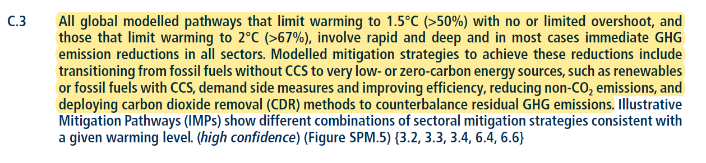
I. Background
2015 Paris Agreement on Climate Change: Keep global mean temperature to “well below 2°C” and “pursue efforts” to cap warming at 1.5°C!
Primary effort must focus on reducing CO₂ emissions, but …
… latest IPCC Report (2022, p. 28) states that Carbon Capture and Storage (CCS) and CO₂ removal technologies are needed to limit the average global temperature rise to 1.5 - 2.0°C:

Slide 4
I. Background
On Carbon Dioxide Removal (CDR), see also:
  IPCC 2018 (Special Report on Global Warming of 1.5°C, Summary for Policymakers, p. 19):
    “All pathways that limit global warming to 1.5°C with limited or no overshoot project the use of carbon dioxide removal (CDR) on the order of 100–1000 Gt CO2 over the 21st century. […] (high confidence).”
  UNEP 2017 (UNEP Emissions Gap Report, p. 65):
    “In order to achieve the goals of the Paris Agreement, to keep the global mean temperature increase well below 2°C (or even below 1.5°C), carbon dioxide removal is likely a necessary step.”

Slide 5
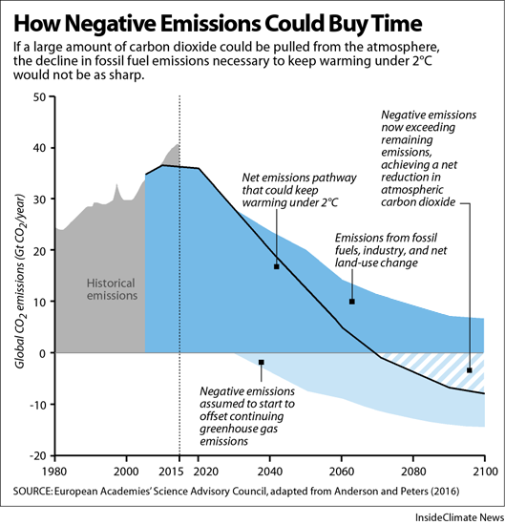

Slide 6

I. Background
What is the difference between CCS and CDR?
  CCS: Sequestration of CO₂ directly at source (thus no
  CO₂ emissions into the atmosphere) and subsequent
  storage in onshore and/or offshore storage facilities
    IAEA 2008: CCS as “key carbon abatement option”
  CDR: Capture of CO₂ that has already been emitted into the atmosphere and subsequent storage

Slide 7
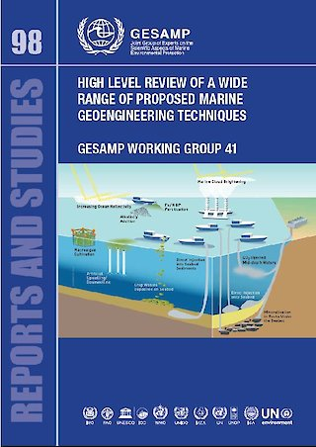
I. Background
Wide array of marine carbon dioxide removal (mCDR) approaches presently under investigation (see next slide)
  Note existing terminological confusion: mCDR,
  marine geoengineering, ocean interventions for
  climate change mitigation, ocean-based negative
  emissions technologies etc.
  In March 2021, the Joint Group of Experts on the
  Scientific Aspects of Marine Environmental Protection
  (GESAMP) Working Group 41 suggested the term
  “ocean interventions for climate
  change mitigation” to replace “marine
  geoengineering”

Slide 8
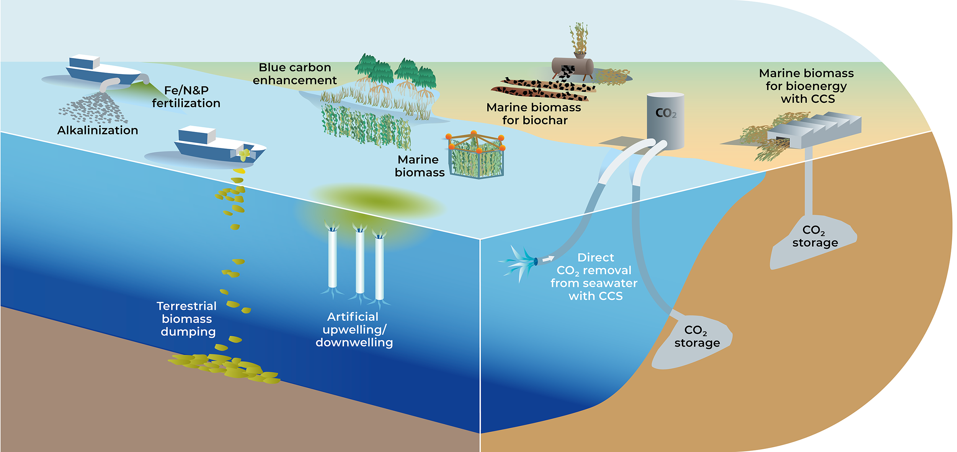
I. Background

Slide 9
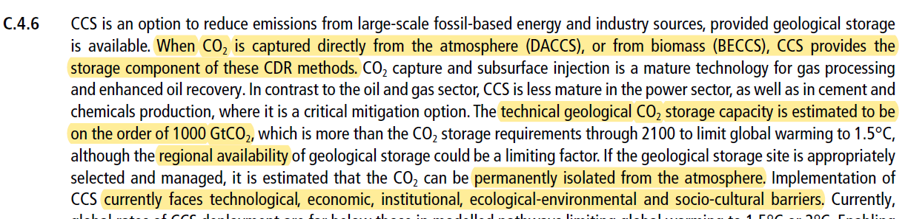
I. Background
  Overlaps and potential (see IPCC 2022, p. 32):

Slide 10
I. Background
    In 2009, it was expected that 100 storage projects would be set up worldwide by 2020
    With the exception of Norway, where CO₂ captured during natural gas extraction has been stored in the Norwegian continental shelf since 1996, CCS has not yet been implemented on a large scale in Europe
    However, this situation is likely to change in the near future
      Ever increasing pressure to act against global warming
      Several projects being planned to store CO₂ from industrial sources in disused oil and gas fields or in sandstone formations
      Opposition to CCS and CRD has declined (even in Germany!)
⟶ DecarbLaw is a highly topical project!

Slide 11

58 companies working on ocean-based CDR*
Field experiments and pilot studies are already being conducted by some!
*excluding those working on “blue carbon”
W. Rickels

Slide 12
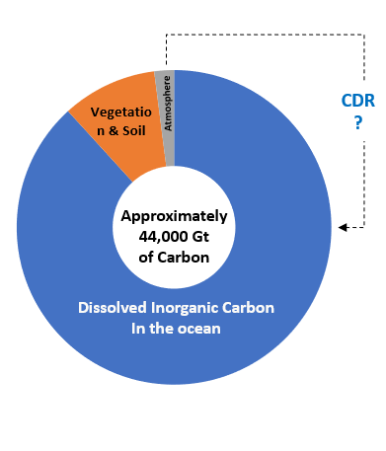
I. Background
Why marine CCS and CDR then?
  Conflicting land uses
  Ocean covers most of the Earth’s surface
  ⟶ generally less competition for space
  when compared to land
  Ocean holds most of the carbon in the active carbon cycle
  ⟶ Massive carbon storage capacity in an area where most anthropogenic carbon will ultimately end up
  For Europe, scientific studies attribute the majority of storage capacity to offshore areas

Slide 13
I. Background
    Storage capacity of formations in offshore areas under German sovereignty/jurisdiction in the North and Baltic Seas is roughly estimated at 3.8 to 23.9 Gt of CO₂
    For comparison, around 0.18 Gt of CO₂ were emitted by industrial processes in Germany in 2021
What is the industry’s interest?
  Potential inclusion of CCS and (m)CDR into carbon credit markets
  But considerable challenges concerning provision of sufficient incentives, monitoring, crediting as well as technical challenges

Slide 14
II. International Legal Framework
Challenge:
  All mCDR activities characterized by varying degrees of scientific uncertainty concerning their feasibility as well as their potential negative impacts on the environment
    → high and continuing relevance of (marine) scientific research (far less so in relation to CCS, however)
Starting points:
  Relevance of international law due to the potential transboundary effects of virtually all relevant activities
  Zonal approach of the international law of the sea

Slide 15
II. International Legal Framework
  Only one international legal regime available that has been amended to specifically address CCS and mCDR:
    1996 London Protocol to the 1972 London Convention on the Prevention of Marine Pollution by Dumping of Wastes and Other Matter (LC/LP)
  Other potentially relevant multilateral agreements include:
    1992 UNFCCC and Paris Agreement
    1992 Convention on Biological Diversity (CBD)
    1982 United Nations Convention on the Law of the Sea (UNCLOS)
    Regional agreements (e.g. OSPAR, HELCOM etc.)

Slide 16
II. International Legal Framework
Zonal approach:
  Internal waters and
  territorial sea are subject to
  the sovereignty of the coastal State
    Coastal State is thus entitled to approve and regulate carbon storage projects without further ado
    Certain limitations arise from the right of other States of innocent passage in the territorial sea

Slide 17
II. International Legal Framework
  Continental shelf:
    Coastal State has sovereign rights over the continental shelf “rights for the purpose of exploring it and exploiting its natural resources” (Article 77 (1) of UNCLOS)
    No mention of carbon storage, but …
    … an interpretation of relevant UNCLOS provisions suggests that any activity associated with interventions in the continental shelf is covered by the sovereign rights of the coastal State, also taking into account
      According to Article 81 of UNCLO, the coastal State has the exclusive right to authorize and regulate drilling on the continental shelf “for all purposes”

Slide 18
II. International Legal Framework
      Article 85 of UNCLOS: rights concerning tunneling
      Factual similarities between carbon storage and exploitation of natural resources
Offshore CCS:
  Sub-seabed storage of CO₂ must be compatible with State obligations concerning protection of the marine environment
  Relevance of LC/LP
  Which States are bound to the London Protocol?
    Its 53 contracting parties (incl. Australia, Germany) AND …

Slide 19
II. International Legal Framework
    … arguably also all (other) contracting parties to UNCLOS
    (altogether 168 States and the EU)!
    Why this?
      Article 210 (6) of UNCLOS (addressing pollution by dumping) contains a ‘renvoi’ to “global rules and standards”
      “Global rules and standards” is generally understood as a reference to the London Convention and the London Protocol, which are specifically applicable to pollution by dumping
      ⟶ UNCLOS is further developed by LC/LP

Slide 20
II. International Legal Framework
  Is sub-seabed storage of CO2 “dumping”?
    According to Article 1.4.1.1 LP as well as Article 1 (5)(a) of UNCLOS, “dumping” is
        “any deliberate disposal at sea of wastes or other matter from vessels, aircraft, platforms or other man-made structures at sea”
    Article 1.7 LP clarifies that the term “marine waters” used throughput the Protocol also includes the seabed and subsoil (with the exception of deposits under the seabed that are only accessible from land)
    ⟶ Injection of CO2 into seabed structures is clearly dumping

Slide 21
II. International Legal Framework
    Dumping is generally prohibited by the LP, unless it is expressly allowed by way of inclusion of the relevant substances in annex 1
    In 2006, section 1.8 (“Carbon dioxide streams from carbon dioxide capture processes for sequestration”) was added to Annex 1 LP (“2006 amendment”)
    ⟶ Subject to the granting of a licence by the competent authority under domestic law (see Article 4.1.2 LP), CO₂ can now be permissibly stored in the seabed
      Note that storage in water column remains prohibited!
    Duty to observe requirements on composition of CO₂ stream, risk management and monitoring included in section 4 of Annex 1 LP, in the new Annex 2, and in several relevant decisions and resolutions of the contracting parties

Slide 22
II. International Legal Framework
Export of CO₂ for storage purposes:
  Article 6 LP establishes a prohibition of authorising the export of waste and other substances to other states for dumping or incineration at sea
  In 2009, Article 6 LP was amended by a new para. 2 specifically enabling transboundary export of CO₂ for the purpose of storage (“2009 amendment”)
  Amendment not yet in force!

Slide 23
II. International Legal Framework
  In 2019, contracting parties to the LP agreed by way of consensus decision to create the possibility of provisionally applying amended Article 6 LP (see Article 25 (1) (b) VCLT)
  Two conditions:
    Only between States that have made a corresponding declaration in accordance with Resolution LP.5(14)
    Conclusion of an agreement or arrangement between the exporting and the importing State

Slide 24
II. International Legal Framework
mCDR:
  Article 1.4.2.2 LP (as well as Article 1 (5)(b)(ii) of UNCLOS) contains an exception clause, under which
    “‘Dumping’ does not include: […] (ii) placement of matter for a purpose other than the mere disposal thereof, provided that such placement is not contrary to the aims of this Convention.”
  Thus, decisive question is whether mCDR is contrary to the aims of the Convention
  This issue has been addressed by the parties to the LC/LP since October 2008

Slide 25
II. International Legal Framework
    Resolution LC-LP.1 on the Regulation of Ocean Fertilization:
      “AGREE that, given the present state of knowledge, ocean fertilization activities other than legitimate scientific research should not be allowed. To this end, such other activities should be considered as contrary to the aims of the Convention and Protocol and not currently qualify for any exemption from the definition of dumping […]” (para. 8)
      “AGREE that scientific research proposals should be assessed on a case-by-case basis using an assessment framework to be developed by the Scientific Groups under the London Convention and Protocol”

Slide 26
II. International Legal Framework
    Adoption of (non-binding) Assessment Framework for Scientific Research Involving Ocean Fertilization by way of Resolution LC-LP.2 (2010)
      Tool to provide for responsible (“legitimate”) scientific research
    → Differentiation between legitimate and non-legitimate scientific research decides upon whether or not activity constitutes unlawful dumping
  Important development: 2013 Amendment to the London Protocol
    2013 amendment to the London Protocol proposed by Australia, Nigeria and the Republic of Korea

Slide 27
II. International Legal Framework
    Proposal was adopted by consensus in October 2013 but will only enter into force following ratification of 2/3 of the (53) parties to the London Protocol
    At present only six ratifications (Estonia, Finland, Germany, Netherlands, Norway, United Kingdom)
    Applicability depends on whether Contracting Parties have decided to include the activity concerned in new Annex 4 to the London Protocol
      So far only ocean iron fertilization

Slide 28
II. International Legal Framework
      In 2022, the Correspondence Group on Marine Geoengineering re-established by the Scientific Groups of the LC/LP agreed on four other techniques to be considered for listing in new annex 4 to the Protocol:
        Enhancing ocean alkalinity
        Macroalgae cultivation and other biomass for sequestration including artificial upwelling
        Marine cloud brightening
        Microbubbles/reflective particles/material
        Consented by the COP/MOP of the LC/LP in a 2022 Statement on Marine Geoengineering, but not yet included in annex 4

Slide 29
II. International Legal Framework
    Art. 6bis LP generally prohibits the placement of matter for marine geoengineering activities NOT listed in Annex 4
    The equally new Annex 5 transforms the Assessment Framework (concerning ocean iron fertilization) into a (potentially) legally binding text
    Reflects a comparatively strict implementation of the precautionary approach by foreseeing at several stages of the assessment that a permission should not be granted if no sufficient evidence is provided that the activity concerned is not likely to produce adverse effects to the marine environment

Slide 30
II. International Legal Framework
Recent developments:
  Establishment of Legal Intersessional Correspondence Group on Marine Geoengineering (LIGC) in 2023
  Production of a document outlining preliminary considerations concerning the provisional application of the 2013 amendments
    Document notes that the provisional application of the amendments would appear in line with international law
    Is 2013 amendment going to follow the model of the 2009 amendment concerning sub-seabed storage of CO₂???

Slide 31
III. EU Legal Framework
Directive 2009/31/EC of the European Parliament and of the Council on the Geological Storage of Carbon Dioxide (“CCS Directive”)
  Provides a binding legal framework for the EU Member States for environmentally sound geological storage of CO₂
  Must be implemented by the Member States in their domestic legal systems
  Also applies in the EEZ and on the continental shelf
  But: Authorizes Member States not to allow storage on parts or all of their territories
  According to EU COM, CCS Directive embodies the agreement between the EU Member States required for transboundary export of CO₂

Slide 32
III. EU Legal Framework
EU ETS
  While the EU pursues the aim to safeguard that the emission cap in the European Emission Trading System (EU ETS) becomes net negative before 2050, no mechanism allows for the inclusion of CO₂ removal credits issued in exchange for certified atmospheric CO₂ removal, in the EU ETS to date
  Concerning the impact of CCS, market participants are merely not obliged to surrender allowances for emissions which have been captured and transferred to an authorised installation for permanent storage
Net Zero Industry Act (2023 Proposal of the EU COM)
  Inter alia, aims at facilitating and enabling CCS projects, including by enhancing the availability of CO₂ storage sites

Slide 33
IV. Situation in Germany
Exiting domestic legislation essentially aimed at preventing CCS and mCDR:
  2012 Carbon Dioxide Storage Act
    Serves to implement the EU CCS Directive
    Covers EEZ and continental shelf
    But: Establishes numerous obstacles for carbon storage (e.g. deadline for applications for the authorization of storage facilities with a capacity of no more than 1.3 mio t of CO₂ expired on 31 December 2016)
  1998 High Seas Dumping Act
    Amended in 2018 by Act on the restriction (!) of marine geoengineering
    Tightens regulations of the London Protocol

Slide 34
IV. Situation in Germany
Since 2022, there are increasing signs that Federal Government and Parliament is intending to change its regulatory approach
February 26th, 2024: Announcement of key elements of “Carbon Management Strategy”
  Storage:
    Germany will allow exploration of offshore storage sites in its Exclusive Economic Zone (EEZ) or the continental shelf; if suitable, safe and in line with ecological criteria, CCS shall be developed for industrial utilization
    Injection of carbon dioxide in marine protected areas excluded
    No onshore carbon storage, but Federal States can request opt-in possibility to be put in law

Slide 35
IV. Situation in Germany
  Export:
    Planned ratification of 2009 amendment to the London Protocol
    Declaration on provisional application of Article 6 LP in order to enable export of CO₂
    Construction of privately-owned pipeline network, abolish hurdles for new projects
  mCDR:
    Potential amendment of High Seas Dumping Act (but still uncertain)

