Slide 1
Habitable Worlds Observatory & NASA opportunities
Tom Greene
(NASA Ames Research Center), HWO camera scientist
February 19/20, 2025
Notes:
11:35-12:05
30 mins including WG co-chair updates

Slide 2
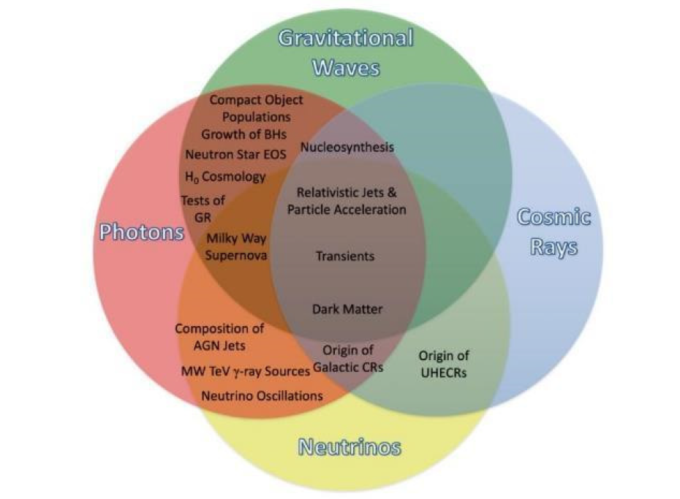
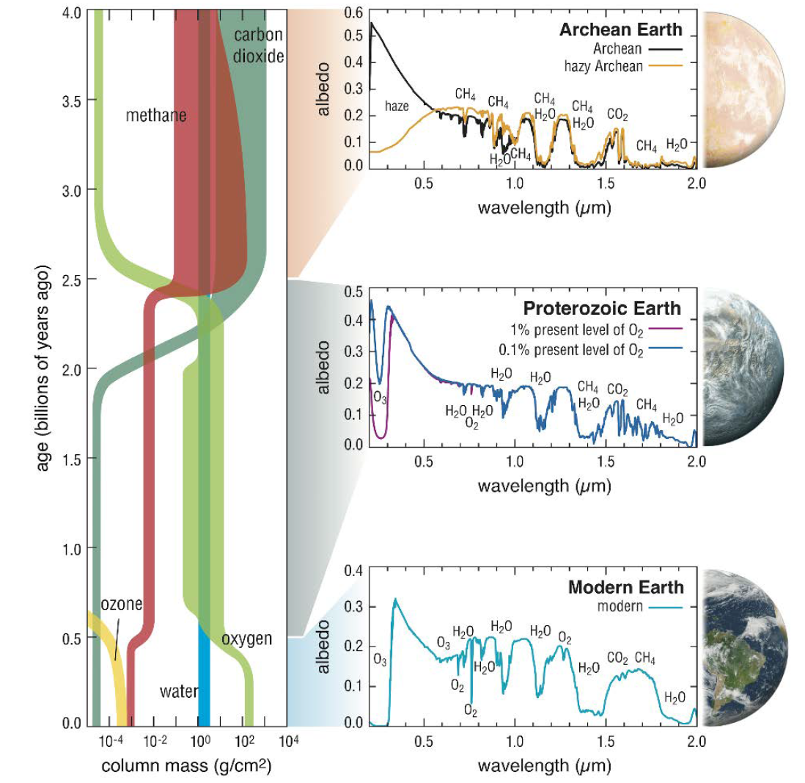
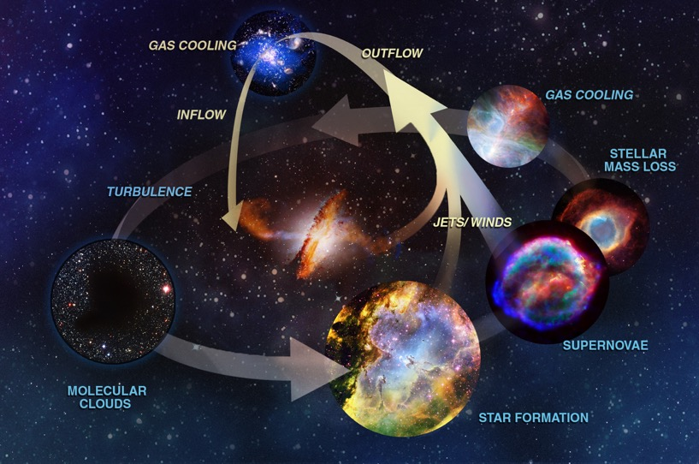
Astro2020 Science Themes
New Messengers & New Physics:
New Windows on the Dynamic Universe
Worlds and Suns in Context:
Pathways to Habitable Planets
Cosmic Ecosystems: Unveiling the Drivers of Galaxy Growth

Slide 3
Astro2020 Science Themes
New Messengers & New Physics:
New Windows on the Dynamic Universe
Worlds and Suns in Context:
Pathways to Habitable Planets
Dark Matter?
Habitable Worlds Observatory
Cosmic Ecosystems: Unveiling the Drivers of Galaxy Growth

Slide 4
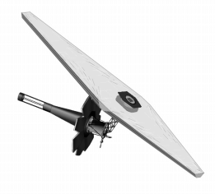
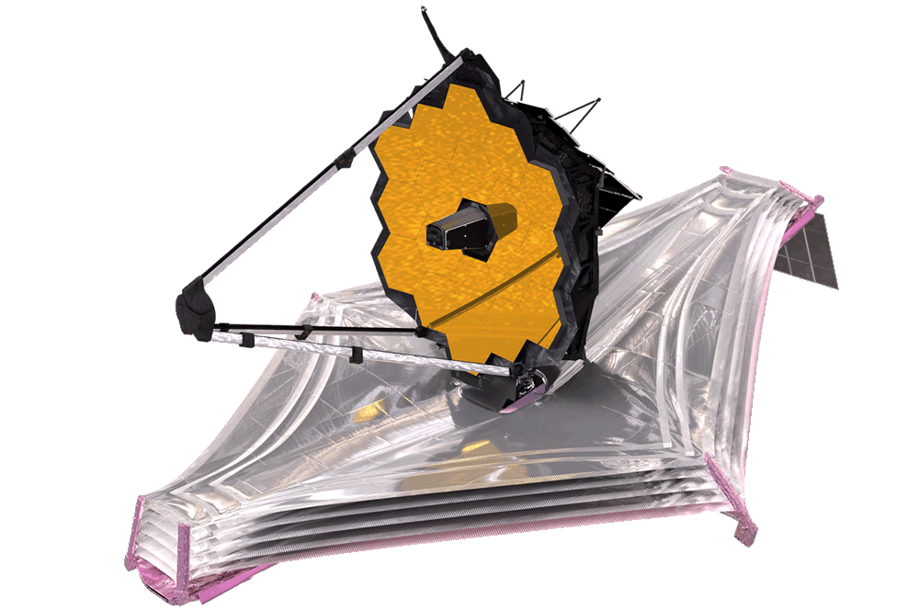
Exploratory Analytic Cases (EACs)
HWO architectures: Exploratory Analytic Cases (EACs)
1st round mission architectures are being developed to explore the HWO trade space.
  Practice end-to-end modeling, from science to engineering. Develop initial models & codes to ”pipeclean” the process using representative examples, understand end to end modeling capabilities and needs
  Use EACs to identify key technology gaps and guide maturation of potential technology solutions
  Explore key architectural options/breakpoints in the context of rockets to help guide future point design choices
  Provide feedback to rocket vendors as soon as possible to help influence their direction
  We don’t expect any of the cases studied will become a baseline design going forward.
  These are only intended to explore and practice.
Final JWST
CML 9+
Early JWST

Slide 5
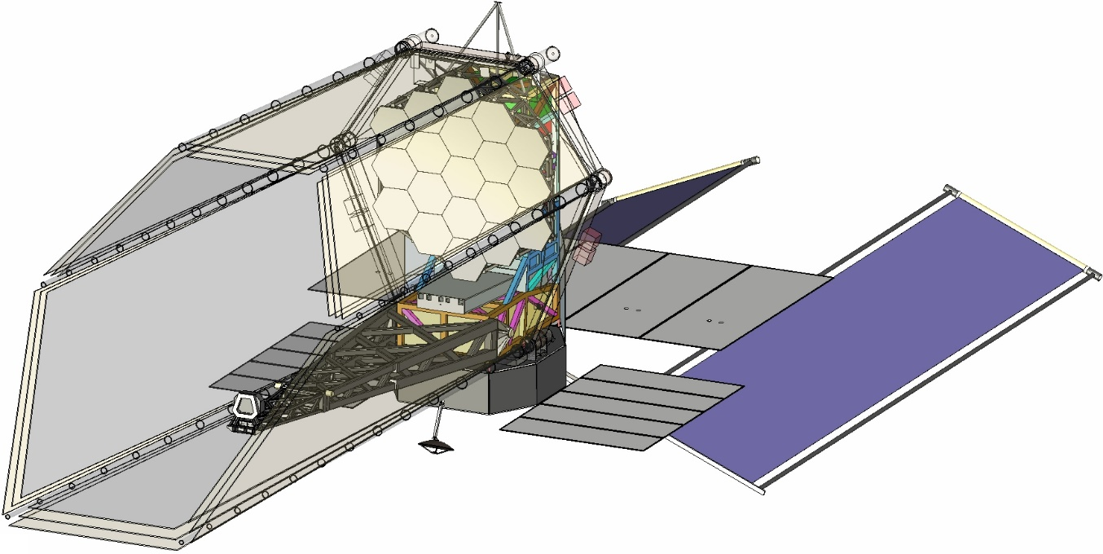
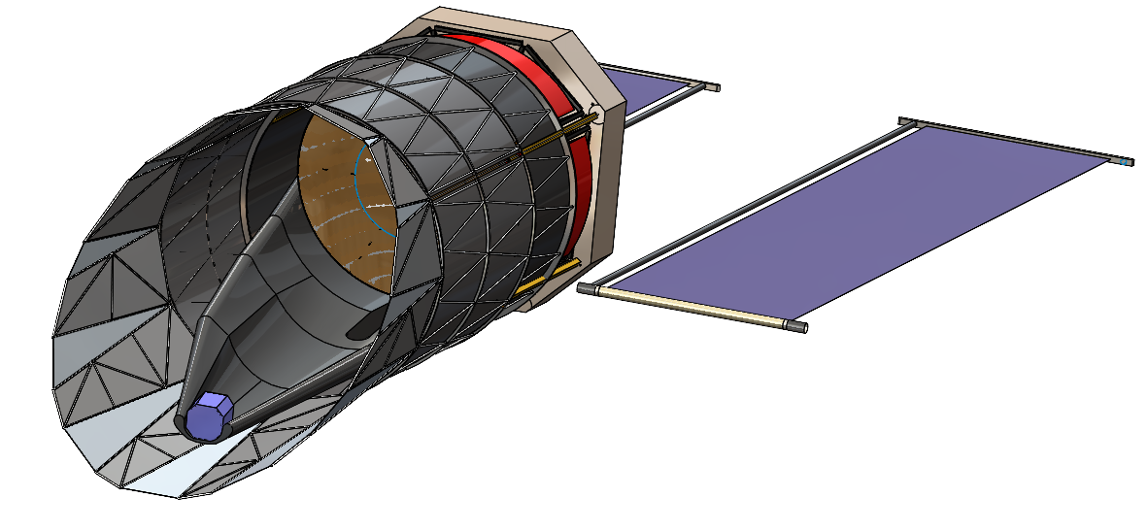
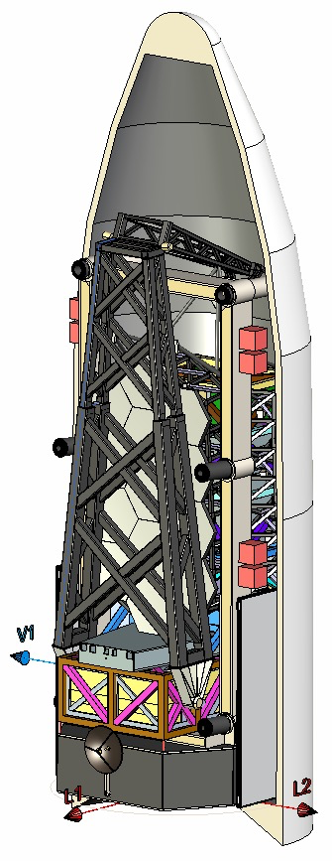
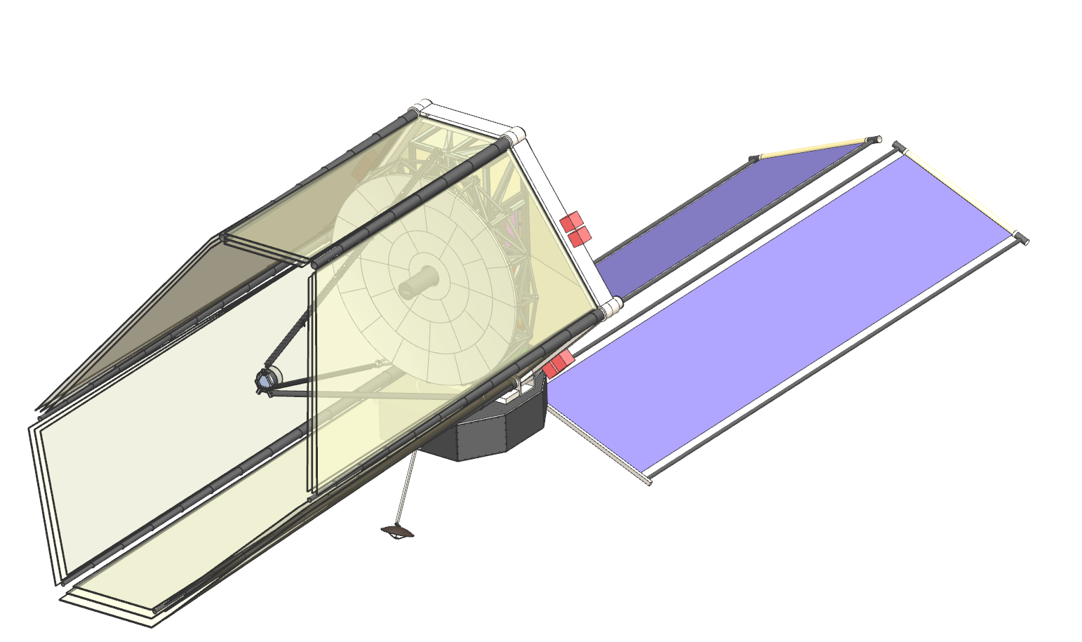
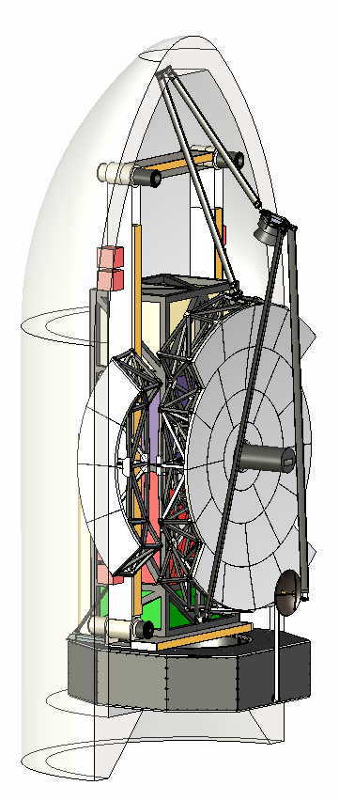
Notional Exploratory Analytic Cases

Slide 6
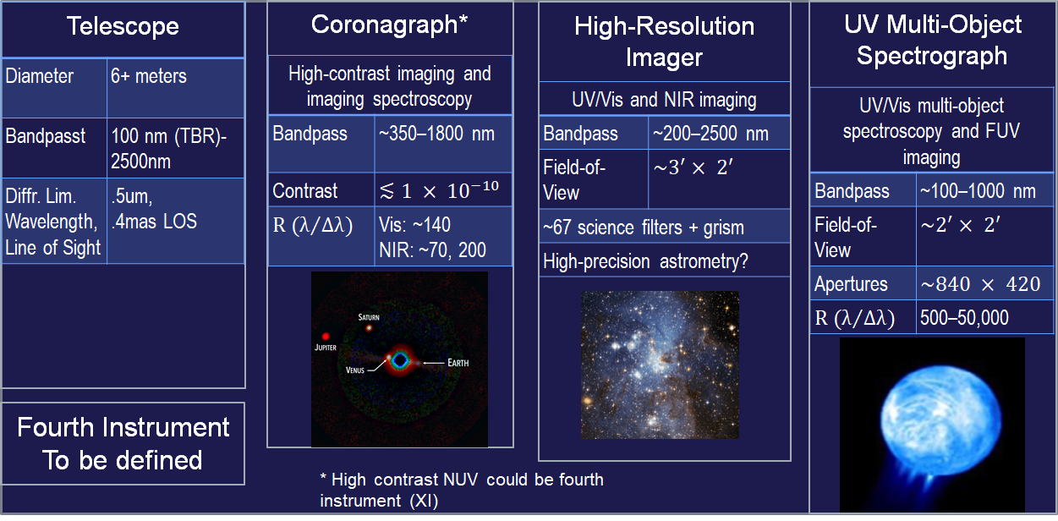
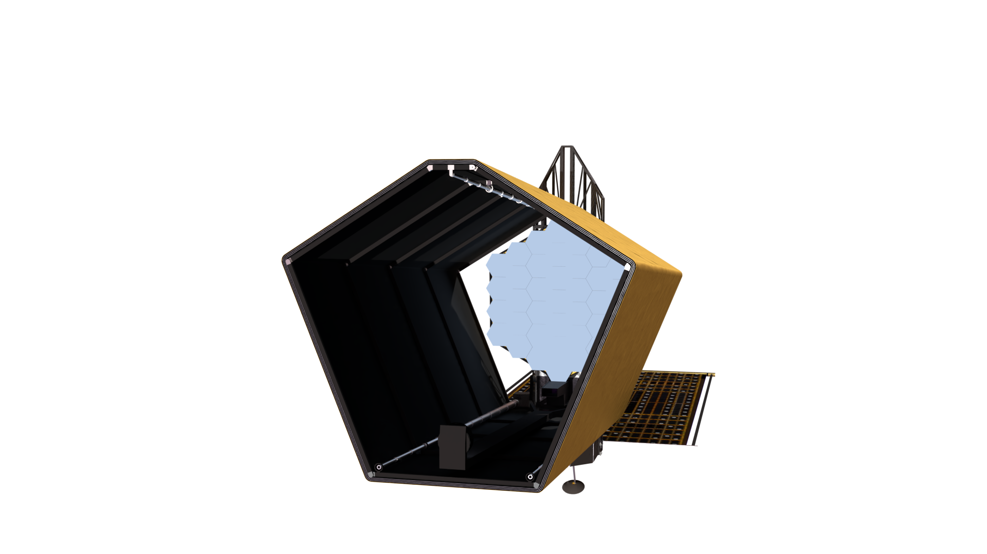
HWO preliminary specs & candidate instruments
Current HWO instrument concepts
(or UV/Vis IFU)

Slide 7
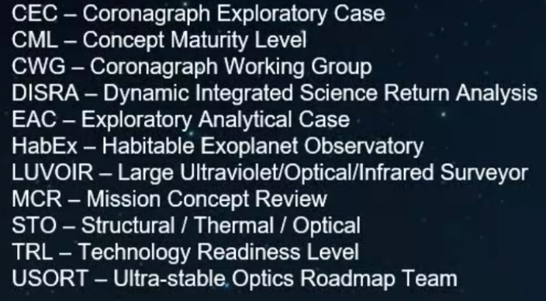
Continuing to follow Decadal Survey Recommendation of iterating between Science, Architecture and Technology:
Sci. Case Dev. Docs.
DISRA
Driving Science Cases
Payload Instruments
HWO
Trade Space (CML 3) Synthesis
Open Issues
Architecture Decisions
Options
HWO
Point Design (CML 4) Synthesis
Risks (i.e. Mission, Tech., Cost)
Architecture, Payload, Technology Decisions
Payload Instruments
STOP
Design & IM to Closure
Decadal Survey
LUVOIR
HabEx
USORT
CWG
EAC 1
STOP
Design & IM
Science Requirements
EAC 4
MCR
EAC 2
Baseline
EAC 5
EAC 3
TRL 5 Milestones
CECs
CECs
Technology Demonstrations
Technology Roadmaps
Parameter Studies
CML 3
CML 4
CML 5

Slide 8
Tech Organization
Responsibility / Accountability
Project Leadership
L. Feinberg
S. Smith
J. Ziemer
Consult / Inform
Project Science
G. Arney
A. Roberge
B. Mennesson
Testbeds
B. Sitarski
C. Baker
Systems Engineer / IM
M. Menzel
A. Liu, M. Levine
Chief Technologist
M. Bolcar
F. Zhao
Coronagraph System Technologies
TBD, Track Lead
Ultra-stable Telescope System Technologies
TBD, Track Lead
High-sensitivity UV & Instrument Technologies
P. Scowen, Track Lead
Starlight Suppression
Ultra-stable Mirrors
Far-UV Mirror Coatings
Pre-Formulation Project Development Team (PDT)
D. Redding, P. Stahl, R. Belikov, S. Park, et al., SMEs
Deformable Mirrors
Ultra-stable Structures
Near-UV / VIS Detectors
Sensing & Control
Thermal Control System
Far-UV Detectors
Low-noise / Noiseless Detectors
Sensing & Control
Multi-object Selection / IFU
Spectroscopy
Low-Disturbance Systems
UV Gratings & Filters
Near-UV Capability
Deployable Systems
External Subject Matter Experts

Slide 9
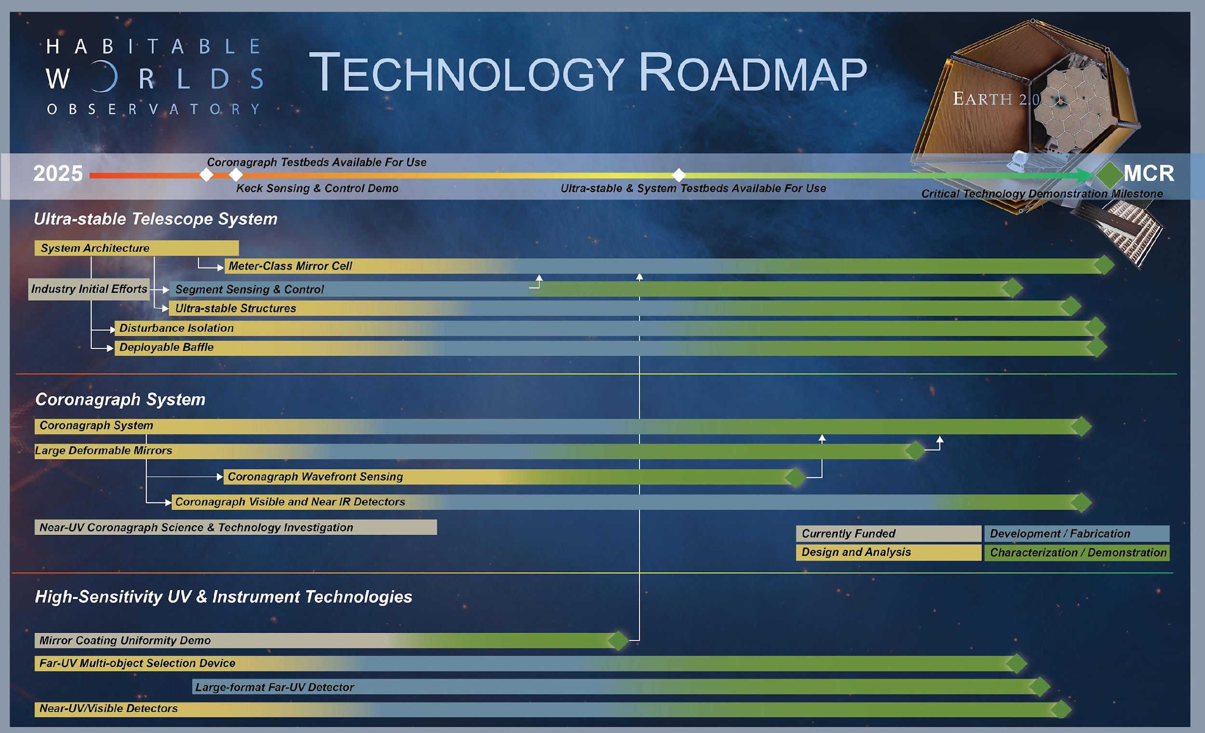
*Contingent on Funding

Slide 10
Science status: Initial ideas for trade space exploration
4 broad science areas are being investigated (working groups and subgroups)
  Working groups will continue through summer 2025
Three observatory architectures are being developed in parallel until mid-2025
About 65 Science case documents have been submitted
Feasibility of science cases will be evaluated iteratively with exposure time calculators (DISRSA process) to find sweet spots (science vs. capabilities/cost)
Initial science and architectures trade spaces will be documented in a NASA ’Concept Maturity Level 3’ report due in late summer 2025

Slide 11
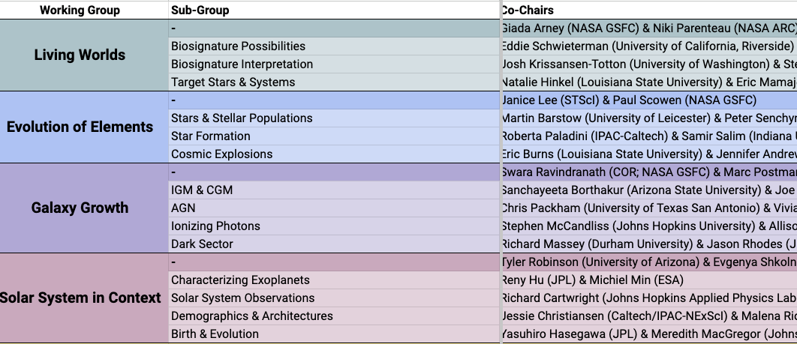
Science working groups (major community participation)
Each subgroup is working on multiple science case development documents
More info on all working groups is here

Slide 12
Science Case Development Documents (SCDDs)
SCDDs are meant to explore the science trade space and articulate Science Goal, Objective, Physical Parameters, Observations, and HWO uniqueness
Need to show how well each objective can be achieved when varying quantity and/or quality of measurements…and describe in detail required observations
There are ~65 expected: https://docs.google.com/spreadsheets/d/1tT69A4hyssCD7eO-Gg-5EUMCEwEog968j0seD6FKAwc/edit?usp=drive_web&ouid=112687849174308921385
Area | CML 3 (Trade Space Exploration) End State
Science | Goals, objectives are linked to specific investigations, each with a range of acceptable physical parameters and observables, including precision/accuracy needs; potential threshold(s) identified as well as science return vs. quality of measurements (document the “partials” or science return gradient)

Slide 13
DISRA structure: Dynamic Integrated Science Return Analysis
Science Case Simulation Modules
Enable creation by large range of community scientists
Developers need streamlined access to ETCs but should not need extensive technical expertise
Modules should be accurate but not computationally intensive. Fidelity can increase with time.
Computationally intensive high-fidelity simulations may need to be done separately to find lower fidelity parameterizations for use in modules and/or do spot-checks for accuracy
Data Simulation / Exposure Time Calculators (ETCs)
Interface between science results and observations
Translates observatory capabilities parameters into observation requirements
Model candidate science instruments & basic observing modes
Science / Engineering Interface
Translates hardware (e.g., optical elements) into observatory capabilities parameters (e.g., throughput)
Holds unified set of astrophysical parameters and telescope / instrument capabilities parameters
Will eventually interface with integrated engineering model
Initially, will be used to explore large ranges of high-level observatory parameters

Slide 14
New Community Science & Instrument Team (CSIT)
CSIT team will replace the current working groups and will formally advise the HWO project
The team will include people who work in science and instrumentation
There is an open solicitation seeking US-based scientists (responses due March 17)
~20 people, plus international ex-officio participation (via national space agencies)
Think of this team as HWO “Co-Investigators” (pre-flight SWG?)
Science input, including helping evaluate science cases
Ambassadors for the mission

Slide 15
Summer 2025 HWO Science and Technology Conference
HWO Science and Technology Conference
Venue is in Washington, DC USA
Dates are 28 – 31 July, 2025: mix of science and technology
  Abstracts are due 21 February!
Conference will include contributed abstracts, presentations, posters.
  Think a regular, topical meeting open to the entire community, NOT another working groups face-to-face.

Slide 16
HWO Top Level Schedule to MCR* (DRAFT)
Pre-Formulation
Plan w/Detailed
Technology
Roadmaps
HWO Science & Technology
Conference
Draft Detailed
Technology
Roadmaps
Down-select to
Single Architecture
CML4
CML3
CML 5
ITR
06/29
MCR
10/29
Project
1/25
05/25
07/25
08/25
02/27
03/29
MCR Baseline
Completed
EAC-1, 2, and 3 Designs Completed
EAC-4 and 5 Completed
SE and Modeling
03/25
11/26
11/28
Comm. Sci & Instr
Team (CSIT) Call
CSIT Team
Selection
HWO Journal
Spec Edn.
Draft L1
Science
01/25
07/25
01/26
12/26
HWO
Advisory
Board (HAB)
TAB TRL-5
Plan Review
Tech Journal
Spec Edn
RST Commissioned
TRL 5
Technology Development
05/25
08/25
3/25
08/27
03/29
Launcher/Servicing
Development
New Glenn 1st Launch,
Starship Landing and Refuel
Mission Robotic
Vehicle
2024
2025
2026
2027
2028
2029
2030
*Contingent on Funding

Slide 17
CML 3 Report and Science Cases documentation
The CML 3 report is a NASA document aimed at a NASA/stakeholder audience. It will include all science cases in some form and will include all SCDD authors as co-authors.
Plans for journal special issue(s) are still being formed. Courtney Dressing will lead the science issue(s). Janice Lee has volunteered to help with journal logistics – thank you!

Slide 18
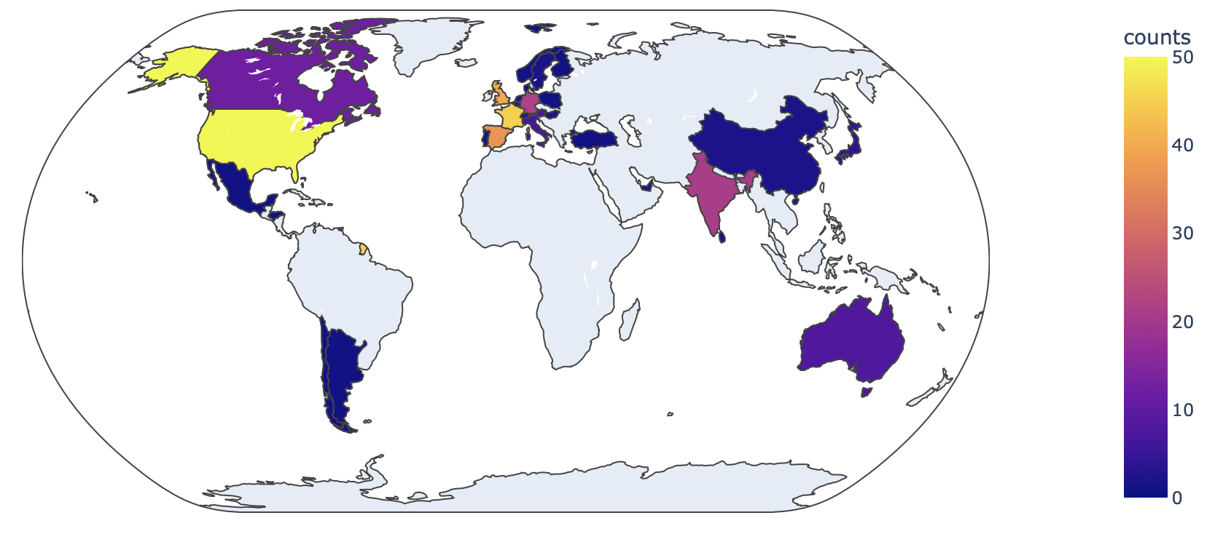
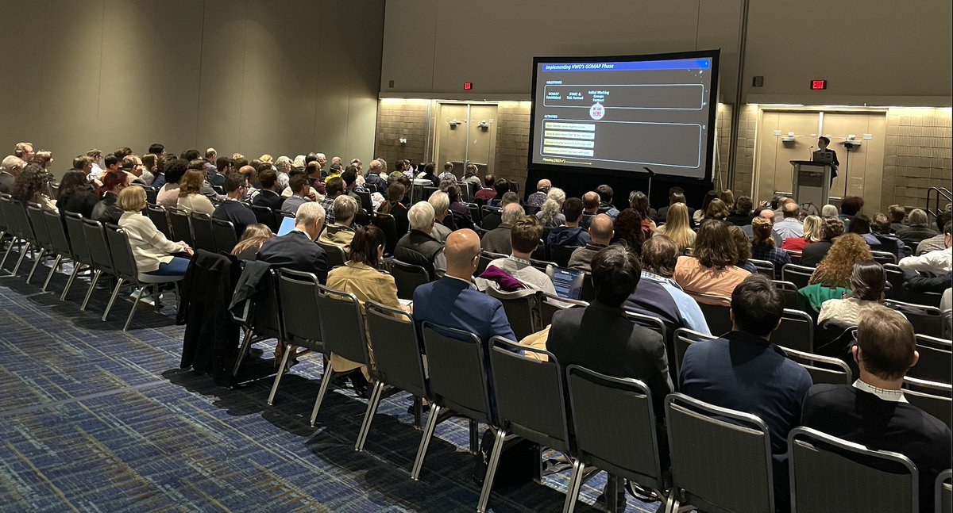
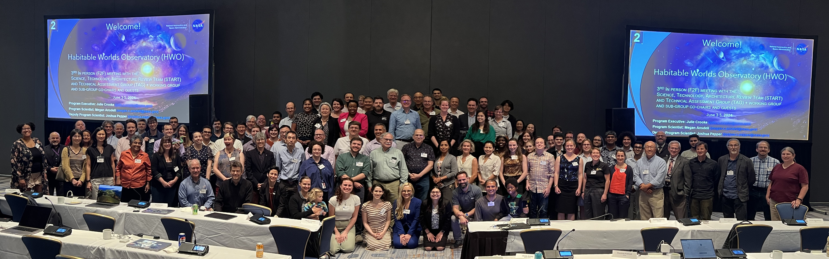
HWO Has Contributors From Around the World:
Get Involved!
HWO Global Involvement in Working Groups!
https://science.nasa.gov/astrophysics/programs/habitable-worlds-observatory/
Jan 2024 AAS Meeting
AAS 2024
Now Outdated!
HWO Face to Face Meeting

Slide 19
Other NASA astrophysics missions & tech opportunities
Keep your eyes open for proposal solicitations on NSPIRES:
  NASA Astrophysics Pioneers are research balloons and smallsat missions (like Aspera & Pandora)
  Astrophysics Research and Analysis (APRA; balloons, cubesats, low TRL) or Strategic Astrophysics Technology (SAT; mid-TRL)
  HWO technology (ROSES D.19)
  NASA PI-led Explorer missions
    Small ($170M US SMEX; 2025 proposals), medium (MIDEX), large (PRIMA Far-IR and AXIS X-ray probes under study in 2025)
Collaborate with a US-based PI or team; no funding is offered for non-US based investigators

Slide 20
Appendix / Backup information

Slide 21
Science Working Groups extended until summer 2025
Extended activities:
Possible iterations of science cases based on feedback
Development of DISRA code modules for science cases
Work on publications for special issue(s)
Preparations for summer meeting
(Insert your idea here!)
We anticipate that meetings will occur on a less frequent cadence.

Slide 22


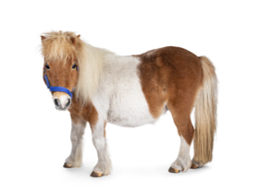

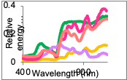
Examples of incremental, enabling, and breakthrough science
Living Worlds Biosignature detections depend on HWO capabilities
Incremental Progress
(enhancing)
0.4 - 1 µm
Substantial Progress
(enabling)
0.25 - 1.7 µm
Major Progress
(breakthrough)
0.25 - 2.5 µm
CO
O₂
O₄
CO
H₂O
CH₄
O₂
H₂O
CH₄
N₂O
O₂
O₃
CO₂
H₂O
CH₄
O₃
CO₂
O₄
known knowns
known unknowns & false positive discriminants
known & unknown unknowns & false positive discriminants
Notes:
At the last meeting, Niki and I joked about how we don’t want HWO to be a pony…we want a unicorn.
All NASA missions start with compelling science. There’s an important push and pull interplay between science and engineering – we’re now entering that next phase of balancing ambition with feasibility, which I think we’re be hearing a lot about at this meeting.

Slide 23
HWO Project Office
Project Leadership
L. Feinberg, Principal Architect
S. Smith, Project Manager°
J. Ziemer, Pre-Formulation Architect*
Testbeds
B. Sitarski,
Deputy Principal Architect
C. Baker*
JPL Testbed Lead*
Systems
M. Menzel,
Mission System Engineer
A. Liu, Deputy MSE
M. Levine*, Systems Modeling
Technology
M Bolcar, Chief Technologist
F. Zhao, Deputy Chief Technologist*
Science
G. Arney, Project Scientist°
A. Roberge,
Pre-formulation Scientist°
B. Mennesson,
Pre-formulation Scientist*
* JPL ex-officio
° Interim
Financial: P. Butler
Pub Affairs: C. Andreoli
Community Engagement:
Rob Zellem & Raissa Estrella*
Mentoring+Inclusion: N. Latouf, T.Kataria*
Deputy PS: Mike McElwain
Deputy PFS: Erin Smith
Deputy PFS: Pin Chen*
Coronagraph Instr Sci: Vanessa Bailey*
High-Contrast Spectr. Sci: Neil Zimmerman
Camera Instr.Scientist: Tom Greene, Ames
UV Instrument Scientist: Paul Scowen
Exoplanet Theme Ld: Chris Stark
Exoplanet Theme Ld: Renyu Hu*
Astrophysics Theme Ld: Jason Rhodes*
Astrophysics Theme Ld: Allison Youngblood
Solar Systems Ld: Lynnae Quick
HOST Lead: M. McElwain
HOST Systems: T. Groff
Keck Demo: M. Troy*
Servicing & Instrument Systems: J. Van Campen
High Contrast Sys: C. Noecker
Payload Systems: J. Abel
High Contrast Error Budgets: Brian Kern
Systems Design and Modeling teams
Coronagraph Technology: Ilya Poberezhskiy/TBD
Telescope Technology: TBD
UV/Instrument Technology: Paul Scowen
WFSC SME: D. Redding*
Mirror Technology SME: P. Stahl, MSFC
Coronagraph system SME: R. Belikov, Ames
The Pre-Formulation Project Development Team will encompass a broad group, including former START/TAG members.

Slide 24
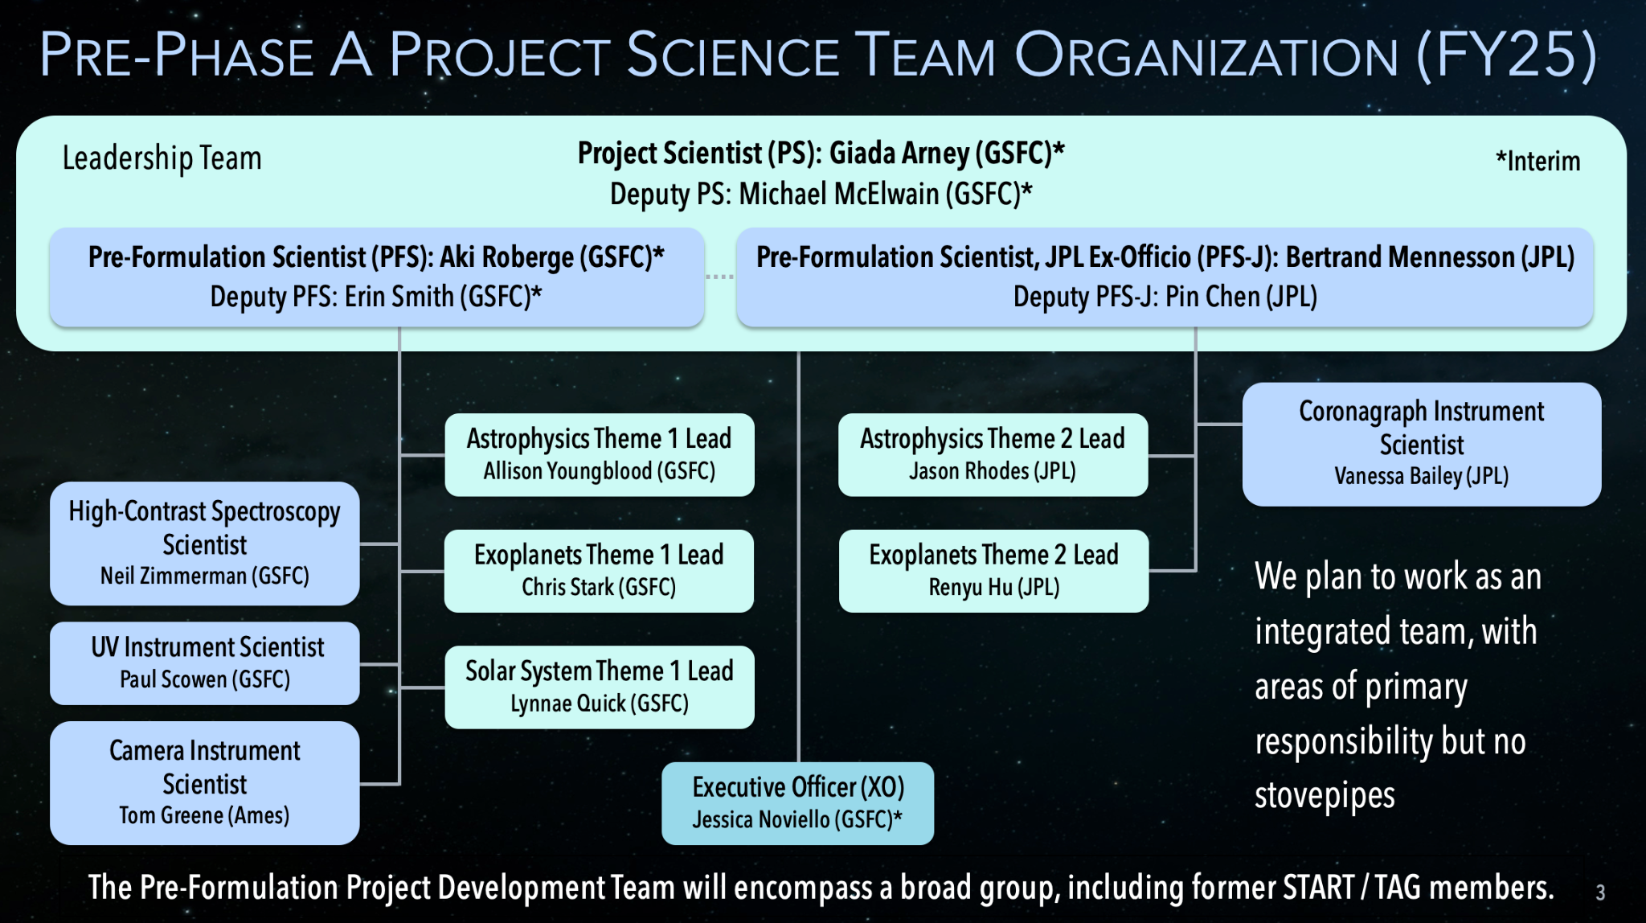
Pre-Phase A Project Science Team Organization (FY25)
Project Scientist (PS): Giada Arney (GSFC)*
Deputy PS: Michael McElwain (GSFC)*
Leadership Team
*Interim
Pre-Formulation Scientist (PFS): Aki Roberge (GSFC)*
Deputy PFS: Erin Smith (GSFC)*
Pre-Formulation Scientist, JPL Ex-Officio (PFS-J): Bertrand Mennesson (JPL)
Deputy PFS-J: Pin Chen (JPL)
Coronagraph Instrument Scientist
Vanessa Bailey (JPL)
Astrophysics Theme 1 Lead
Allison Youngblood (GSFC)
Astrophysics Theme 2 Lead
Jason Rhodes (JPL)
High-Contrast Spectroscopy Scientist
Neil Zimmerman (GSFC)
Exoplanets Theme 2 Lead
Renyu Hu (JPL)
We plan to work as an integrated team, with areas of primary responsibility but no stovepipes
UV Instrument Scientist
Paul Scowen (GSFC)
Solar System Theme 1 Lead
Lynnae Quick (GSFC)
Camera Instrument Scientist
Tom Greene (Ames)
Executive Officer (XO)
Jessica Noviello (GSFC)*
The Pre-Formulation Project Development Team will encompass a broad group, including former START / TAG members.
Notes:
Note at the bottom is really important

Slide 25
Technology
Industry:
  Northrop Grumman, L3 Harris/BAE, and Lockheed Martin are now all under contract for the D19 FY23 ROSES efforts
  Next FY24 D19 ROSES Draft is out
Next SAT is out and prioritizes HWO - huge opportunity
Detailed Technology Roadmaps are being written and will lead to HWO specific investments
  This will include discussion of testbeds, Keck demo, facilities, strategic technology investments (eg, RFP’s)

Slide 26
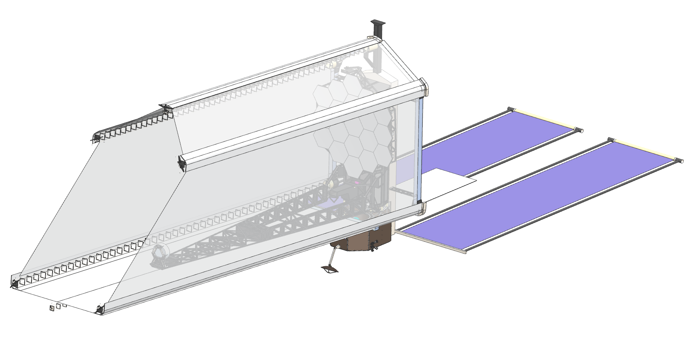
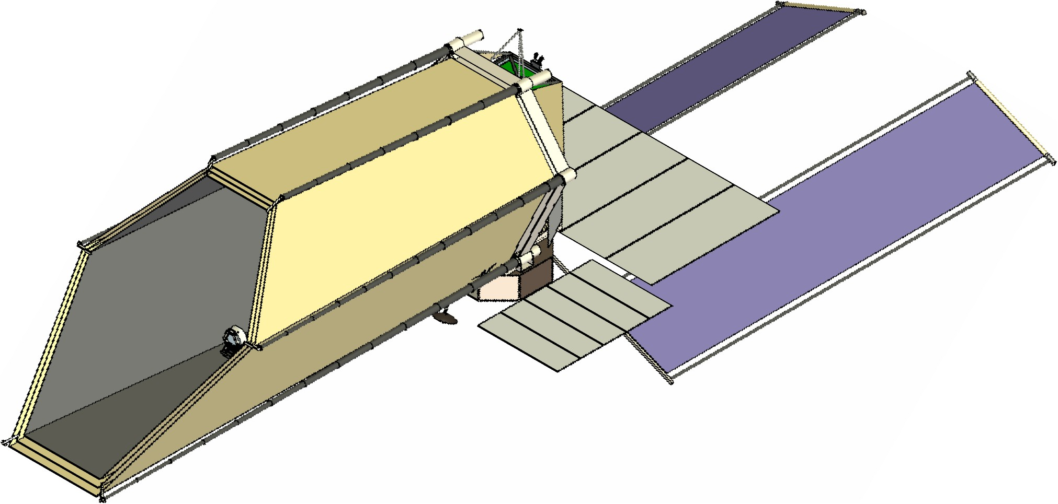
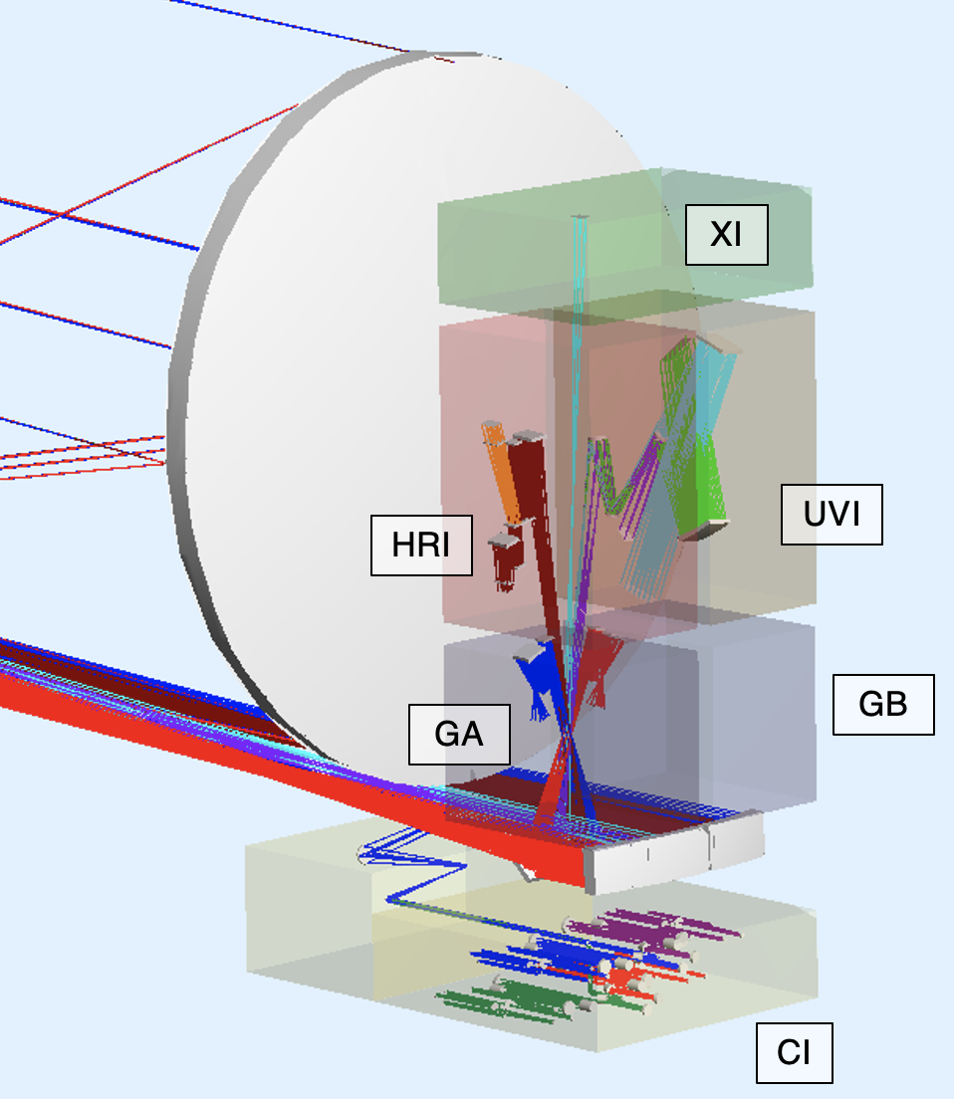
EAC-1 Design Evolution
Initial EAC-1 Concept
Current EAC-1 Concept
Science Instrument (SI) concepts were developed:
  SI Field of View Allocations were defined
  Optical layouts required considerable SI volume, particularly for the Coronagraph Instrument (CI)
  Number of CI NIR Cryogenic Detectors increased from 1 to 4
  SI dissipations were developed with significant values for temperatures less than room temperature
Roll Range increased from +15° to +22.5°
  Thermal Shields added to minimize thermal back-loads
  Solar Canted to reduce thermal back-loads
Desire to maximize Primary Mirror Backplane Assembly (PMBA) and Secondary Mirror Support Structure (SMSS) stiffness

Slide 27
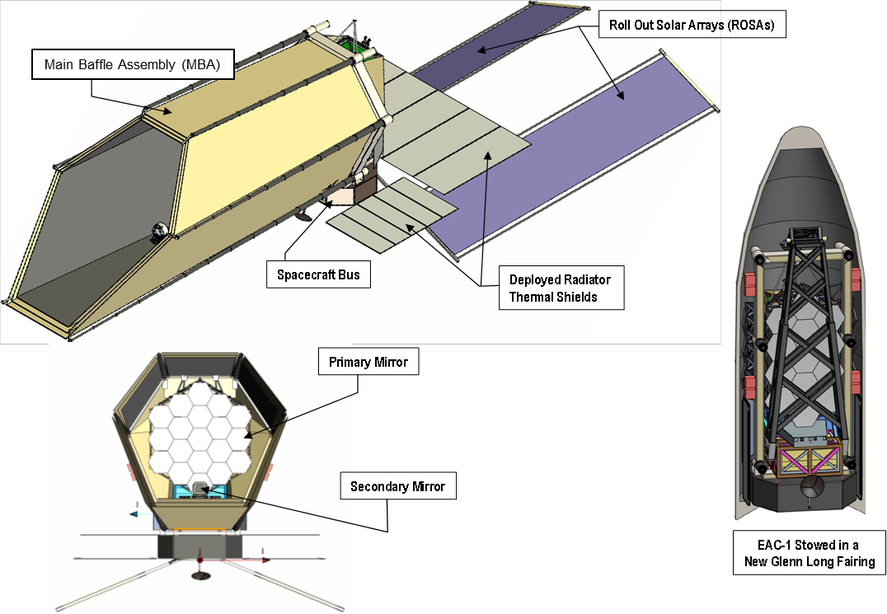
EAC-1 Design Configuration
The HWO Systems Engineering Team presented the EAC-1 Design Concept on July 19, 2024.
  The EAC-1 Concept is shown below in the deployed and stowed configurations.

Slide 28
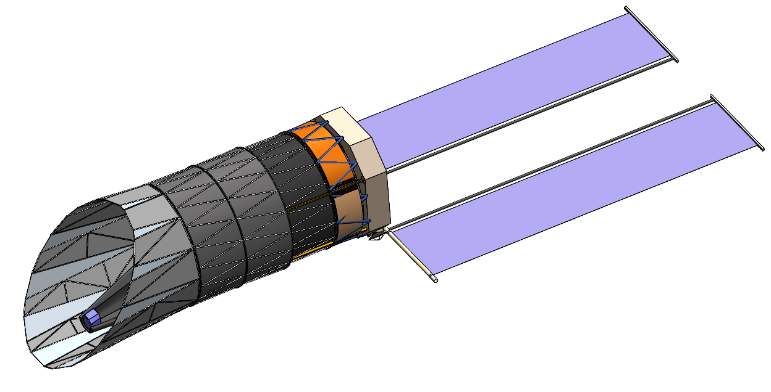
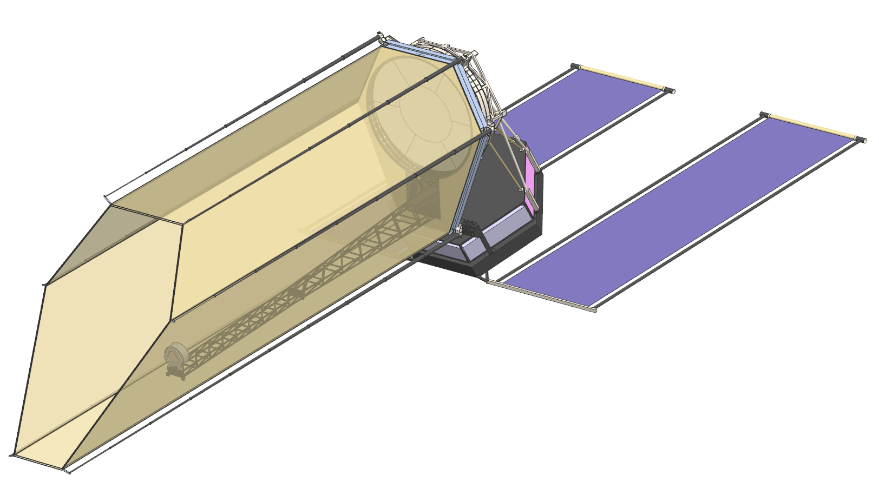
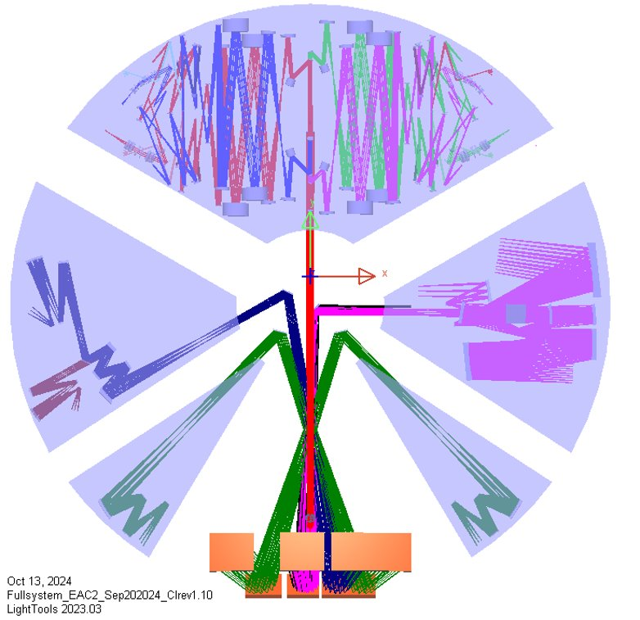
EAC-2 Design Status (1 of 4)
Current EAC-2 Concept
Initial EAC-2 Concept
CI
EAC2, view along Z
EAC-2 Design is proceeding toward a completion in early November. The concept for the observatory are shown on the right.
Science Instrument volumes and locations have been finalized.
  Positioning Coronagraph Instrument (CI) on the cold side of the observatory enables most advantageous thermal/radiator views.
Optical design layouts have been completed for CI, UVI, HRI, and 2 guiders.
  Integrated Field Spectrometers (IFS) were added to each CI channel.
  In the CI design, the dichroic and polarization splitter elements were swapped, positioning the Near-Infrared (NIR) detectors closer to the volume edge and improving the interface with radiators.
  Ultra-Violet Imager (UVI) volume was reduced to allow space sharing with a reserved instrument (XI), while maintaining the same specifications as EAC-1.
HRI
UVI
XI
GI
GI

Slide 29
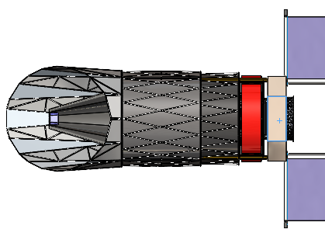
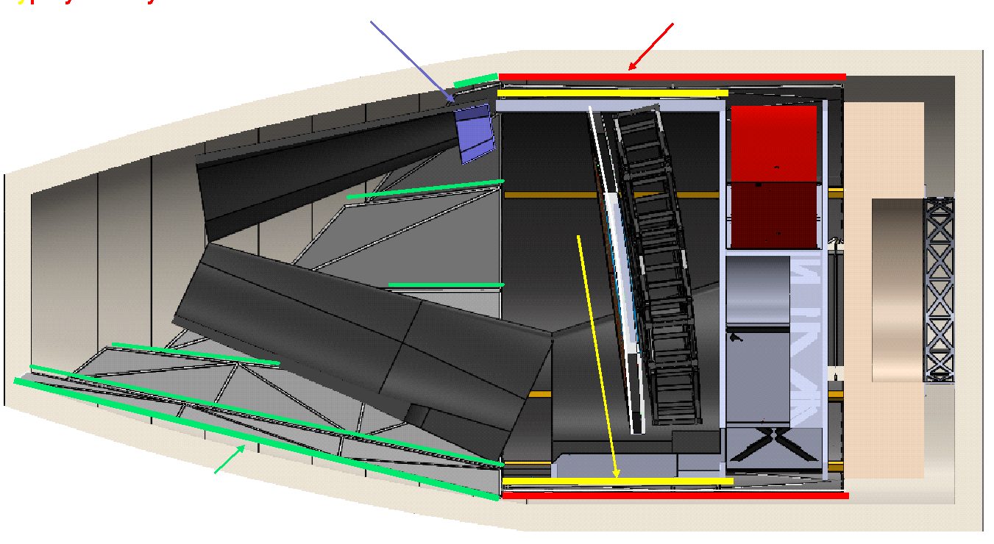
EAC-2 Design Status (2 of 4)
The mechanical team has developed their deployable barrel concept to fit within the Launcher Volumes.
  The barrel consists of two concentric solid cylinders. One cylinder deploys along the telescope boresight, with unfolding petals at the end to form a “scarf”.
  Deployed configuration on the right
  Stowed configuration on the lower left.
Working with the thermal and optical teams on selecting barrel material
Deployed Configuration
Stowed Configuration

Slide 30
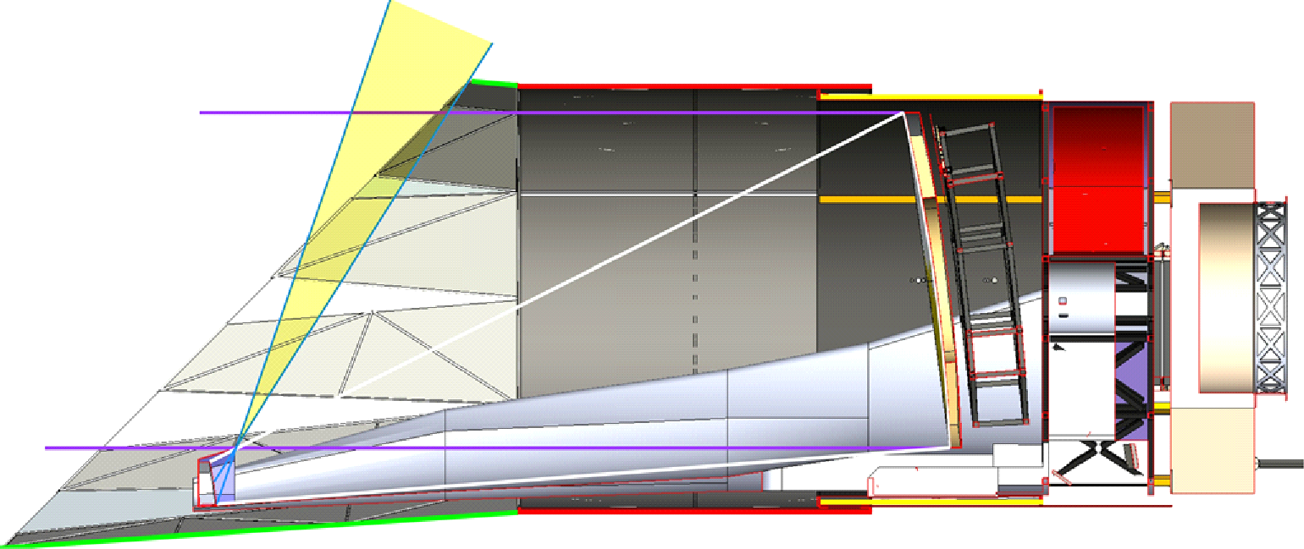
EAC-2 Design Status (3 of 4)
A design lien was accepted in order to change the “scarf” angle to 38 degrees to provide micrometeor protection to the secondary mirror while avoiding interference between the upper forward petals and the launcher. (See figure on the right)
  This would decrease maximum pitch angle toward the sun from 45 degrees to 36 degree with the maximum 22.5 degree roll angle.
  If this becomes a significant impact to science there are multiple ways to correct, but they would consume an inordinate amount of schedule.
  MSE decided that these investigations could be delayed to future EAC studies at this time.
    Low level geometric investigations will be conducted to gain some insight into the sensitivities of some of these mitigations.
Initial petal sizing leaves a portion of secondary mirror exposed to the micrometeor environment as shown in yellow.
This exposure can be eliminated by extending the upper deployed petal shown in green.
The lower petal cannot grow due to fairing volume constraints. Therefore increasing the upper petal and keeping the lower constant will decrease the “scarf” angle.

Slide 31
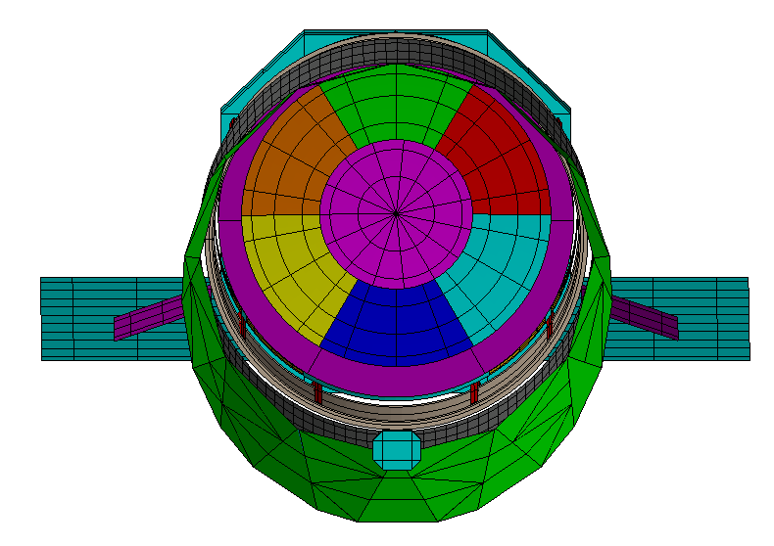
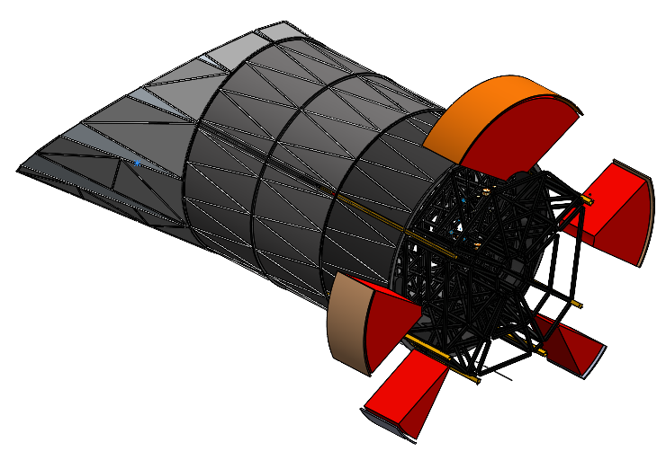
EAC-2 Design Status (4 of 4)
Thermal model being built from supplied CAD
  Model will inform sink temperatures for the instruments and update radiator calculations
  Assume MBA interior is fully black for stray light consideration
    Final coating choice will depend on MBA material and be made after working with stray light expert from Roman
Additional alterations being made:
  Modifying MBA model to explore heating options
  Adjusting model to ensure cold biasing of the primary mirror heaters
  Required EAC2 area calculations are in-work
Initial trade space to be explored
  Primary Mirror (PM) sink temps throughout the field of regard (FOR, fully passive)
  PM sink temps through FOR (active heating)
  Radiator sink temps (with revised bus)
Thermal Model
Instrument Radiator Areas
CI Radiator
UVI Radiator
HRI Radiator
Guider-B Radiator
Guider-A Radiator

Slide 32
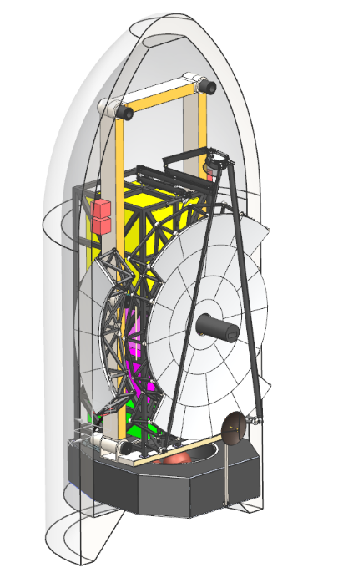

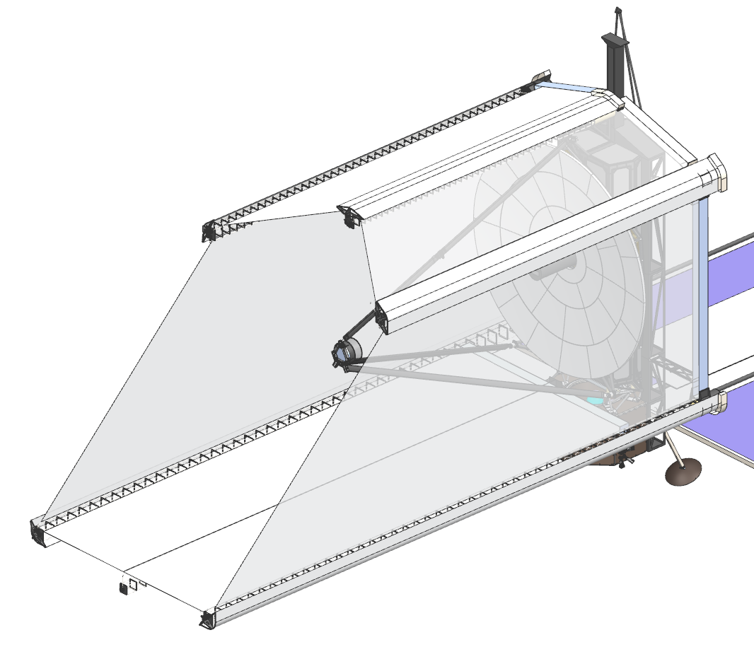
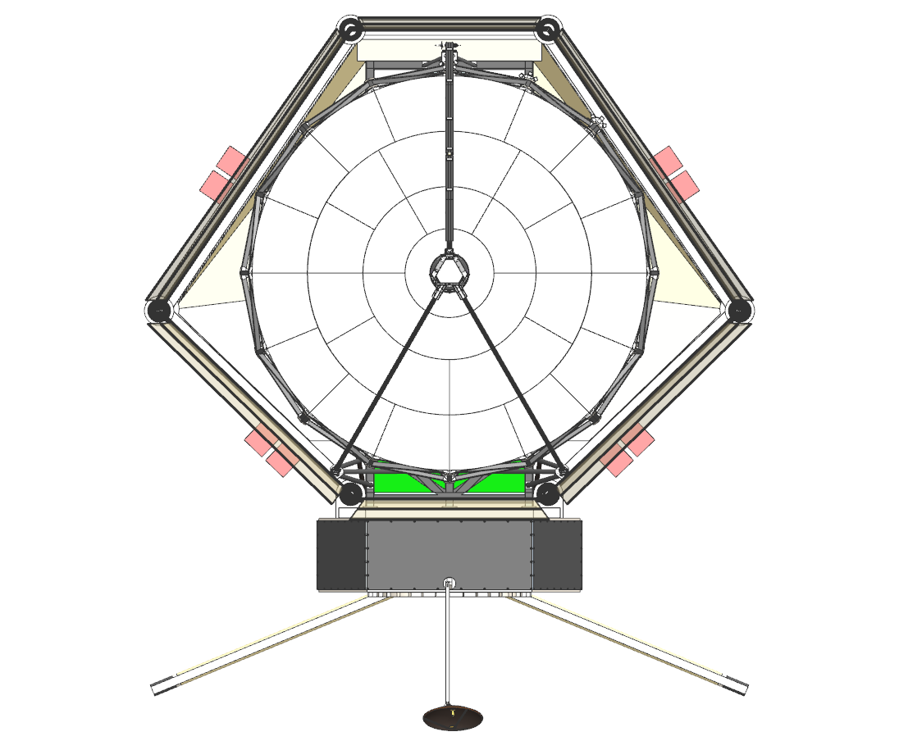
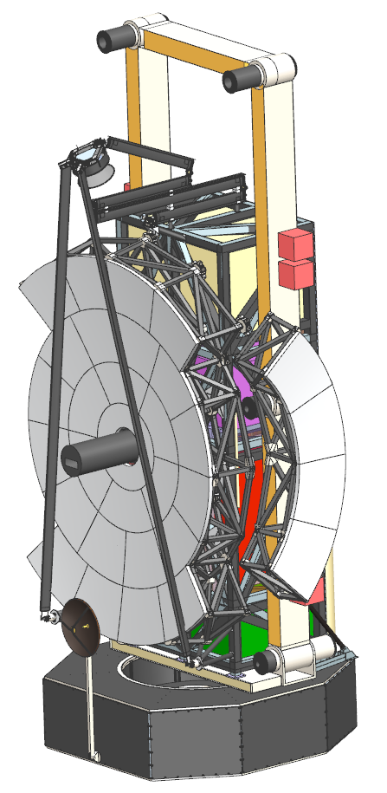
EAC-3 Design Status
Initial EAC-3 Concept
Current EAC-3 Concept
EAC-3 design is being worked in parallel with the EAC-2 Concept proceeding toward a freeze date in early Feb 2025.
  The concept for the observatory are shown on the right leverages many features from EAC-1.
EAC3 packaging maturing (within SLS & Starship fairings)
  PM backplane CAD driven by equations for stiffness maturing.
  Delta-frame interfaces to PMSA, BP starting to be conceptualized
  SMSS strut width exceeds optical goal of <= 80 mm. Working on frequency assessment and CI performance impacts
EAC3 aft optics (in “snout”) will require ”collimator” to provide acceptable light path through ~90° bend
    Will allow CI to be in high position to enable most advantageous thermal/radiator views

Slide 33
Candidate Technology Assessment
Each lane will identify candidate technologies to address technology gaps
The TRL of each candidate technology will be assessed via the following criteria
Demonstrated level of performance or function
Fidelity of hardware associated with demonstration
Fidelity of analysis associated with demonstration
Level of integration associated with demonstration
Environment in which demonstration occurred
Full Technology Development Plan contains more detailed definitions for each of these items
Information has been tailored from “SP-20205003605 NASA Technology Readiness Assessment: Best Practices Guide”

Slide 34
TRL Assessment

Slide 35
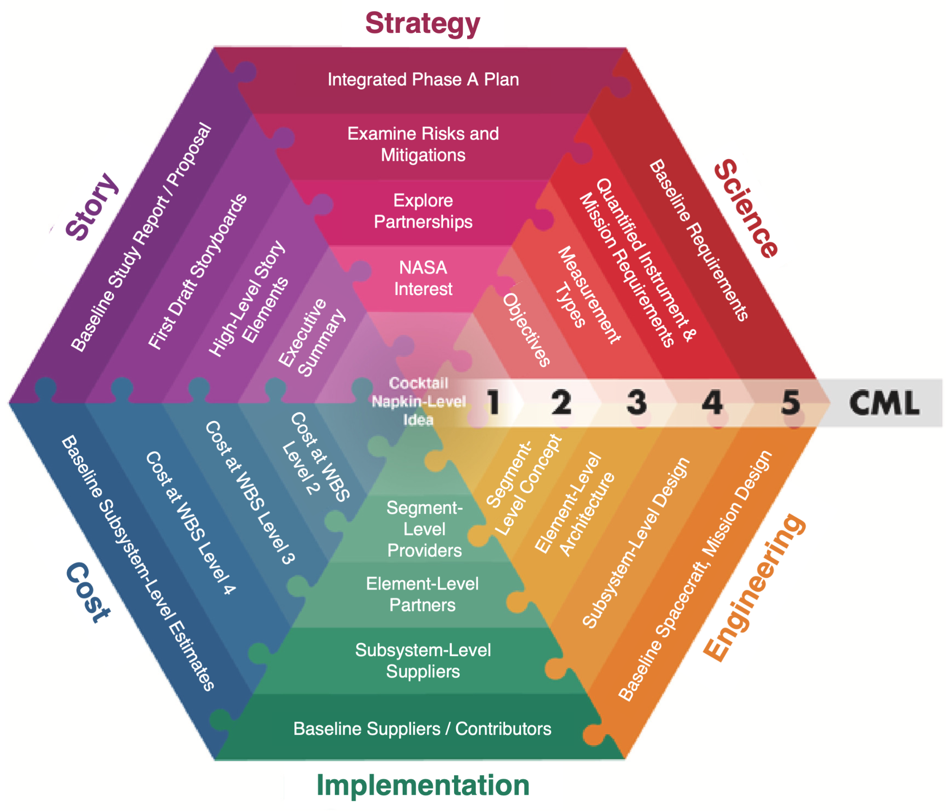
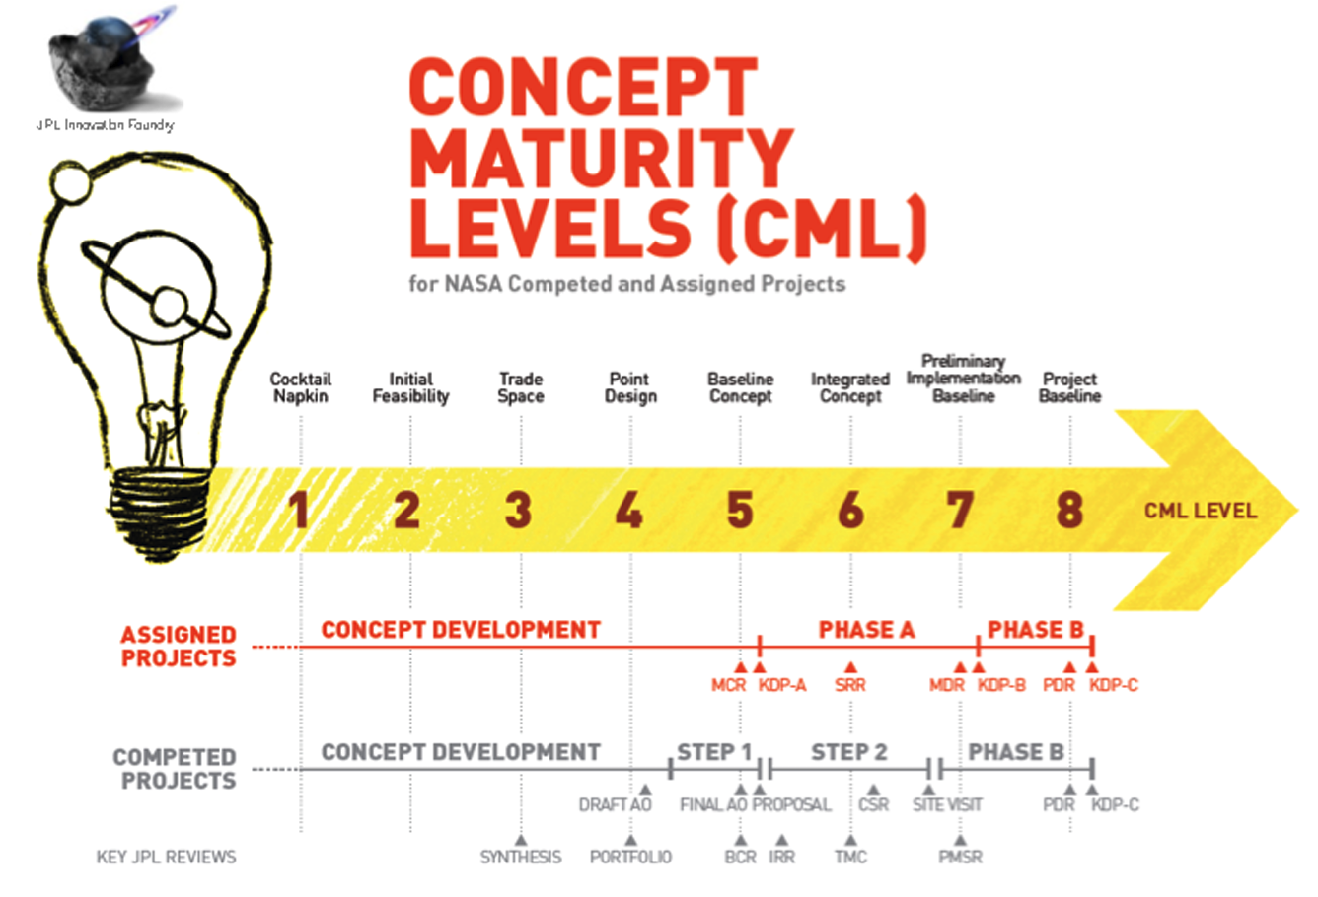
What is the Concept Maturity Level system?
CML 3 explores the trade space, it does NOT pick a point design

Slide 36


