Slide 1
Bubbles, Bank Defaults, Bail-In
Christopher Joye, Portfolio Manager
Smarter Money Investments
March 2016

Slide 2
Bubbles
Defining bubble:
Asset values need to fall ~15%-25% to reach fair value
Largest Australian price fall on record since 1980 = -6.5%
Does not require high credit growth
Defining dangerous bubble:
Overlay high levels of leverage
Leverage that is difficult to service at higher interest rates
Australian housing is:
Fairly valued if you think rates will never increase
In a bubble if you think rates normalise to post-1993 averages

Slide 3
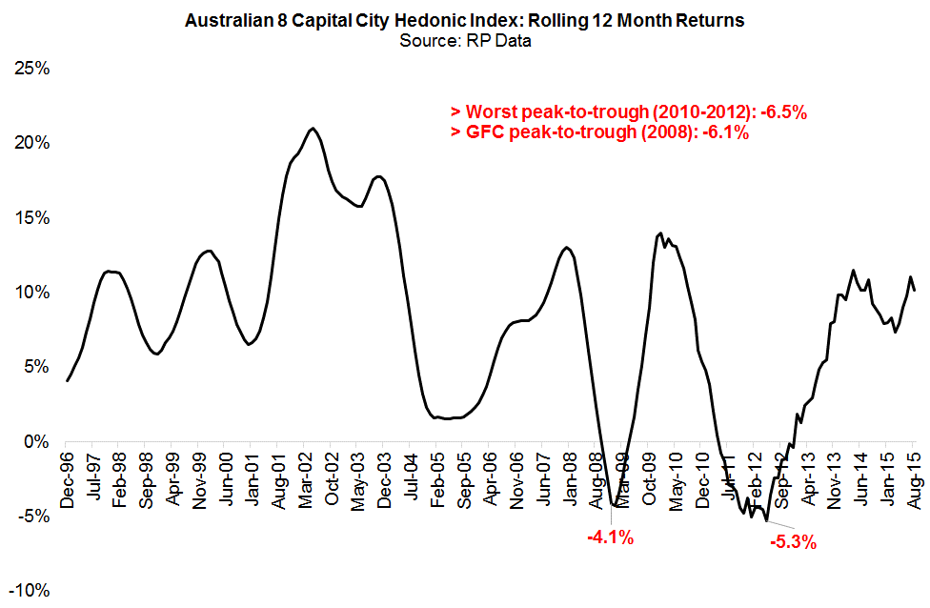
Worst Price Falls Since ‘95 = -6.5% (Hedonic Index)

Slide 4
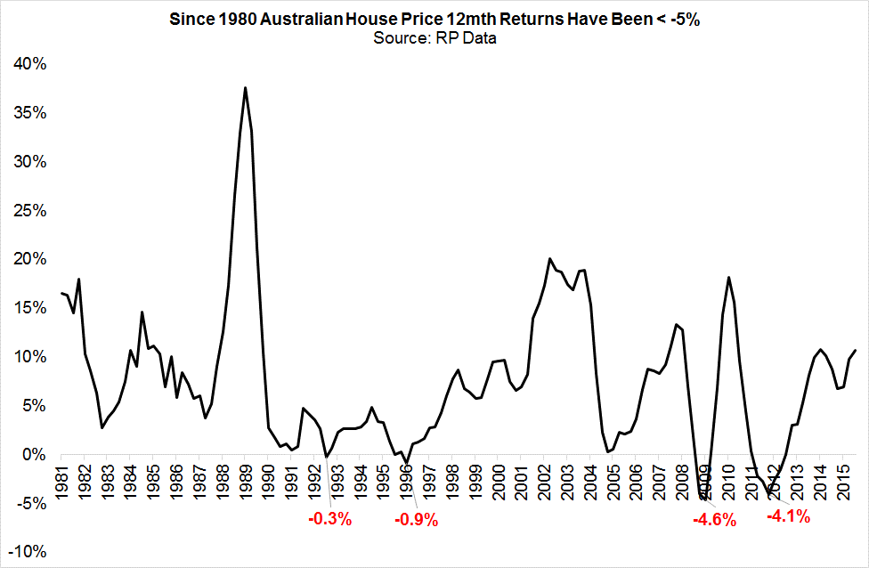
Worst Rolling 12mth Return Since 1980 = ~-5% (Median)

Slide 5
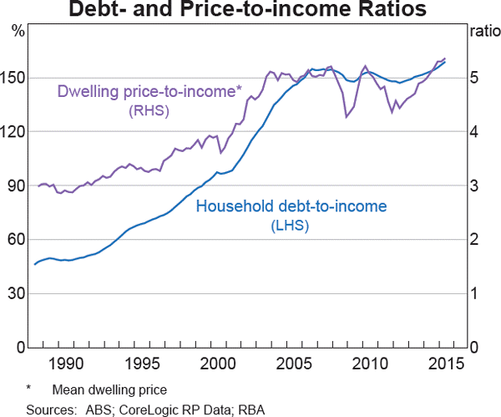
As Predicted: Record Leverage/Record Price-Income Ratio

Slide 6
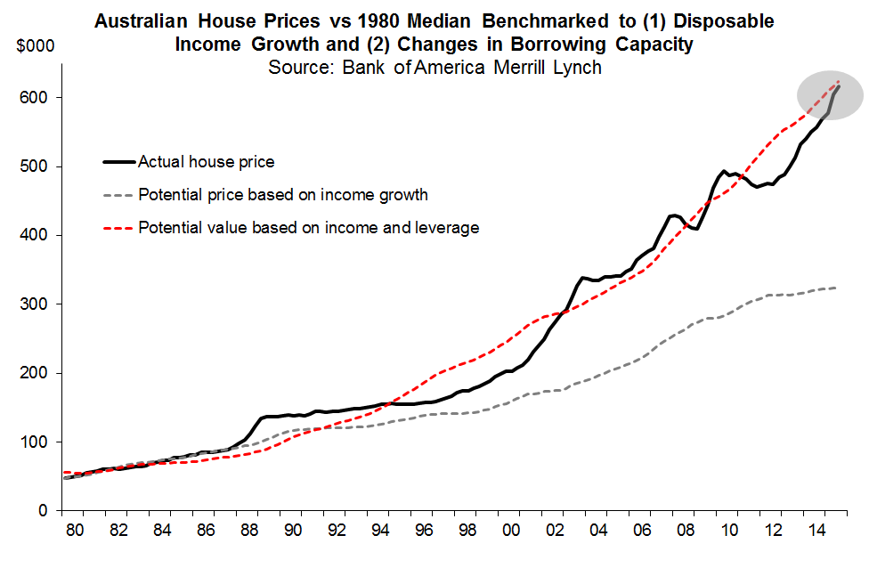
1980 Prices Indexed to Incomes & Rates → Fairly Valued

Slide 7
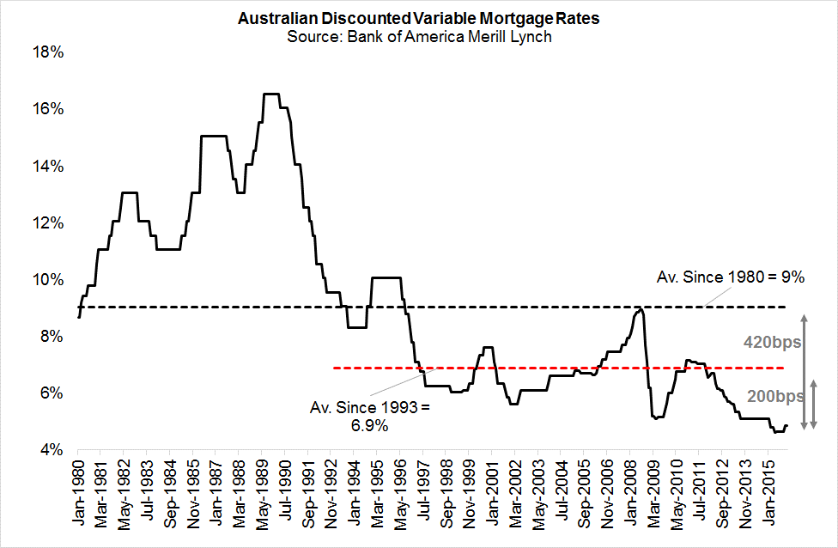
Normal Aust. Mortgage Rates Likely ~200bps Higher

Slide 8
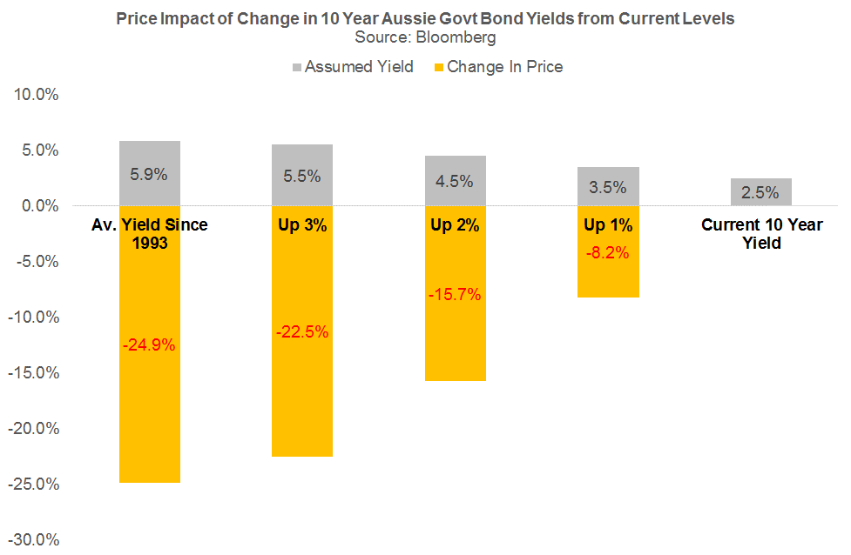
Equilibrium Long-Term Rates ~200-250bps > Current Rates
Markets/economists generally agree
Nominal 10yr Yield = Nominal GDP
True since 1993
Currently
Real GDP = 3%
Core inflation = 2%
Nominal GDP = 5%
BUT 10yr Yield = ~2.6%
Long-Term Equilibrium
Real GDP 2.5%
Core CPI = 2.5%
Nominal GDP = 5%
10yr Yield = 5%

Slide 9
Banks
> $40bn of Tier 1 capital raised since Jun ‘14 generated biggest deleveraging in modern banking history
4 majors now rank >75th percentile global peers on basis of risk-weighted CET1 ratios
But more work to do
Investors very sceptical of risk-weighted assets
Westpac’s risk-weightings generated 1.3% CET1 against $468bn home loan book—77 times leverage!
Most robust back-stop is non-risk-weighted “leverage ratio”
Can’t fudge Equity/Assets
Problem: 4 majors all below 75th percentile on leverage ratio basis and not therefore “unquestionably strong”

Slide 10
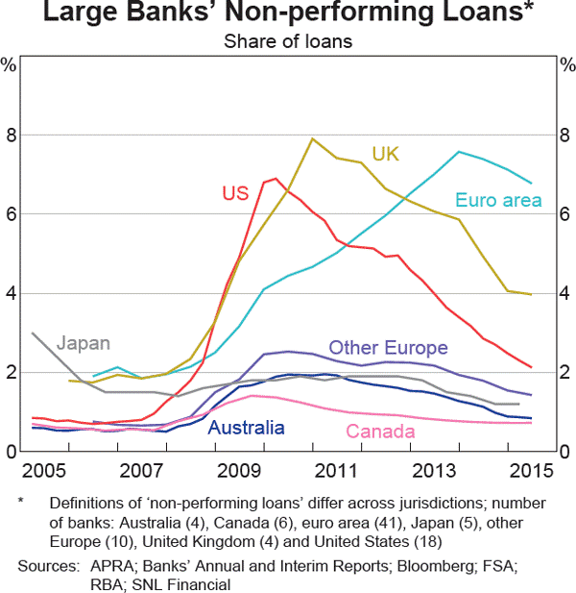
Aussie NPLs Remain Low by Global Standards
Notes:
10

Slide 11
CBA Reports Better Consumer Arrears in 2H CY15
Notes:
11

Slide 12
NAB Risk-Weighted Capital Ratios Soar

Slide 13
CBA Risk-Weighted CET1 Ratio 3rd Best in World

Slide 14
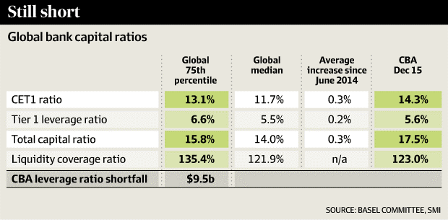
But CBA ~100bps Below 75th Percentile Leverage Ratio

Slide 15
Modelling Risk of Bank Failure
We use suite of Merton models to estimate
Real-time probability of major banks’ defaulting
Defined as assets falling below liabilities
Several modelling approaches
Classic Merton where default occurs at maturity
First Passage Merton allows default to occur any time
Jump Diffusion Merton with higher probabilities of negative jumps in asset values
Inputs: equity volatility; debt levels; market capitalisation; term of debt
Allows us to estimate real-time credit rating changes

Slide 16
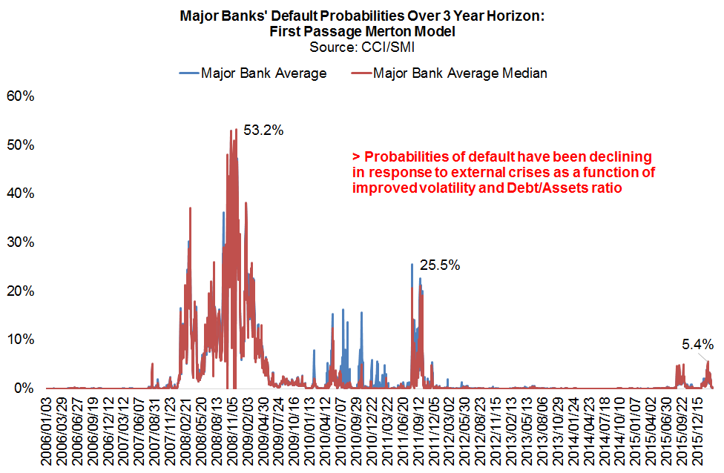
Default Probabilities During GFC and Since…

Slide 17
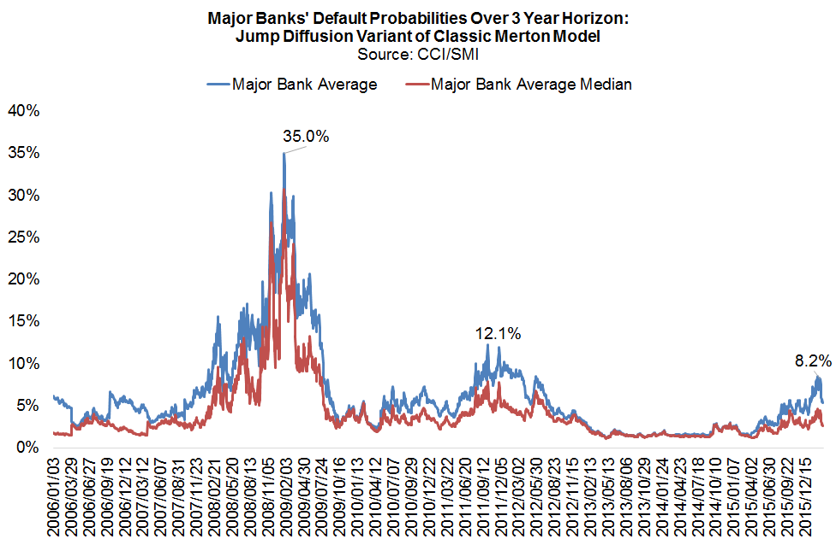
Default Probability Spikes More Contained

Slide 18
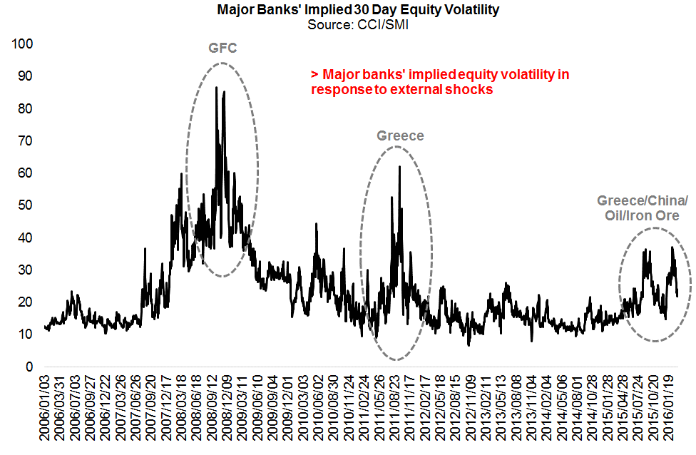
Implied Volatility in Response to Shocks

Slide 19
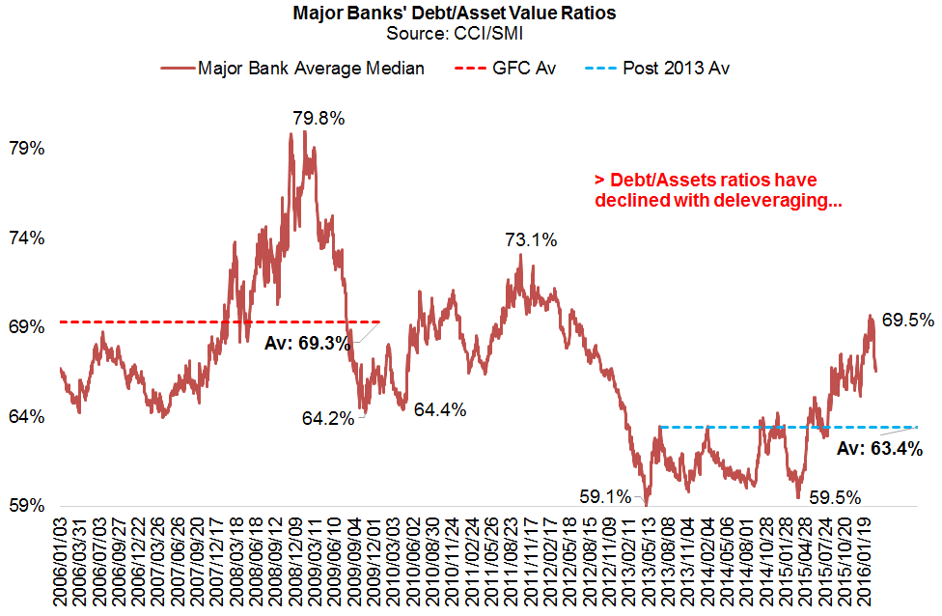
Debt/Assets Ratios Improve Via Deleveraging

Slide 20
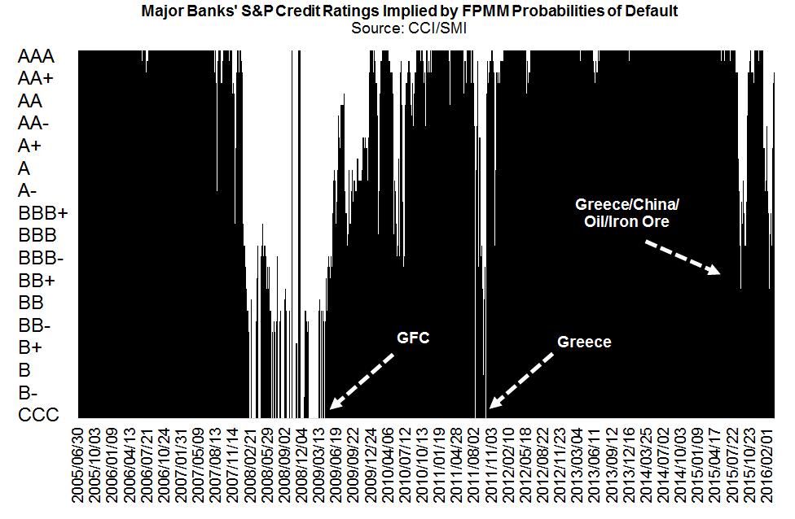
Credit Rating Shocks Improve: Normally ~AAA Credits

Slide 21
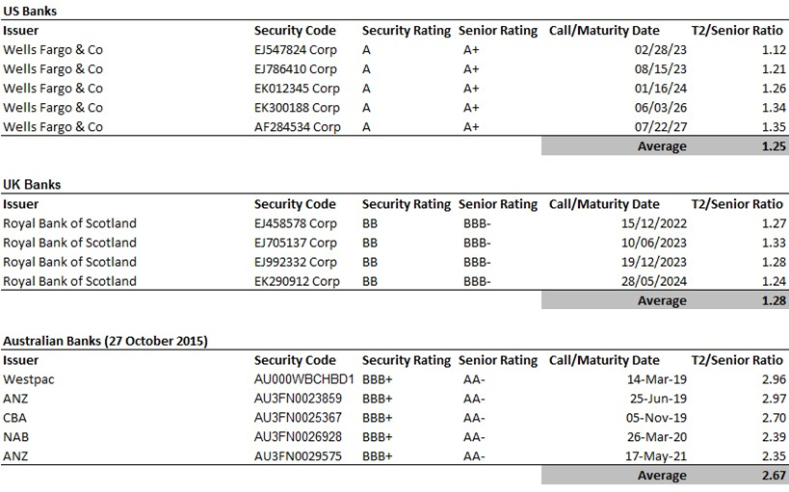
But Major Bank Debt Still Attracts Excess Risk Premia

Slide 22
Bail-In
Bail-in just regulatory euphemism for “exposure to risk of loss”
GFC problem was debt pretended it was risk-free
All bank bonds should be “loss-absorbing”
Exposed to loss in event of default/non-repayment
Same as all corporate creditors
Major banks accept senior bonds already loss-absorbing under Banking Act
APRA has extremely strong asset-transfer powers
Asset transfers must be on “just terms”; similar to Dodd Frank’s “creditor no worse off” protections

Slide 23
Bail-In Problems
Where regulators have right to unilaterally bail-in securities on “non-standard” terms, investors will price catastrophe risk
Specifically, when regulators bail-in and:
Give creditors recovery proceeds less than bankruptcy process expectations (eg, write down to zero)
Violate creditor hierarchy (eg, write-off bonds before equity)
Discriminate between identical creditors (eg, only bail-in some senior bonds)
Provide creditors with no legal protections from rogue behaviour/regulatory mistakes
Markets will also have conniptions if regulators bail-in bonds prior to insolvency events (non-viability = insolvency)

Slide 24
Focus on Capital Build; Hasten Slowly on Bail-In
Already precedents: Bank of Portugal senior bail-in; Genworth T2 in Australia; unilateral write-off clauses
Best bail-in models:
Statutory powers confirmed in contract (Dodd Frank)
Losses imposed through asset transfers at fair market value (Dodd Frank/Australian Banking Act)
Creditor no worse off protections (Dodd Frank/Banking Act)
No forced contractual write-off or forced equity conversion
As predicted, Basel 3 bail-in becoming accelerant of financial contagion because of fears around regulatory decision-making
EU’s BRRD allows regulators to do anything if in taxpayer interest: creditor no worse off; hierarchy; market value tests
Deutsche Bank’s AT1 capital securities

Slide 25
Important Information
The information in this presentation has been prepared by Smarter Money Investments Pty Ltd. It is general information only and is not intended to provide you with financial advice. You should not rely on any information herein in making any investment decisions. To the extent permitted by law, no liability is accepted for any loss or damage as a result of any reliance on this information. The Product Disclosure Statement (PDS) for the Smarter Money Fund should be considered before deciding whether to acquire or hold units in it. The PDS can be obtained by visiting www.smitrust.com.au. None of Select Asset Management Limited, SMI, Yellow Brick Road Holdings Limited, Coolabah Capital Pty Ltd, BBB Capital Pty Ltd or Winston Capital Pty Ltd (the Promoters) nor any of their respective shareholders, directors and associated businesses assume any liability to investors in connection with any investment in the fund, or guarantees the performance of any obligations to investors, the performance of the Smarter Money Fund or any particular rate of return. The repayment of capital is not guaranteed. Investments in the fund are not deposits or liabilities of any of the abovementioned parties, nor of any Authorised Deposit-taking Institution. The fund is subject to investment risks, which could include delays in repayment and/or loss of income and capital invested. Past performance is not an indicator of nor assures any future returns or risks.
Notes:
25

